Slide 1
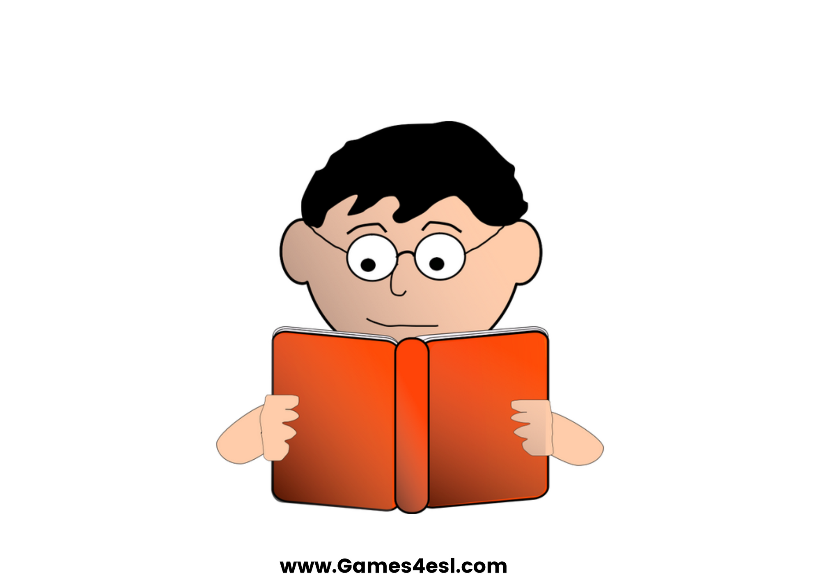
read
SHOW

Slide 2
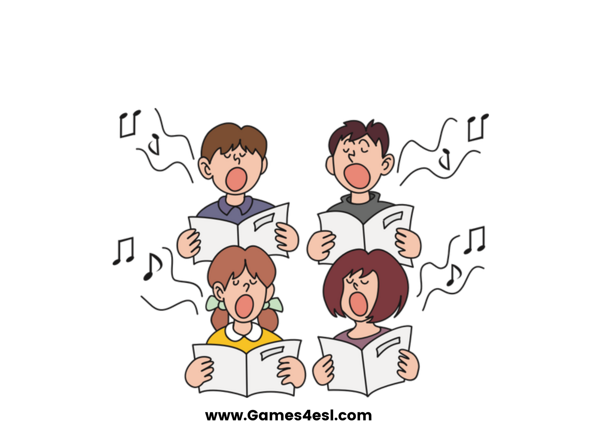
sing
SHOW

Slide 3
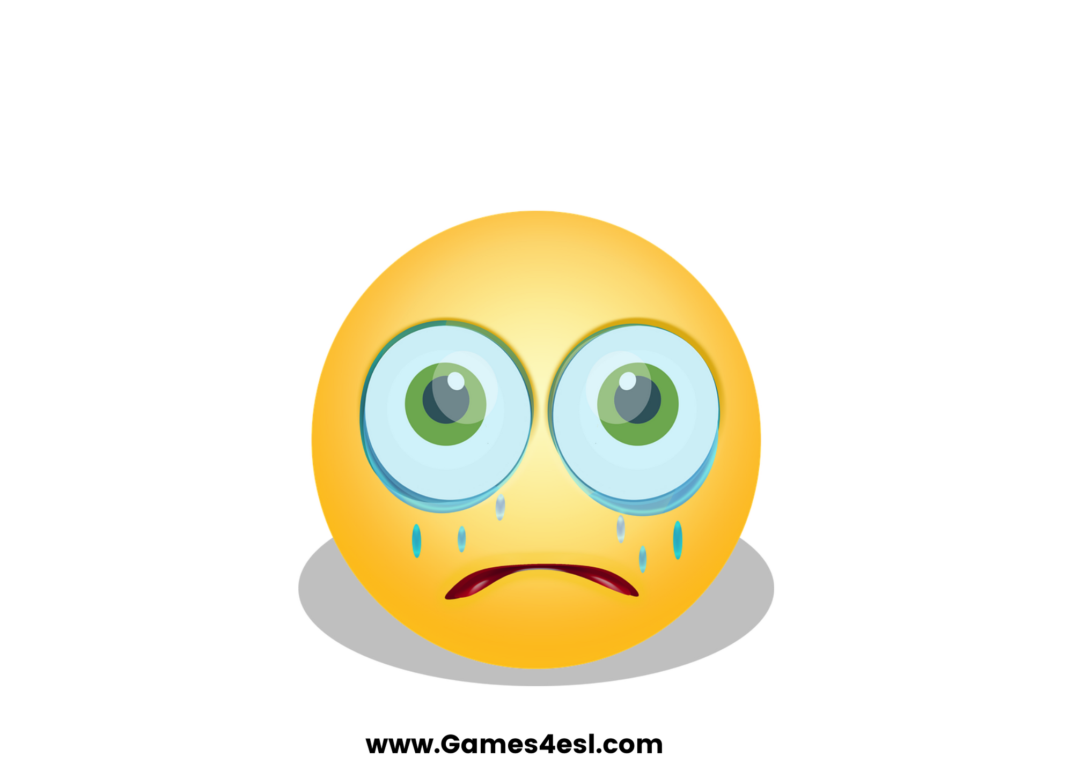
cry
SHOW

Slide 4
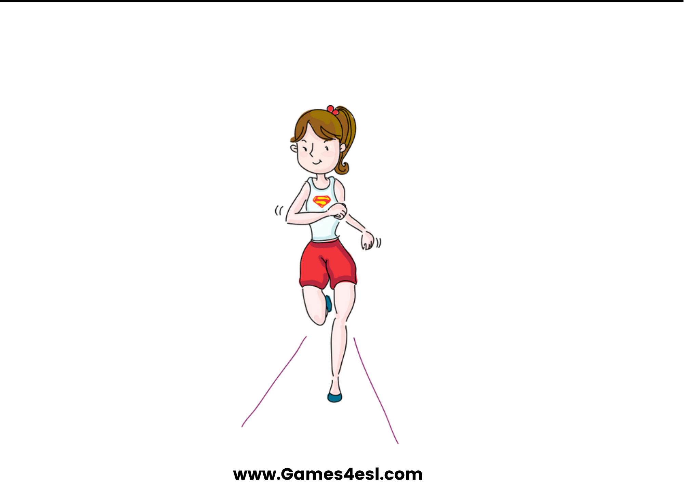
run
SHOW

Slide 5
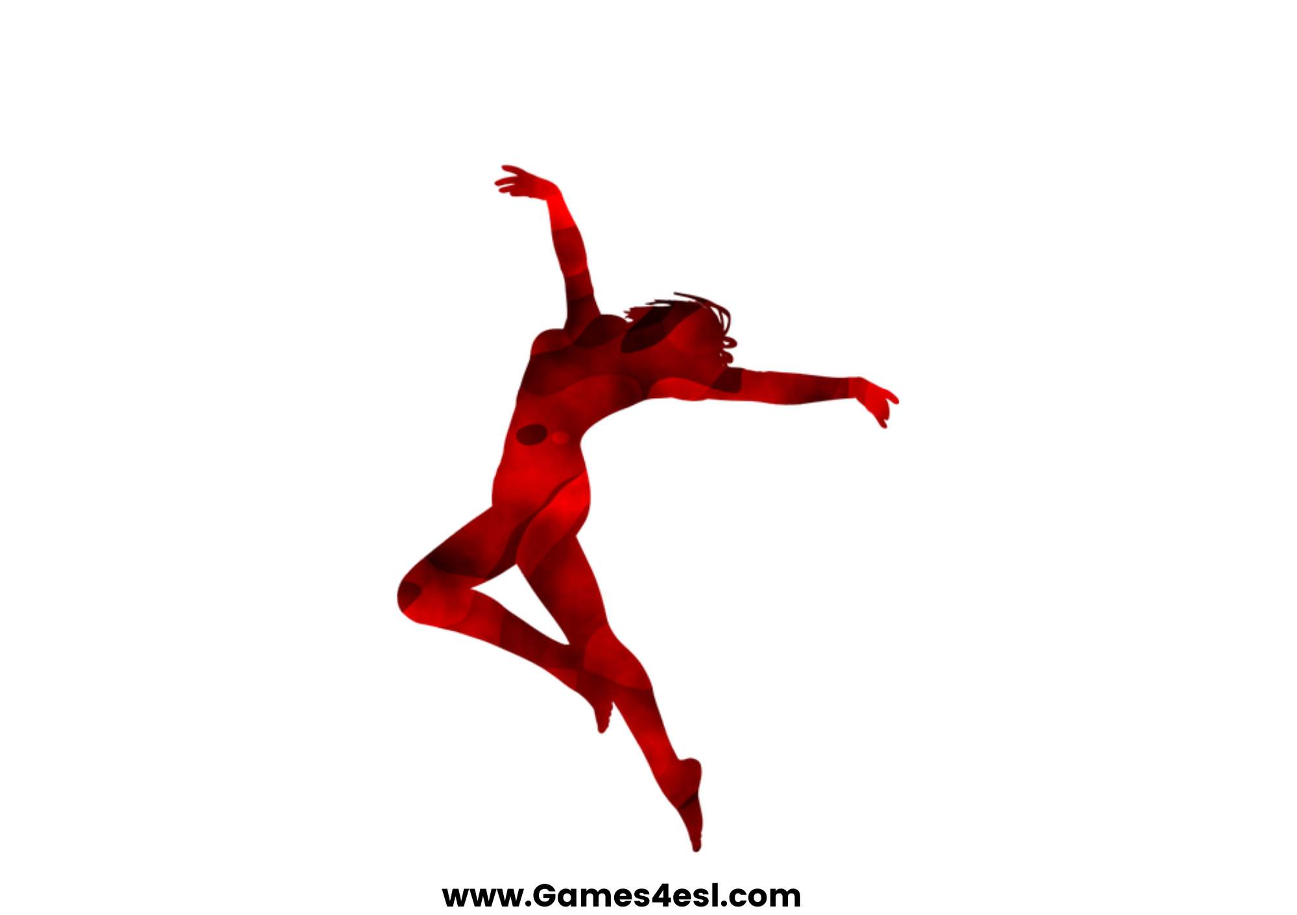
dance
SHOW

Slide 6
walk
SHOW

Slide 7
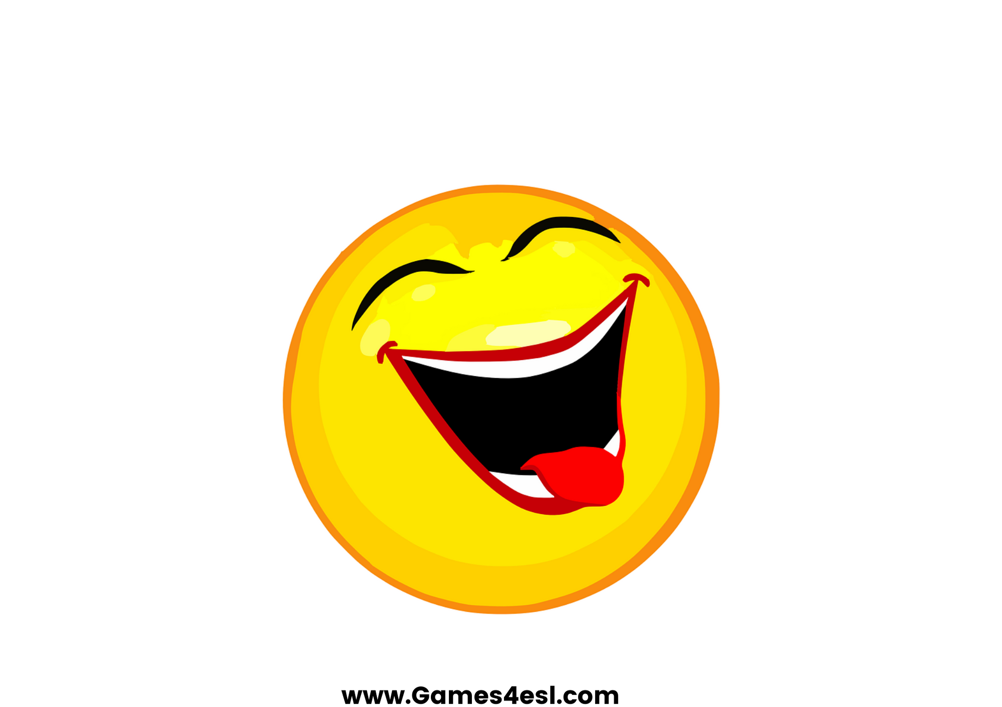
laugh
SHOW

Slide 8
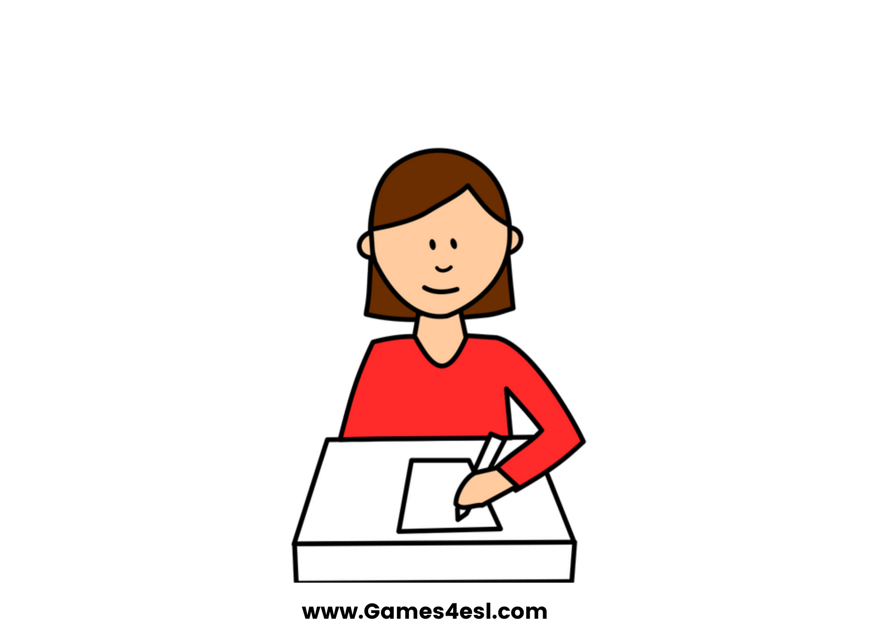
write
SHOW

