Slide 3
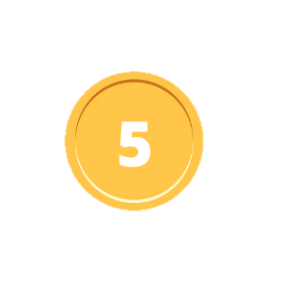
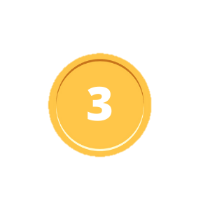
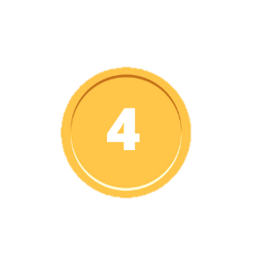
run
jump
fly
eat
drink
swim
sleep
play
throw
shout
cry
laugh
ride
sit
stand
clap
stomp
hit
kick
fold

