Slide 2
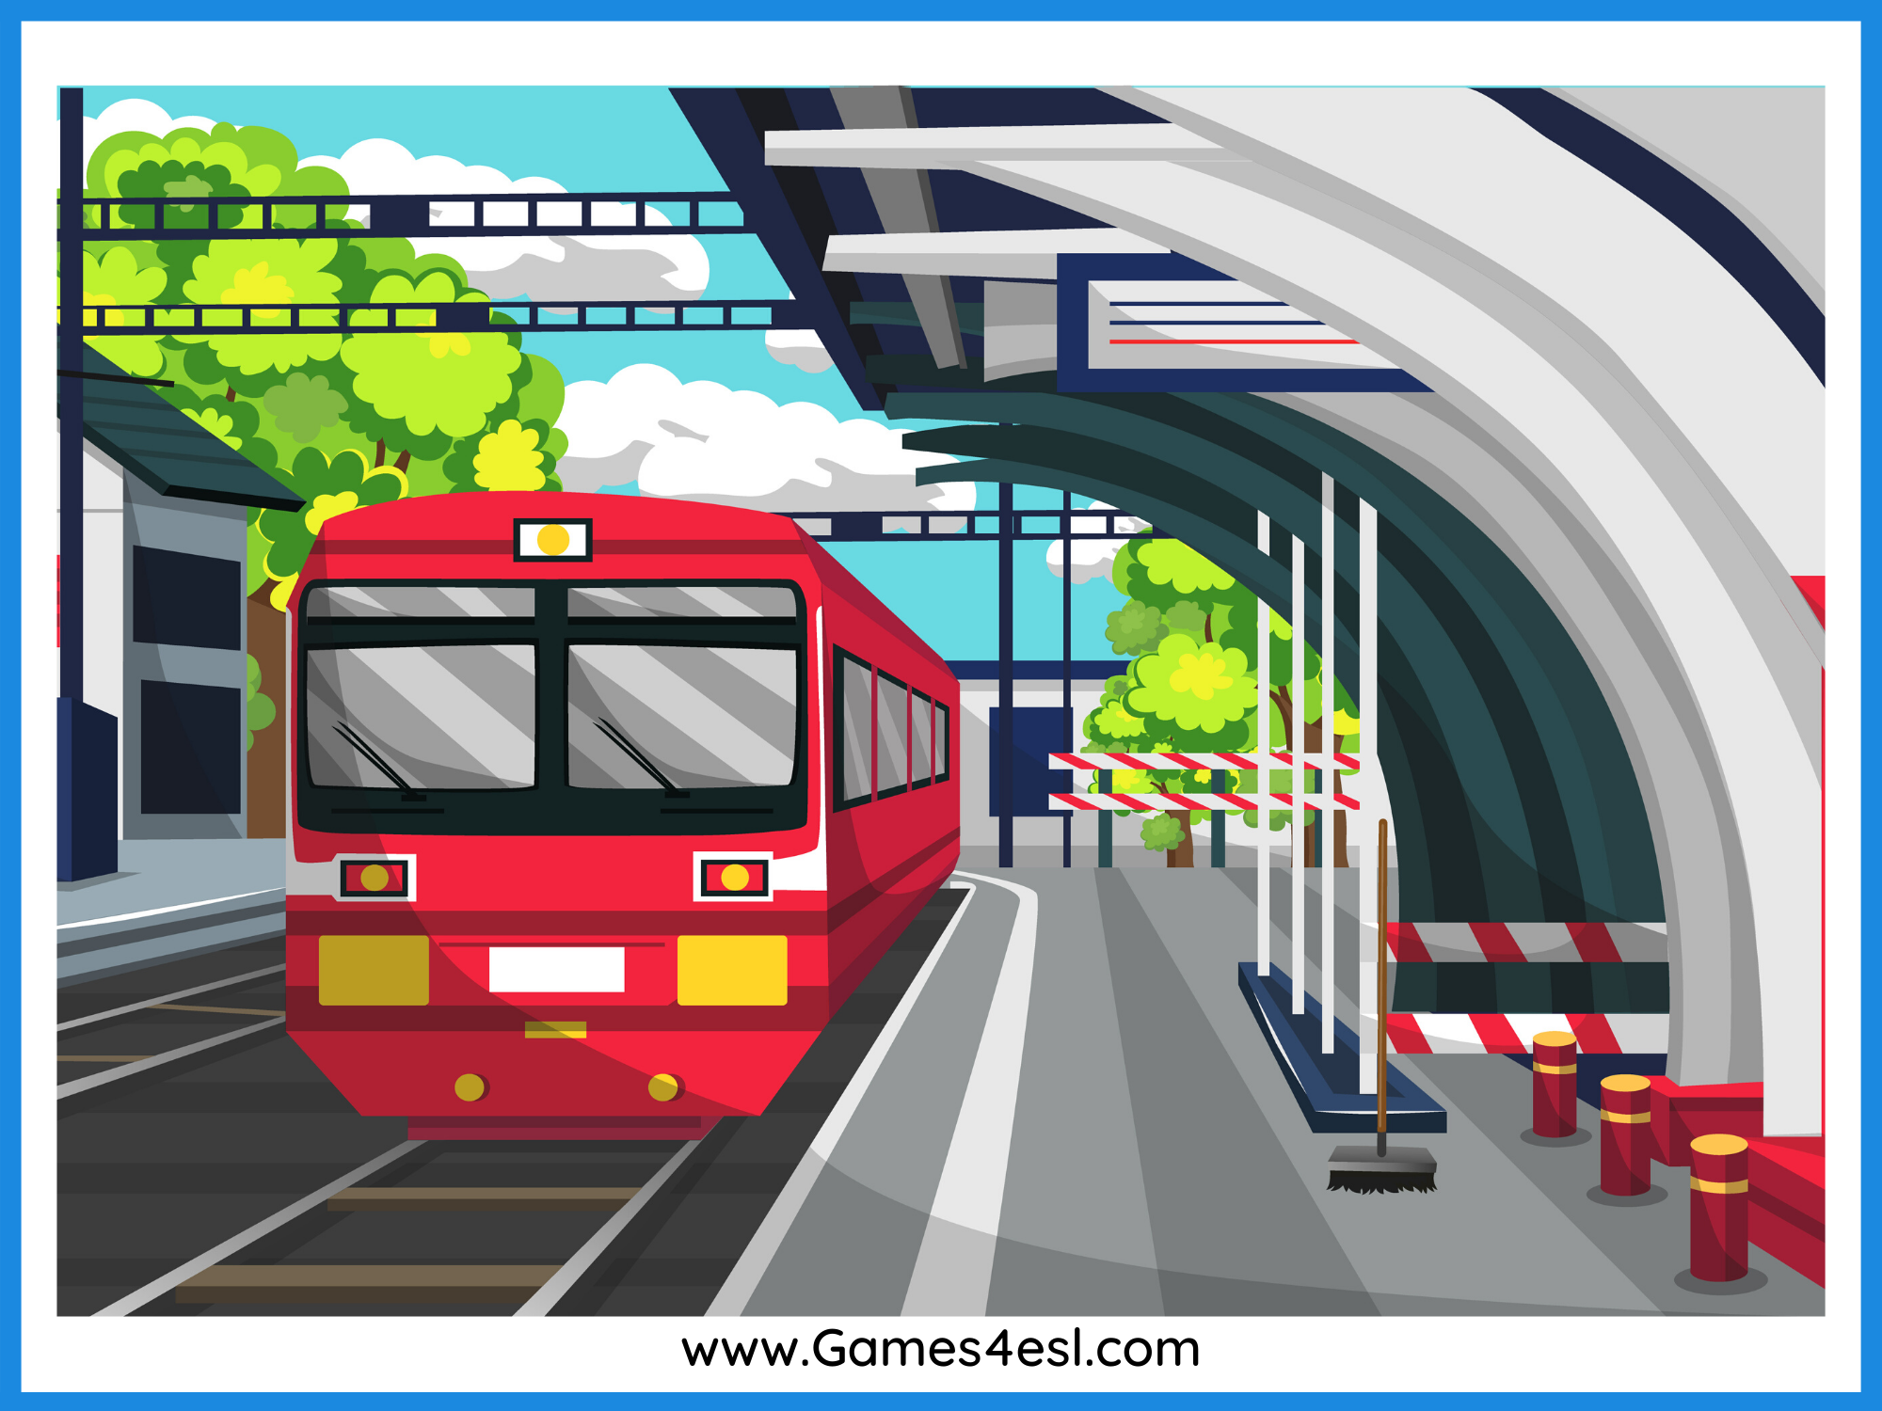
train station
SHOW

Slide 3
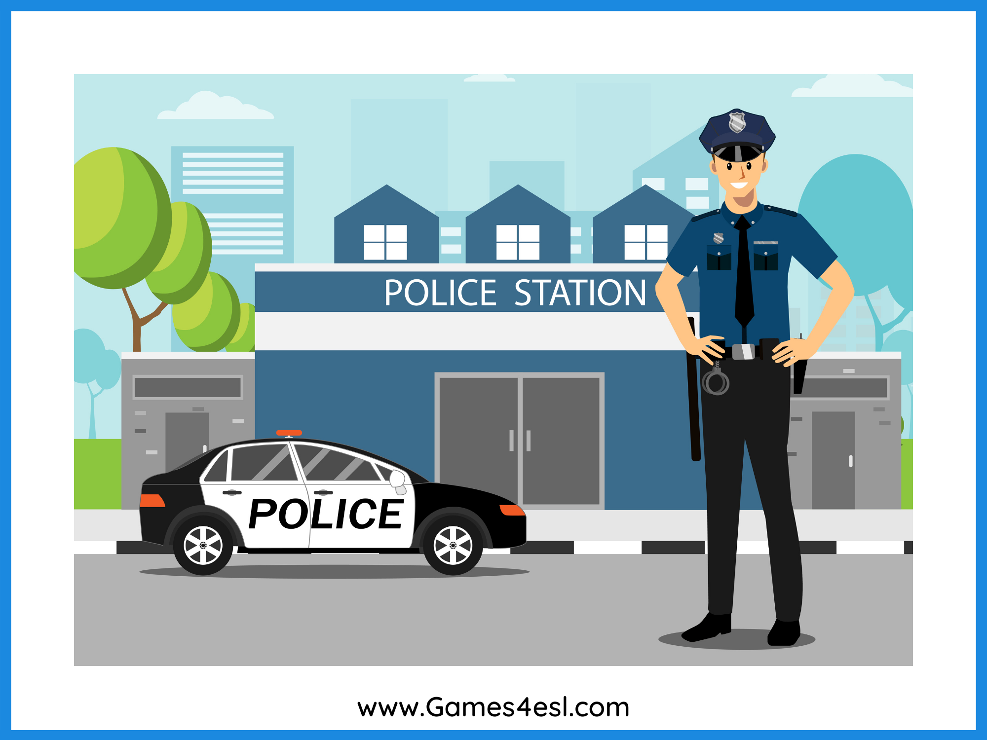
police station
SHOW

Slide 4
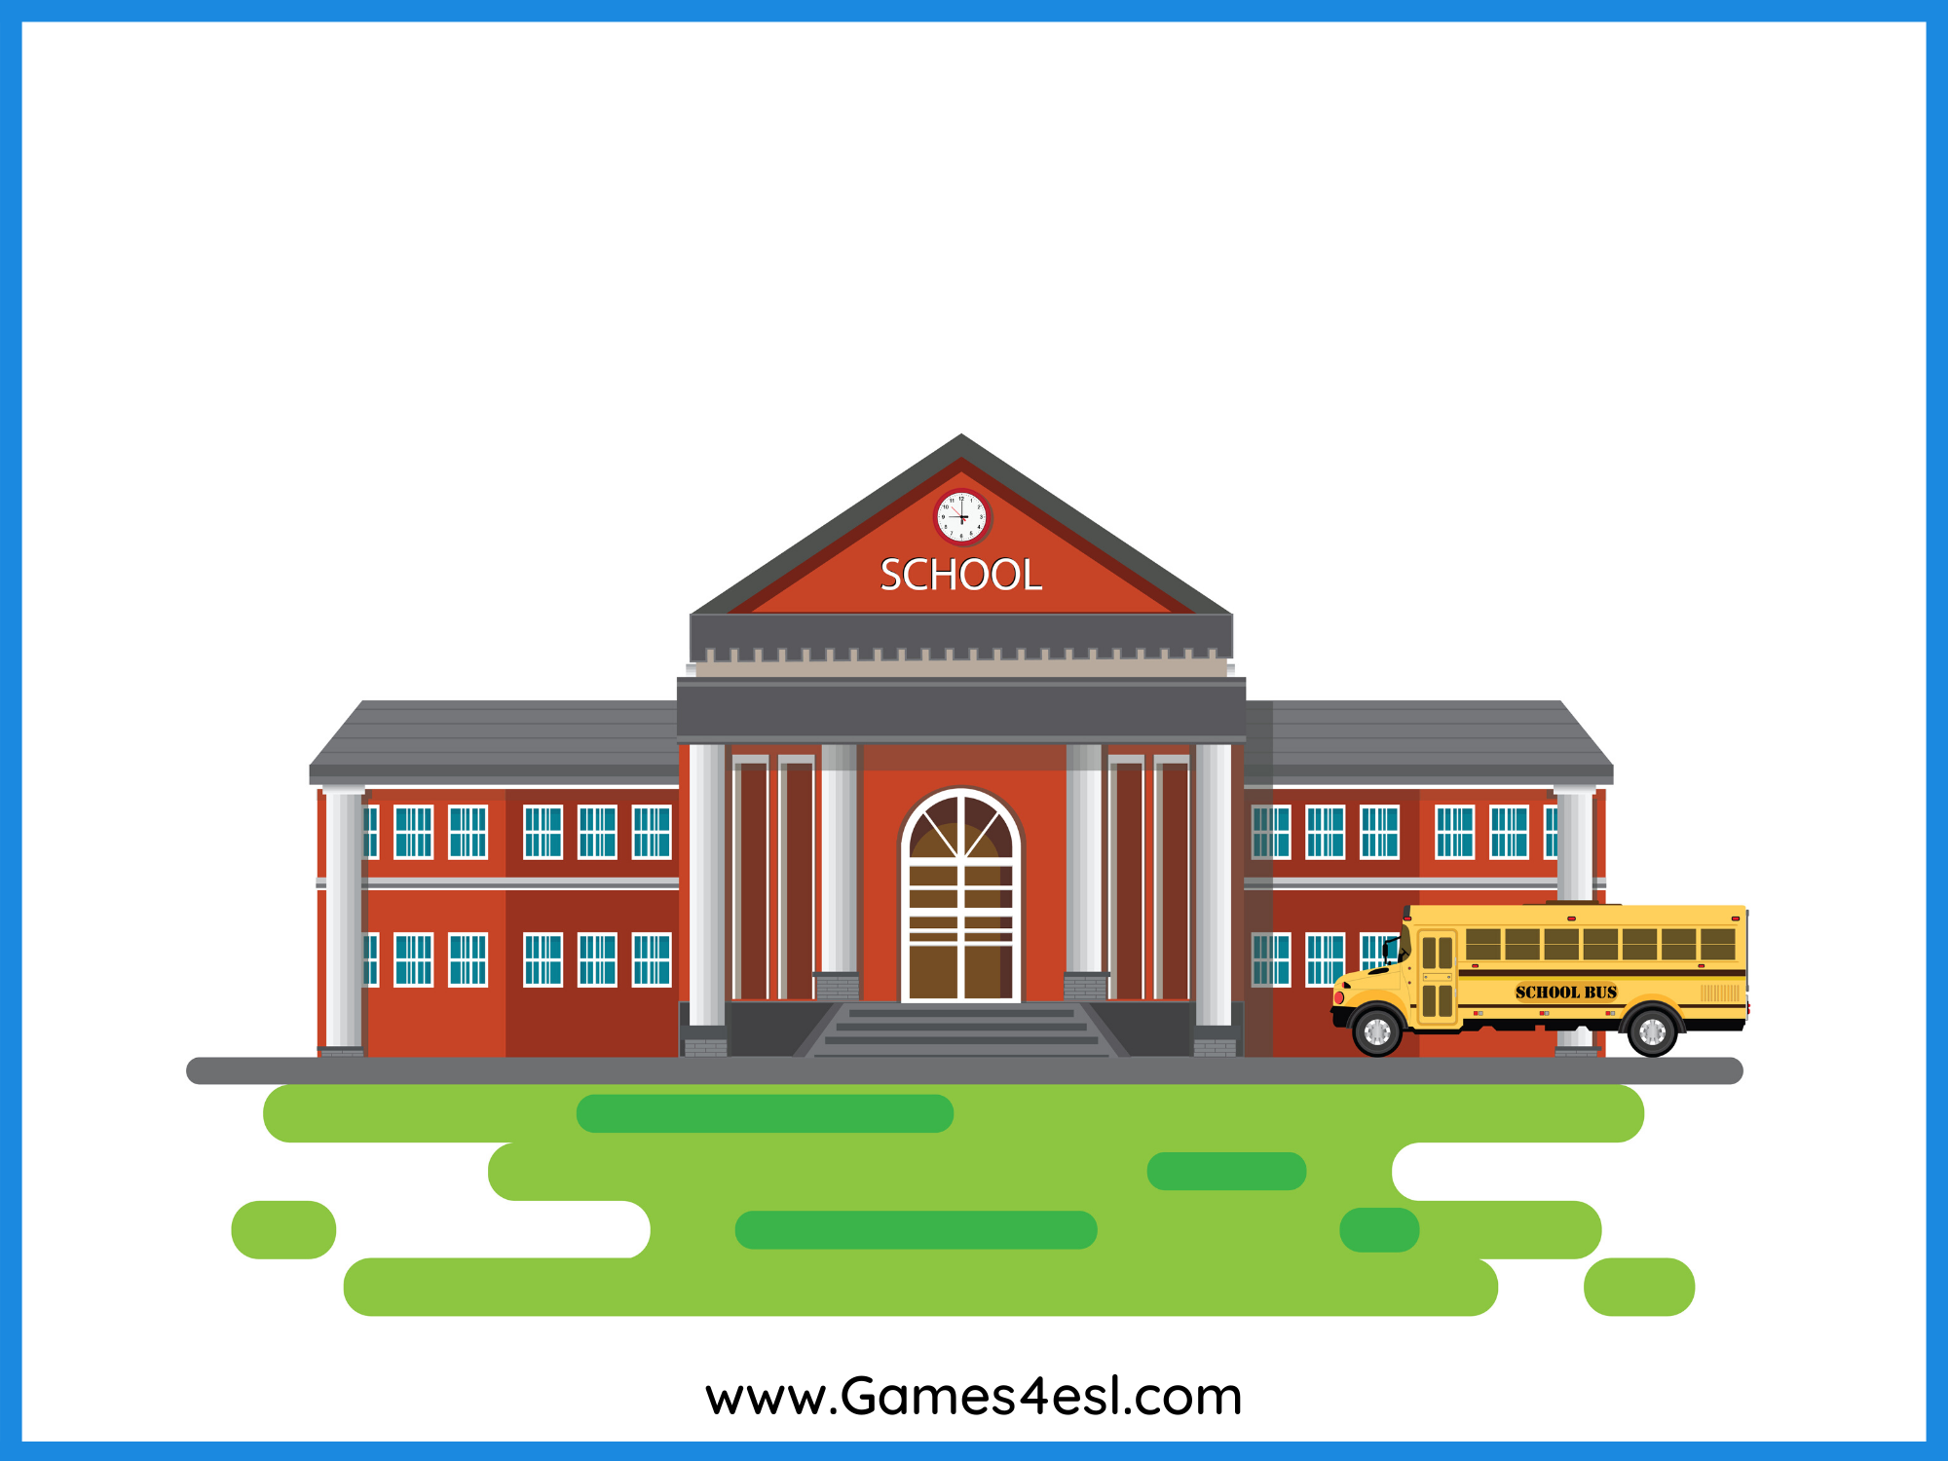
school
SHOW

Slide 5
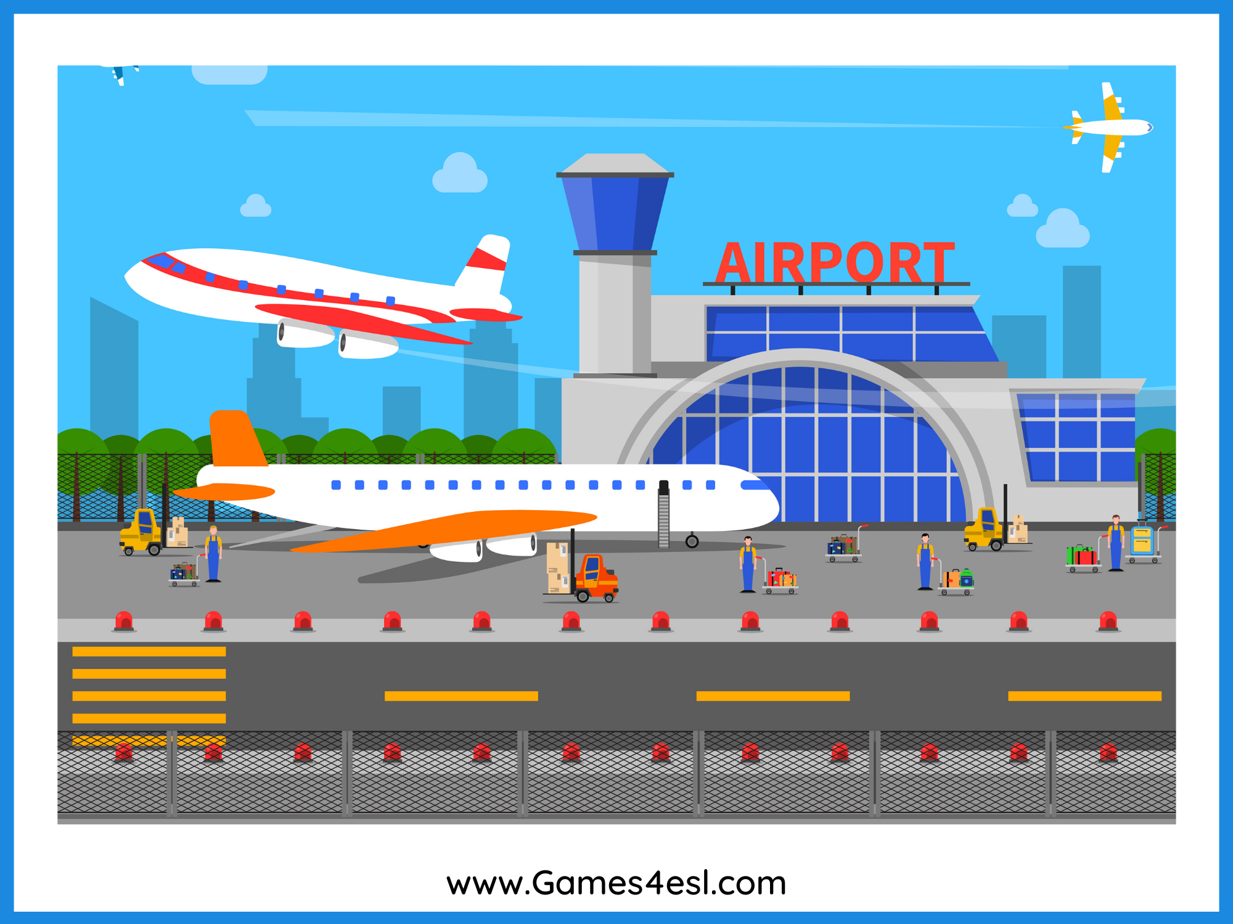
airport
SHOW

Slide 6
zoo
SHOW

Slide 7
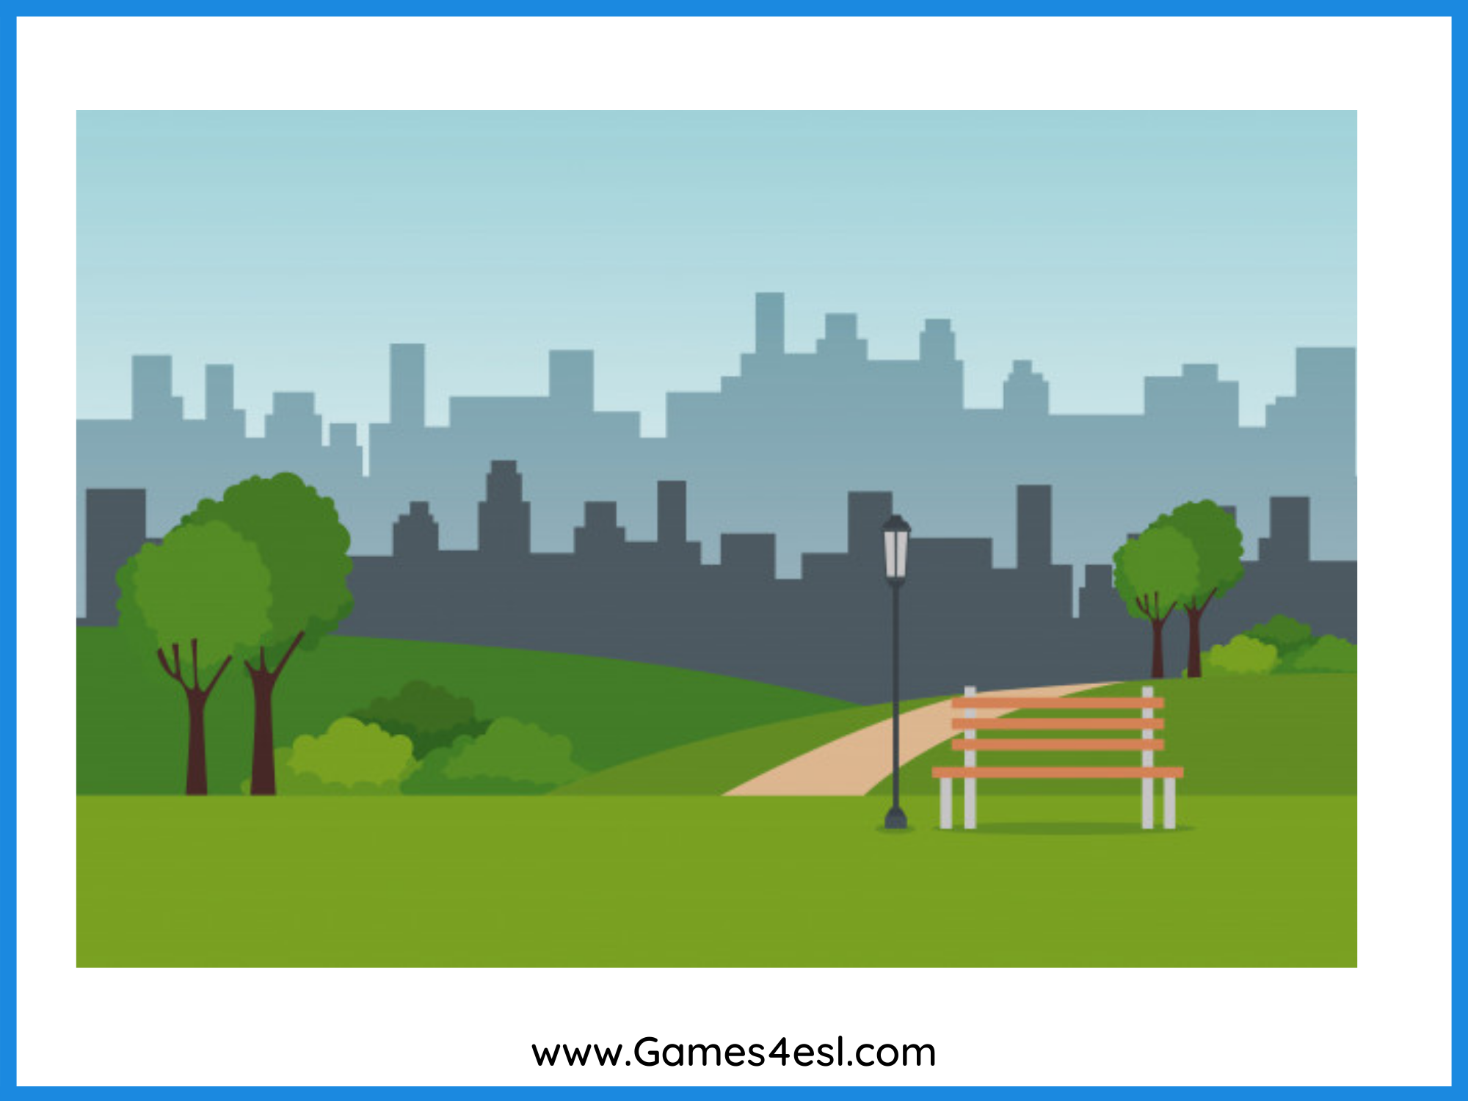
park
SHOW

Slide 8
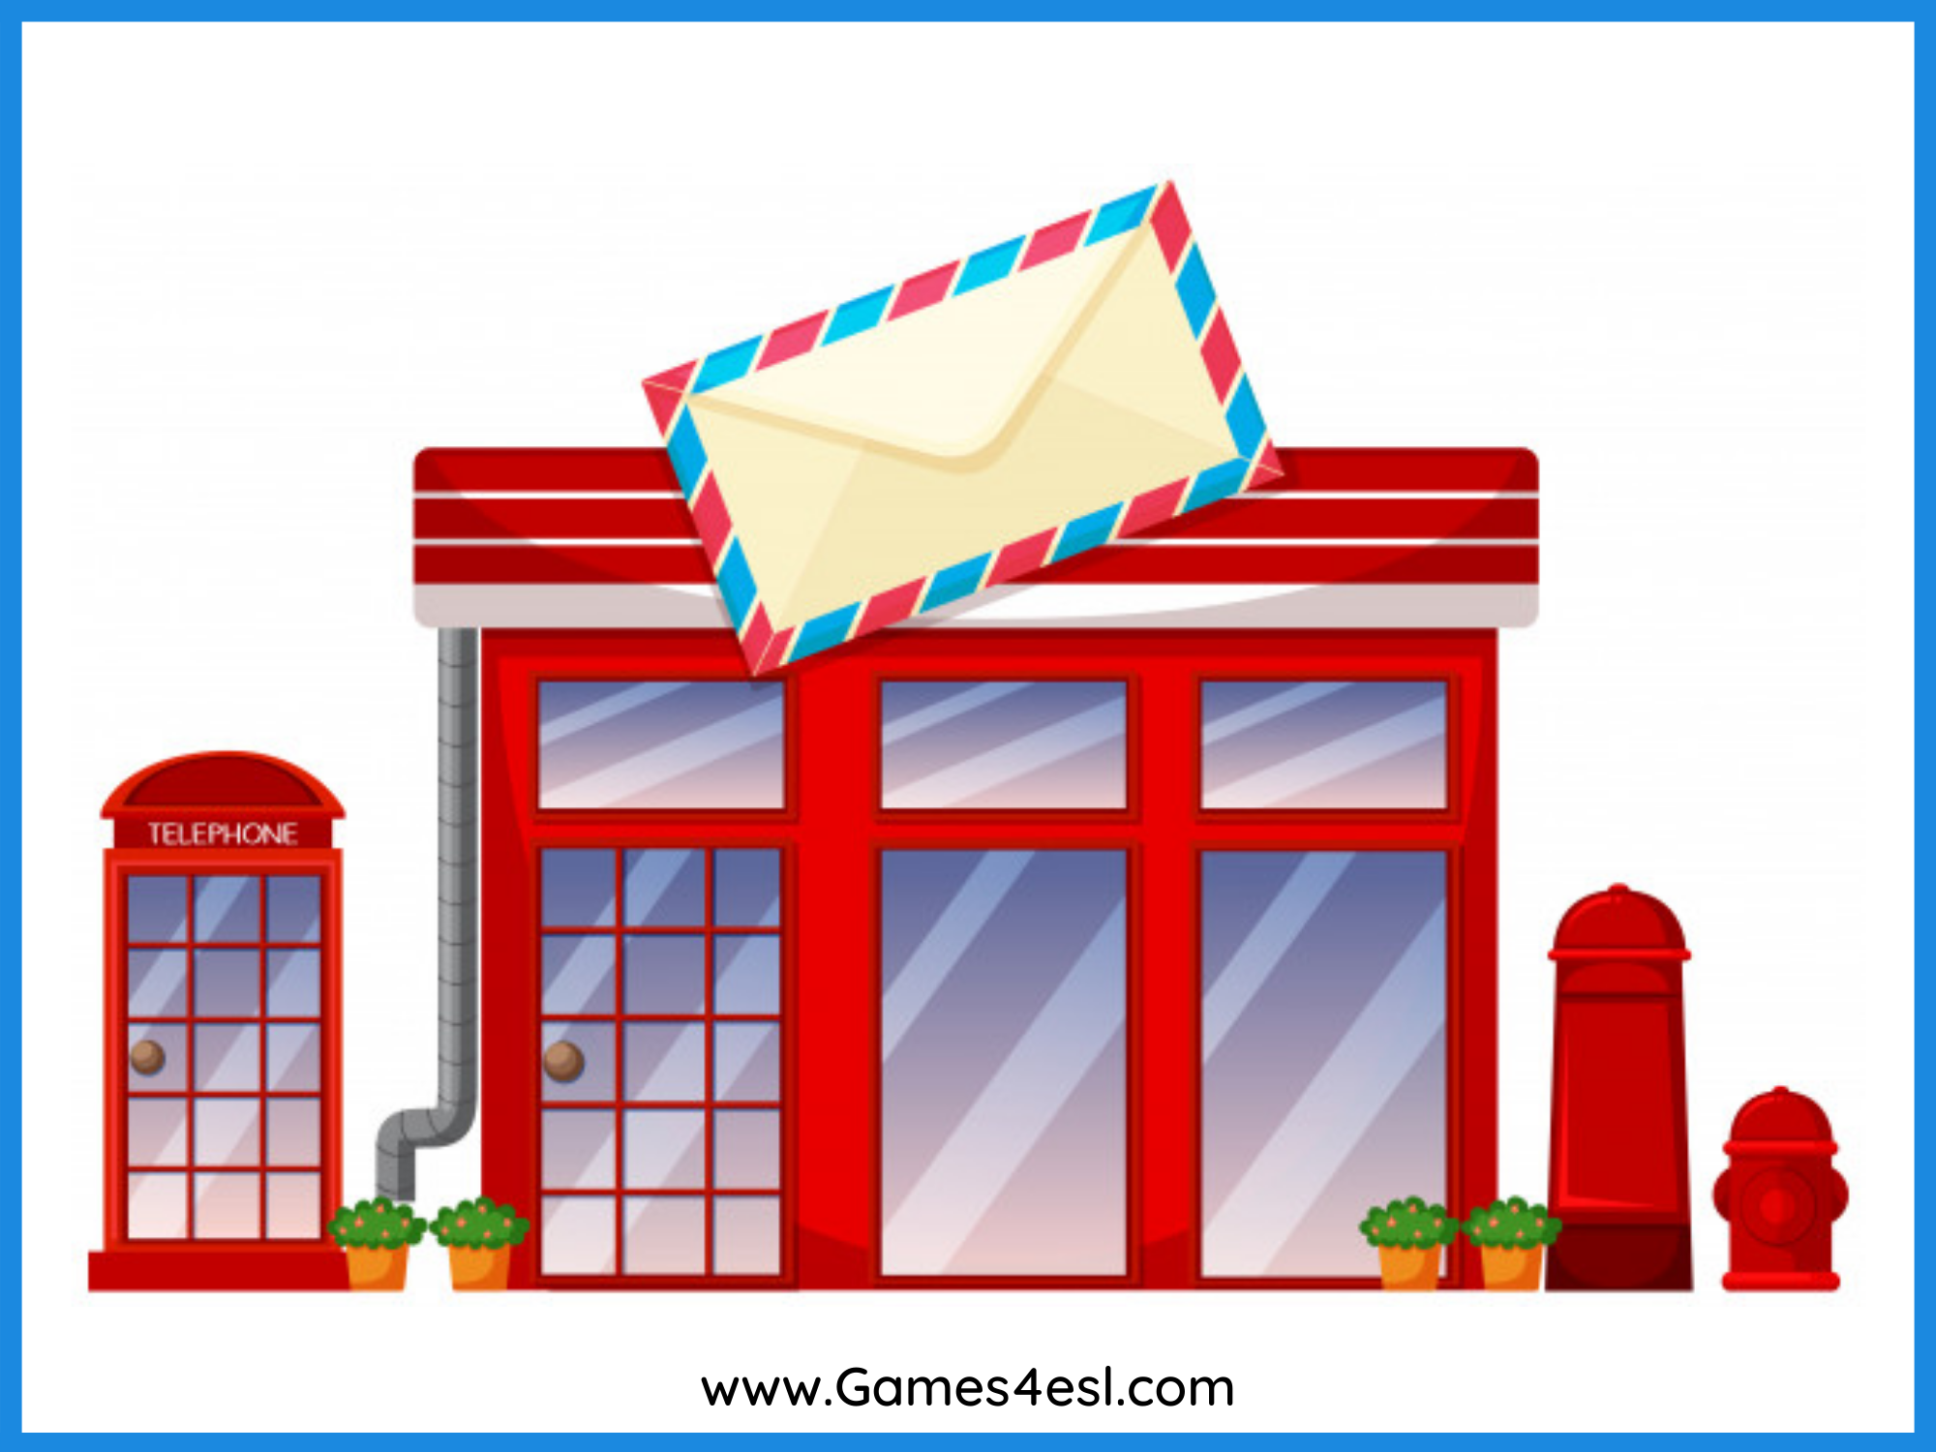
post office
SHOW

Slide 9
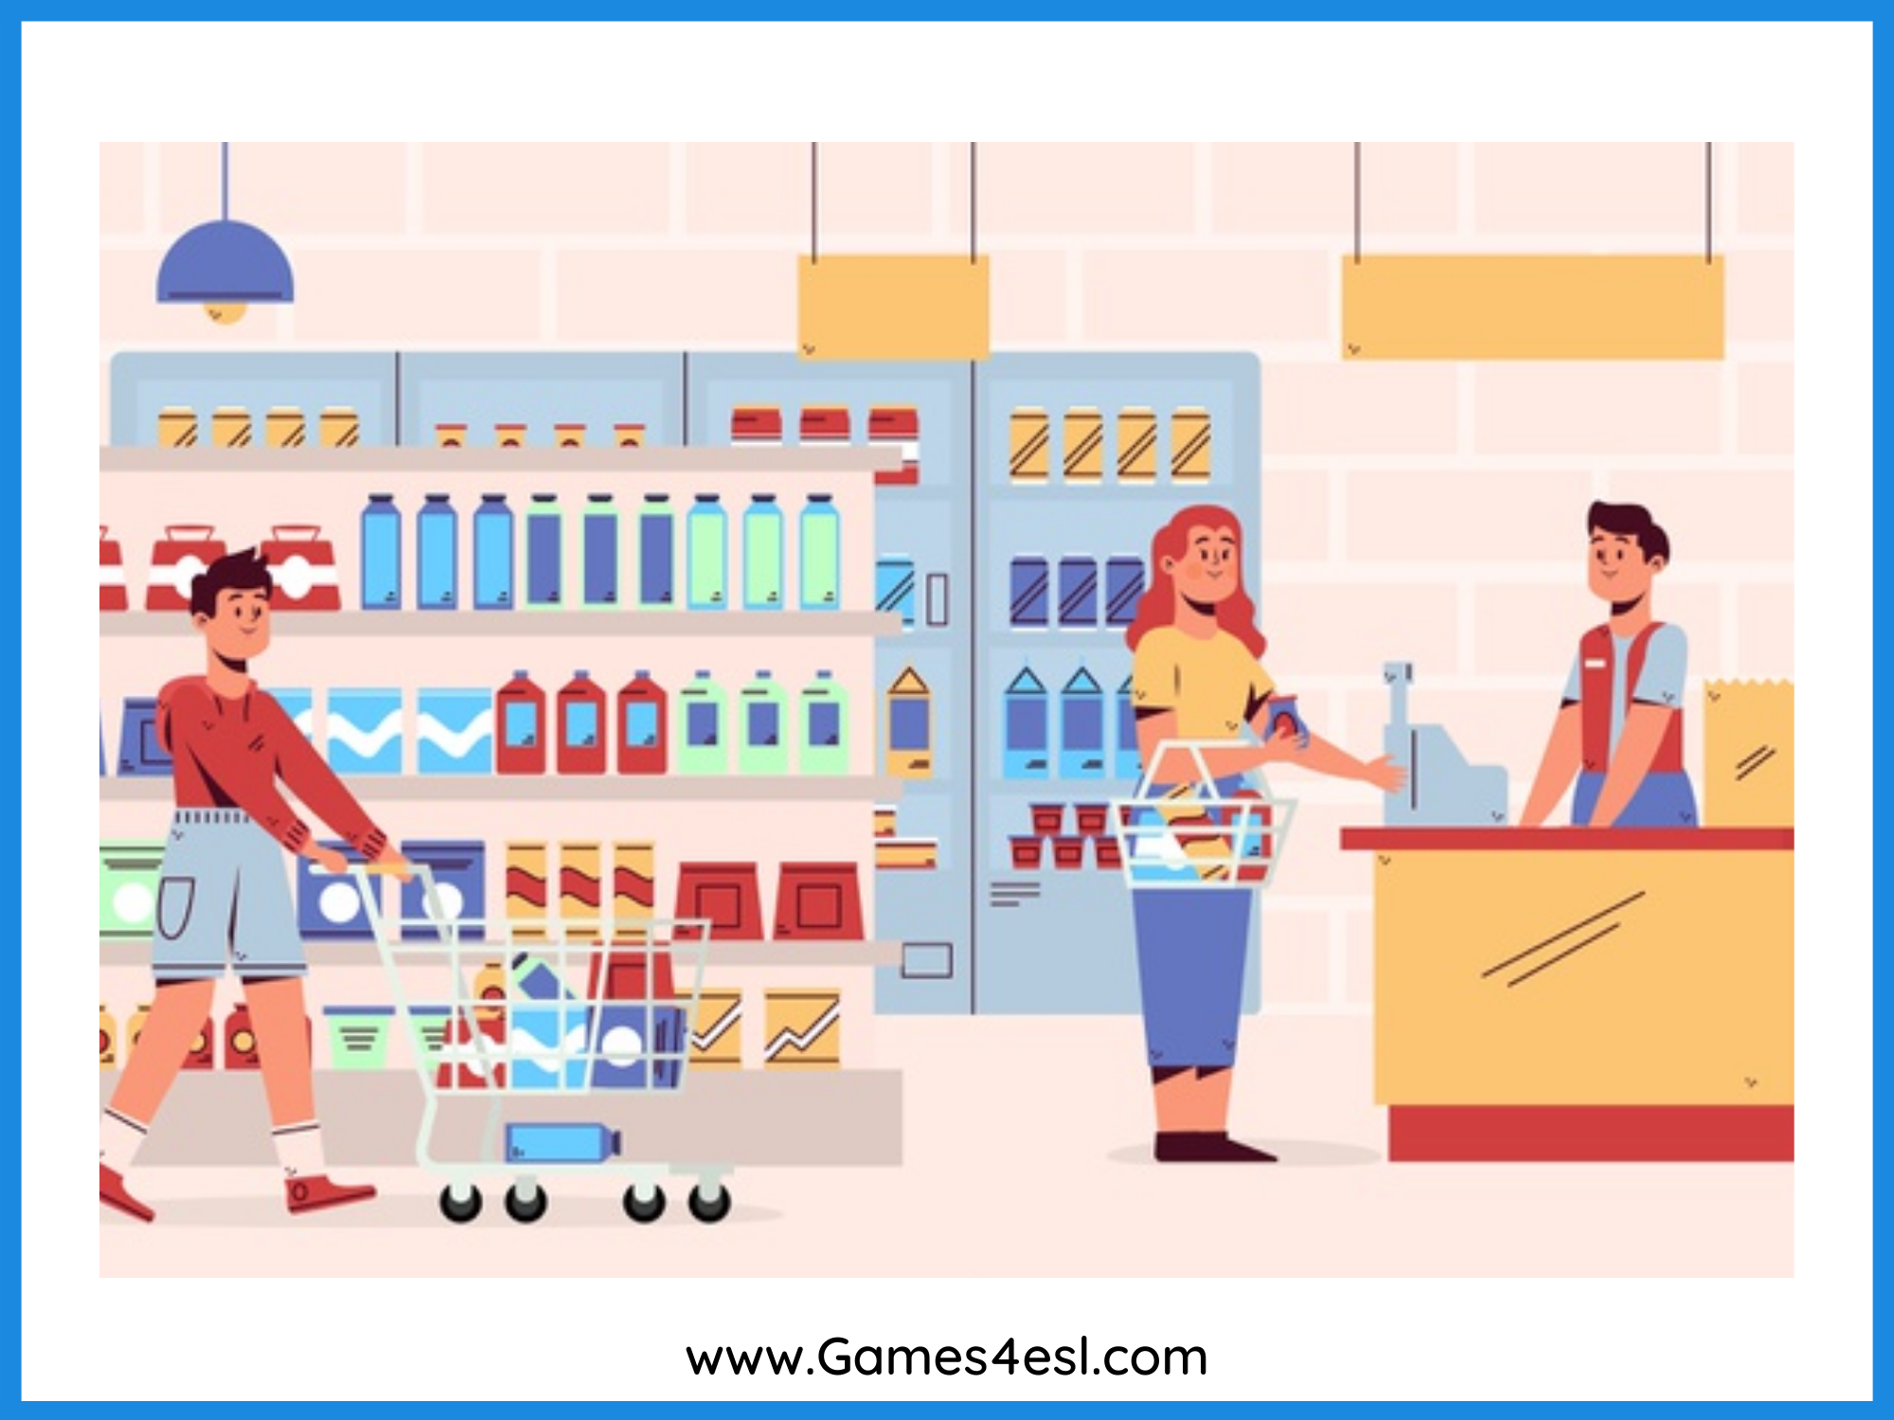
supermarket
SHOW

