Slide 1
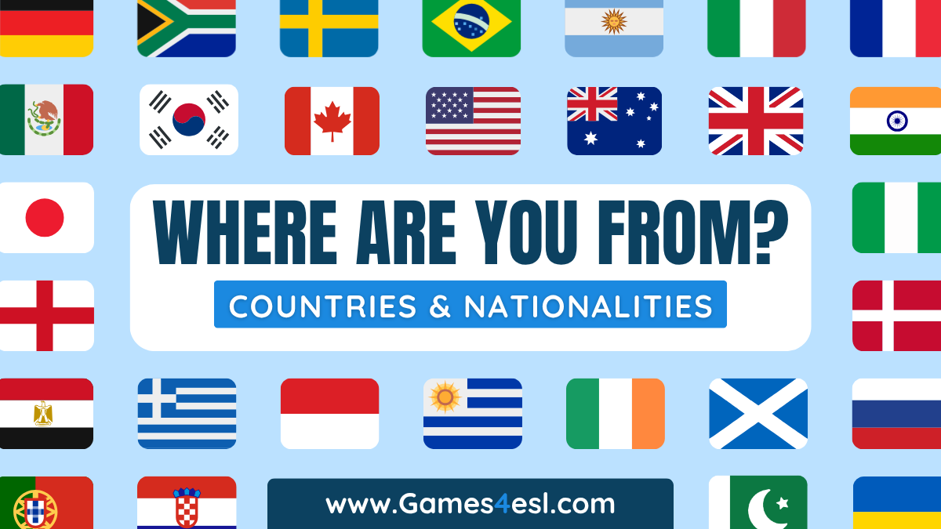

Slide 2


Slide 3
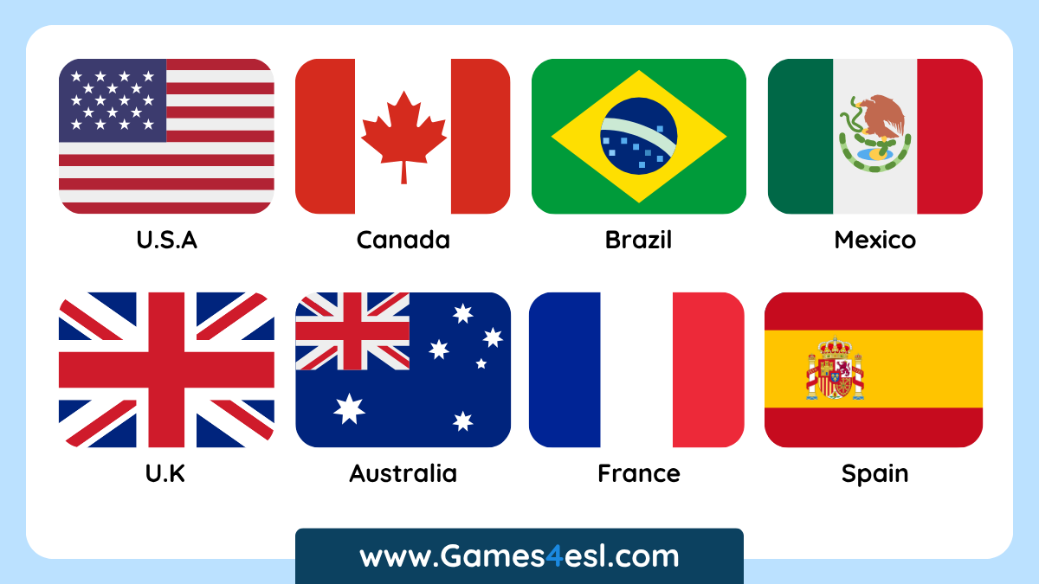

Slide 4
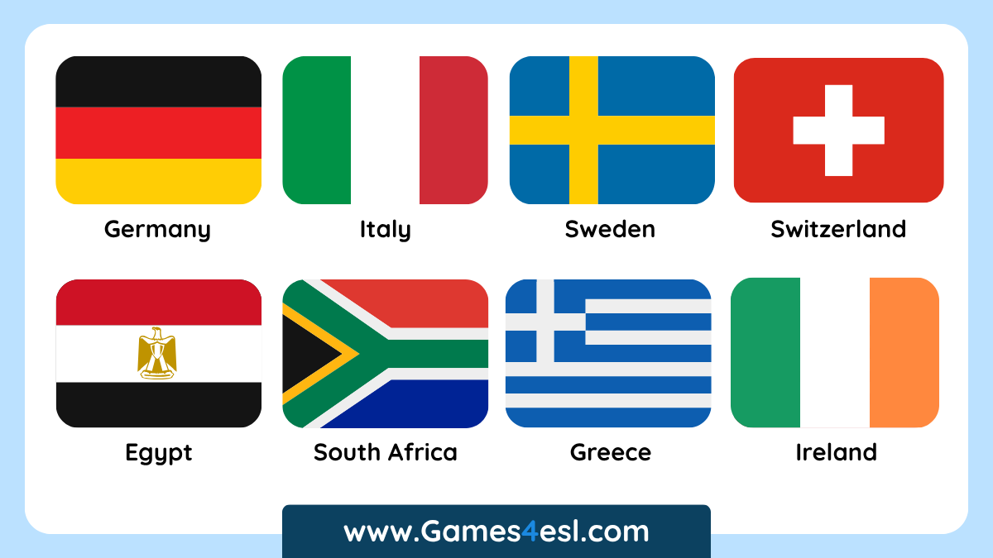

Slide 5
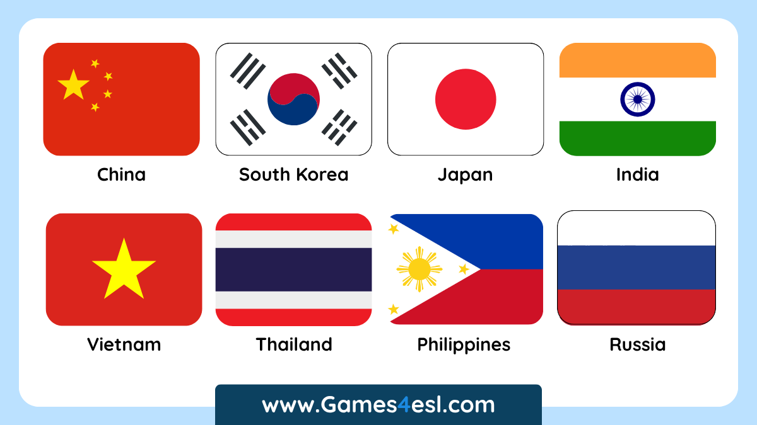

Slide 6
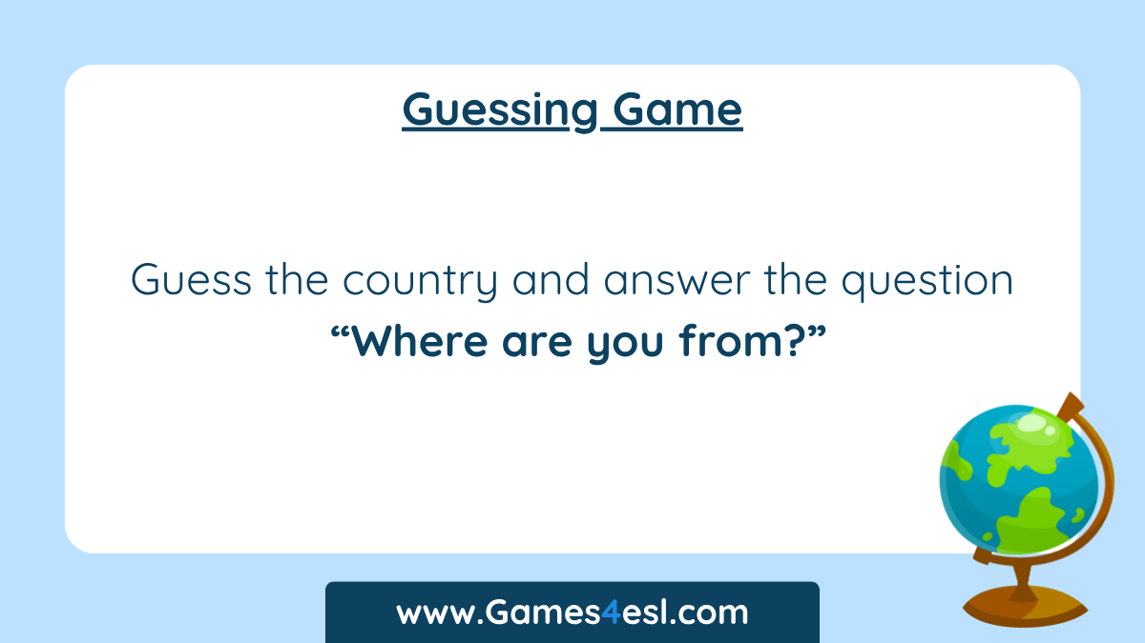

Slide 7
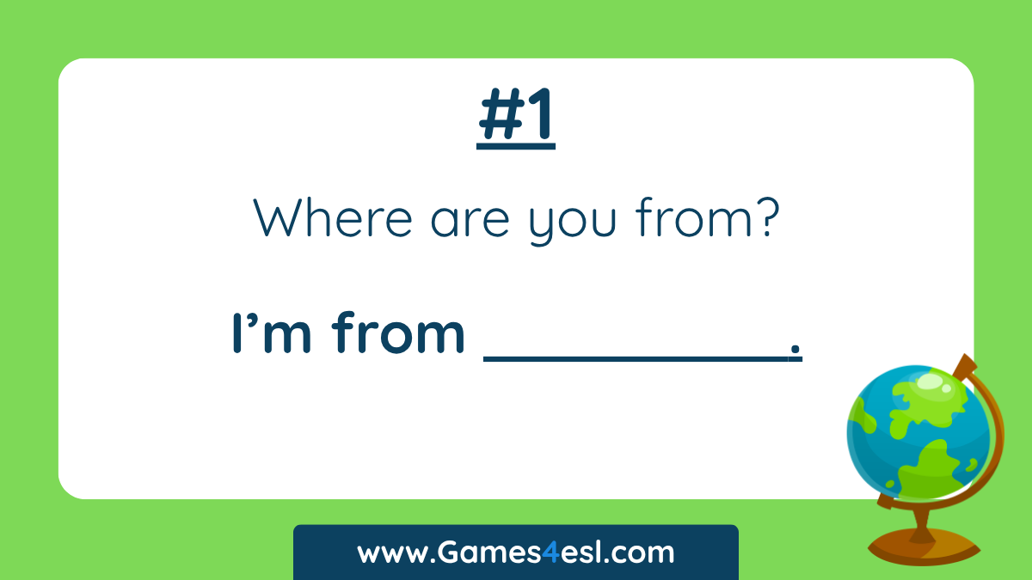

Slide 8



I’m from Canada.
SHOW
NEXT

Slide 9


Slide 10
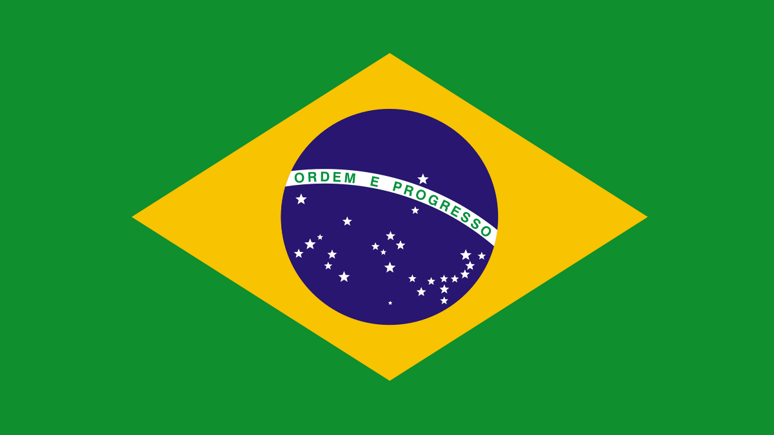
I’m from Brazil.
SHOW
NEXT

Slide 11


Slide 12

I’m from China.
SHOW
NEXT

Slide 13


Slide 14

I’m from South Korea.
SHOW
NEXT

Slide 15


Slide 16

I’m from Australia.
SHOW
NEXT

Slide 17


Slide 18

I’m from Mexico.
SHOW
NEXT

Slide 19


Slide 20

I’m from Vietnam.
SHOW
NEXT

Slide 21
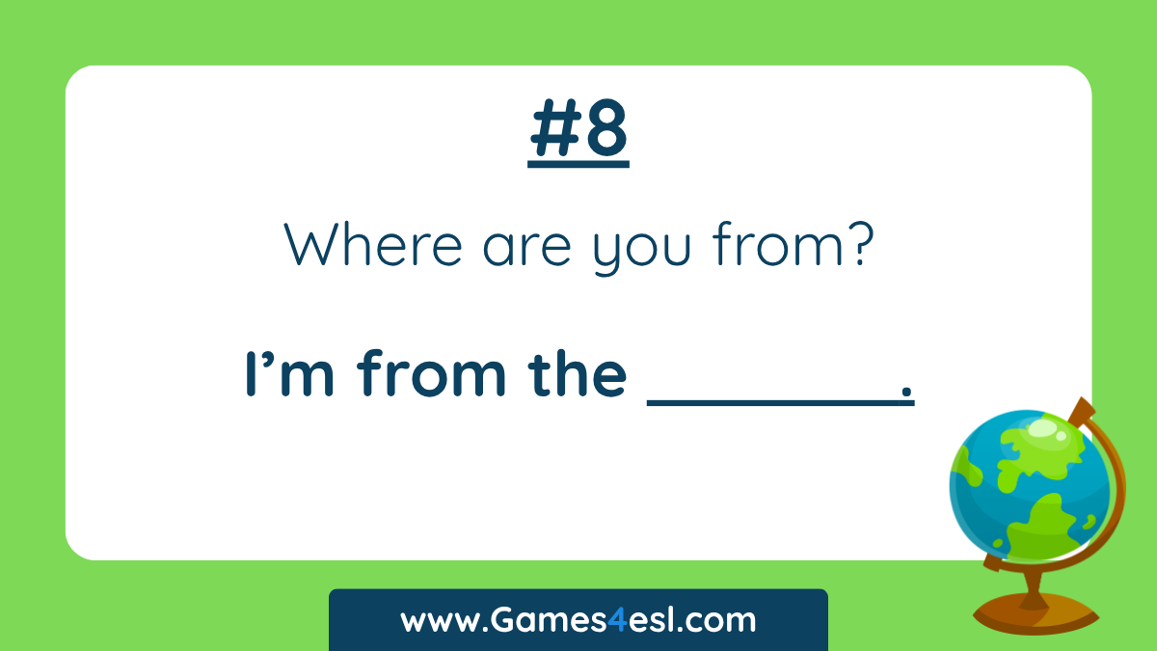

Slide 22

I’m from the U.S.A.
SHOW
NEXT

Slide 23


Slide 24

I’m from France.
SHOW
NEXT

Slide 25


Slide 26
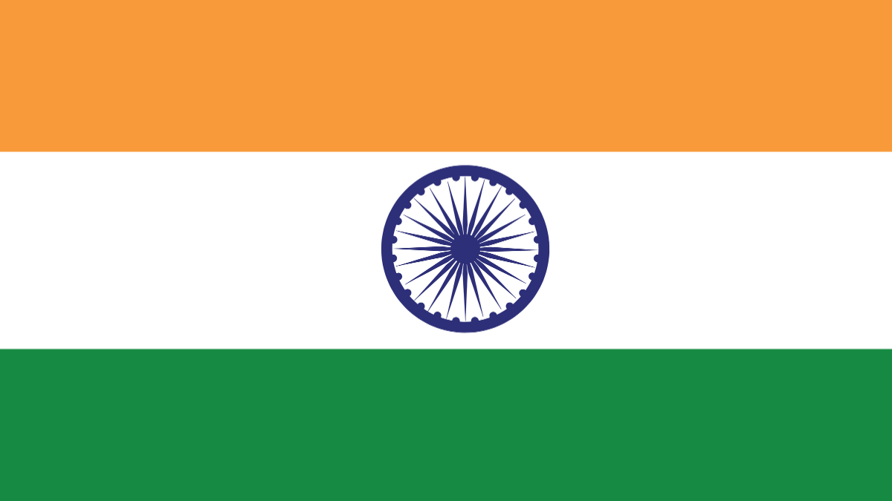
I’m from India.
SHOW
NEXT

Slide 27


Slide 28
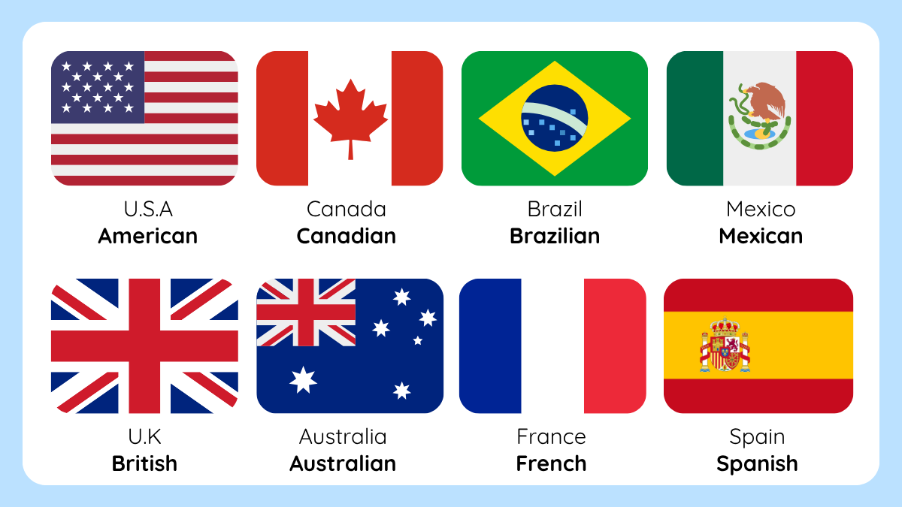

Slide 29
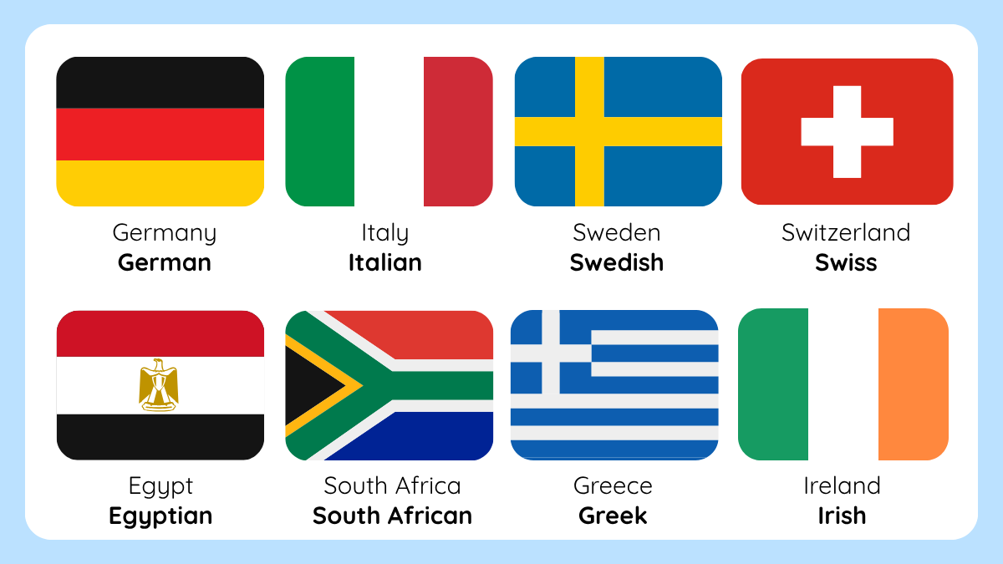

Slide 30
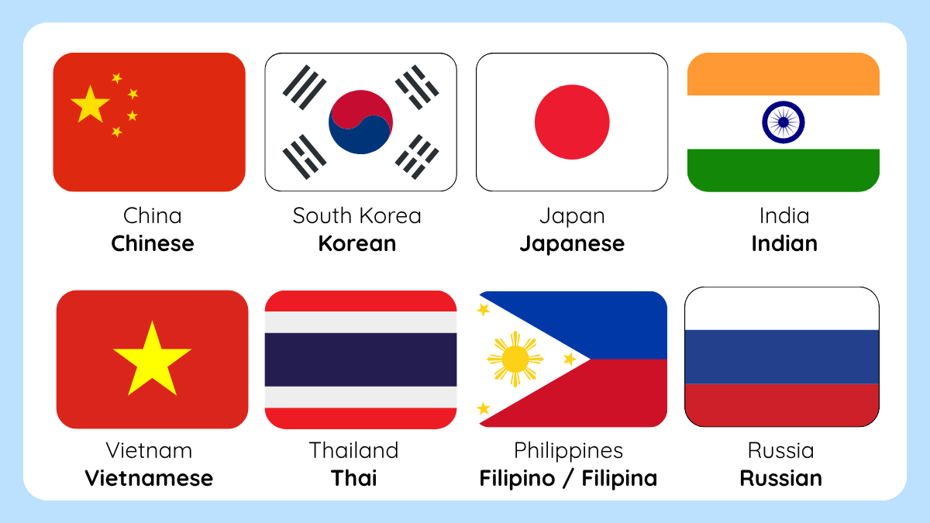

Slide 31


Slide 32
