Slide 2
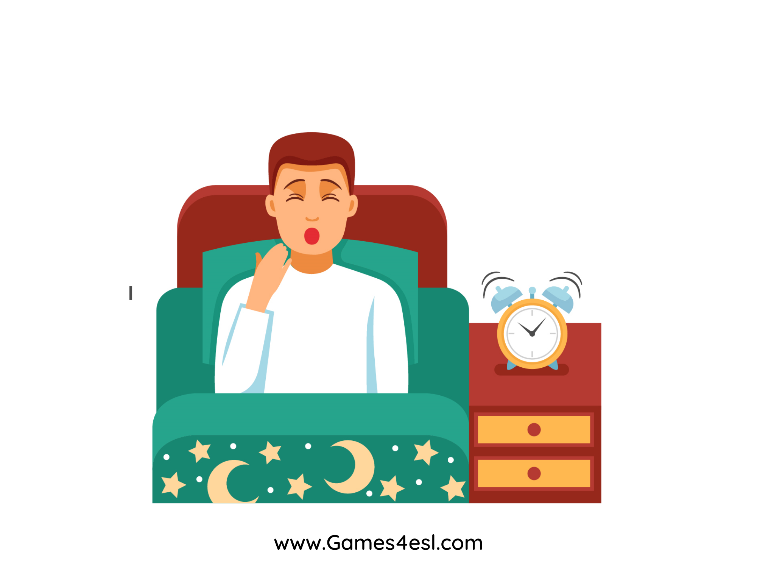
wake up
SHOW

Slide 3
exercise
SHOW

Slide 4
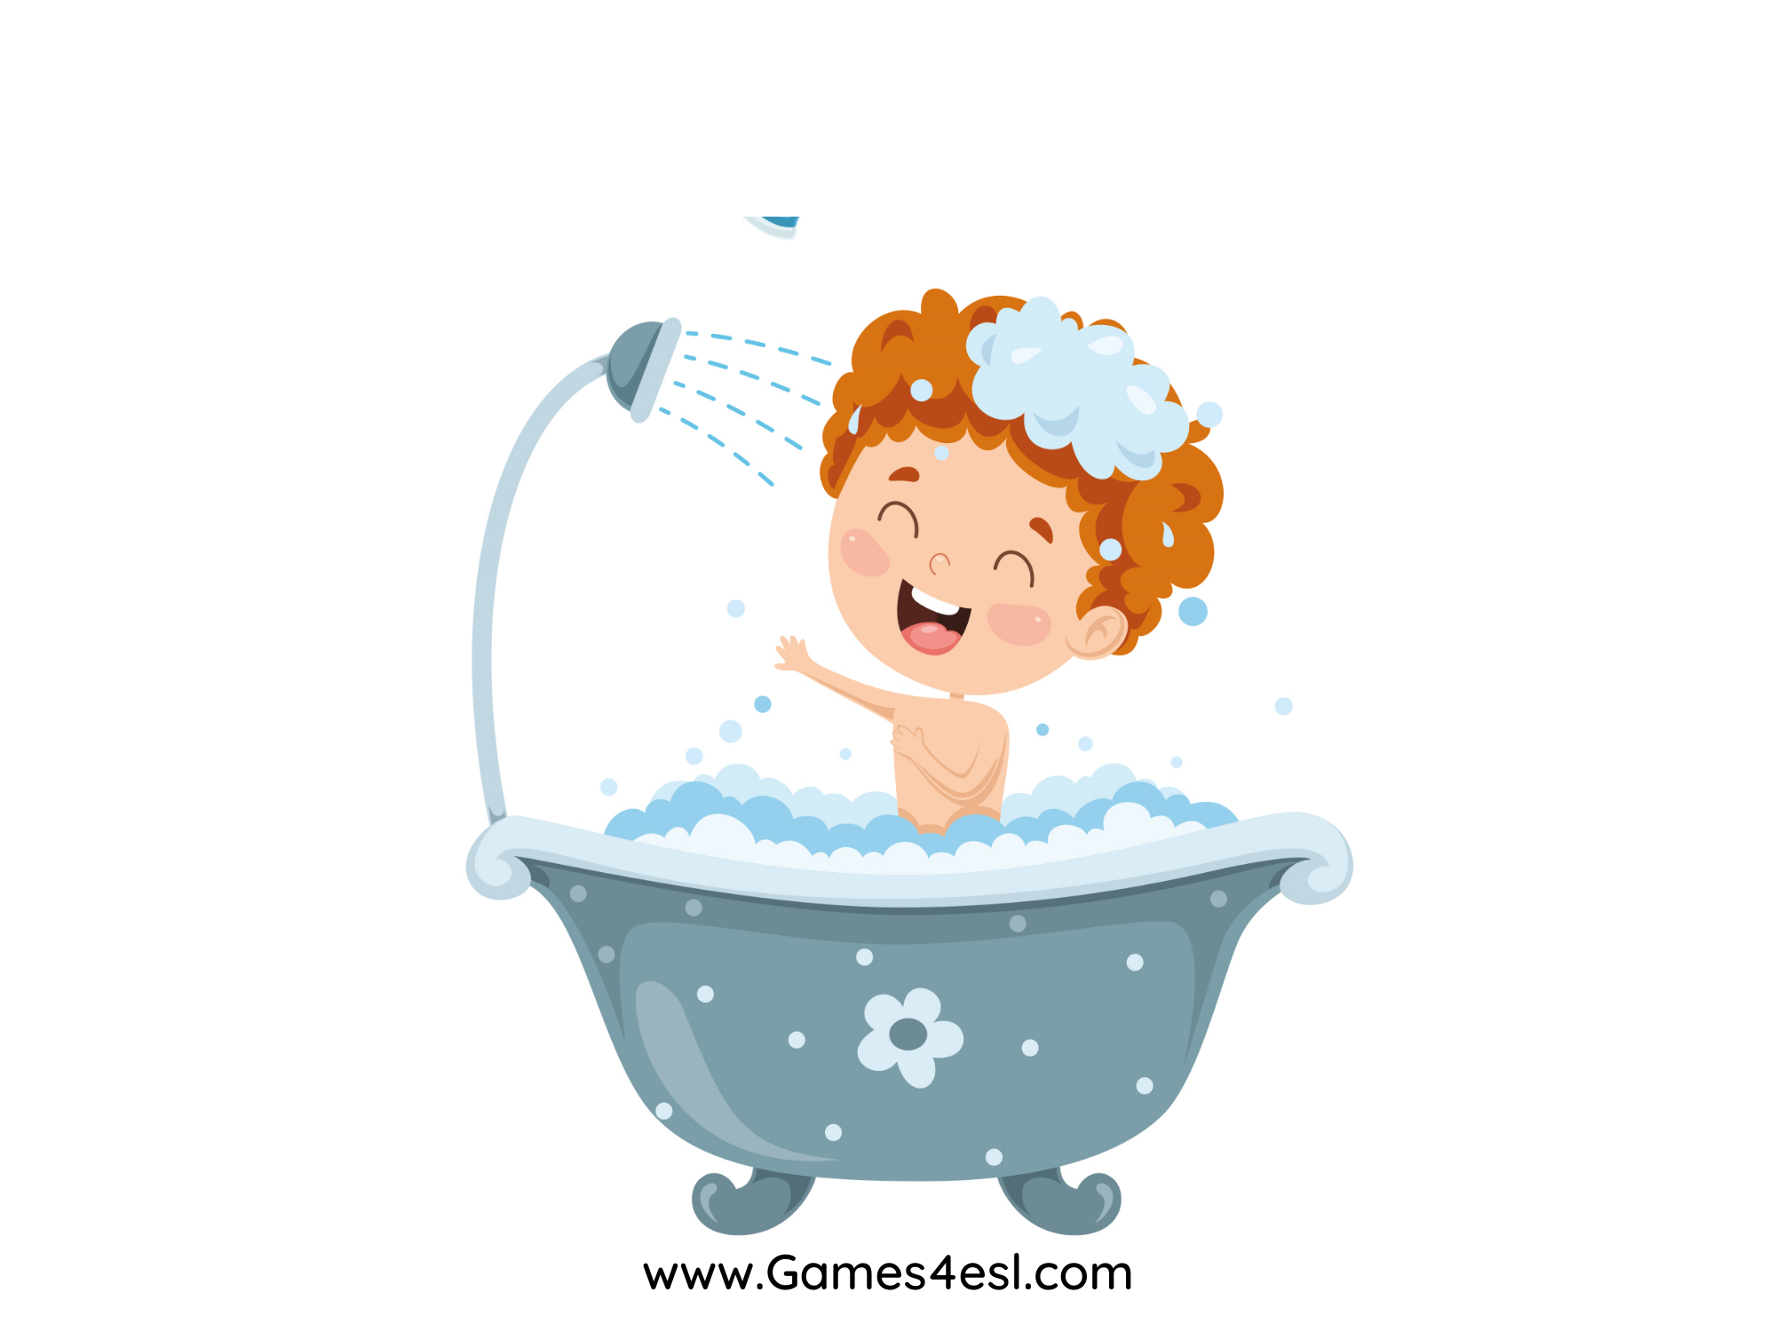
take a shower
SHOW

Slide 5
go to school
SHOW

Slide 6
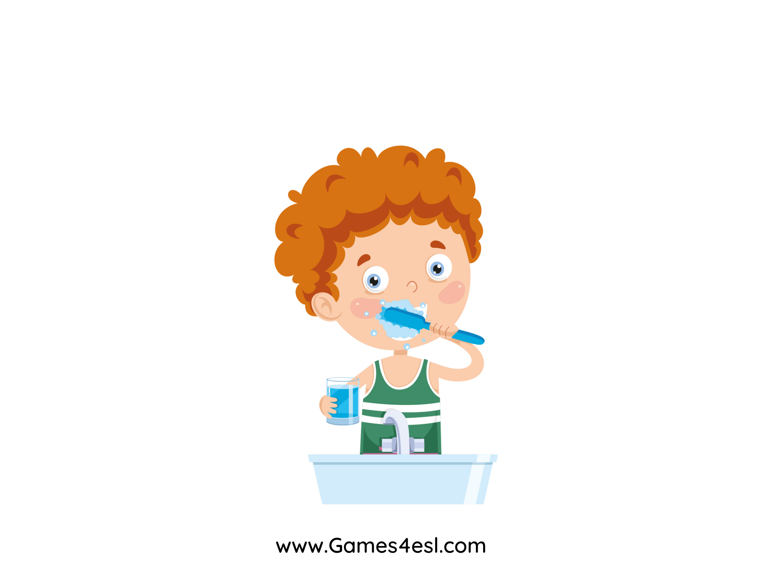
brush your teeth
SHOW

Slide 7
practice the guitar
SHOW

Slide 8
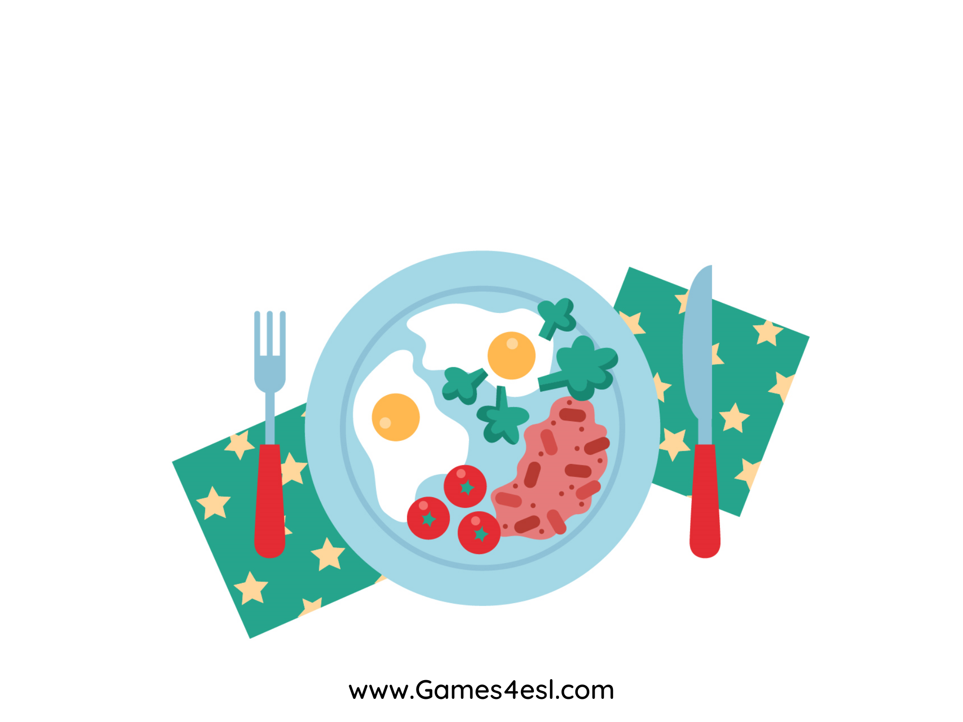
have breakfast
SHOW

Slide 9
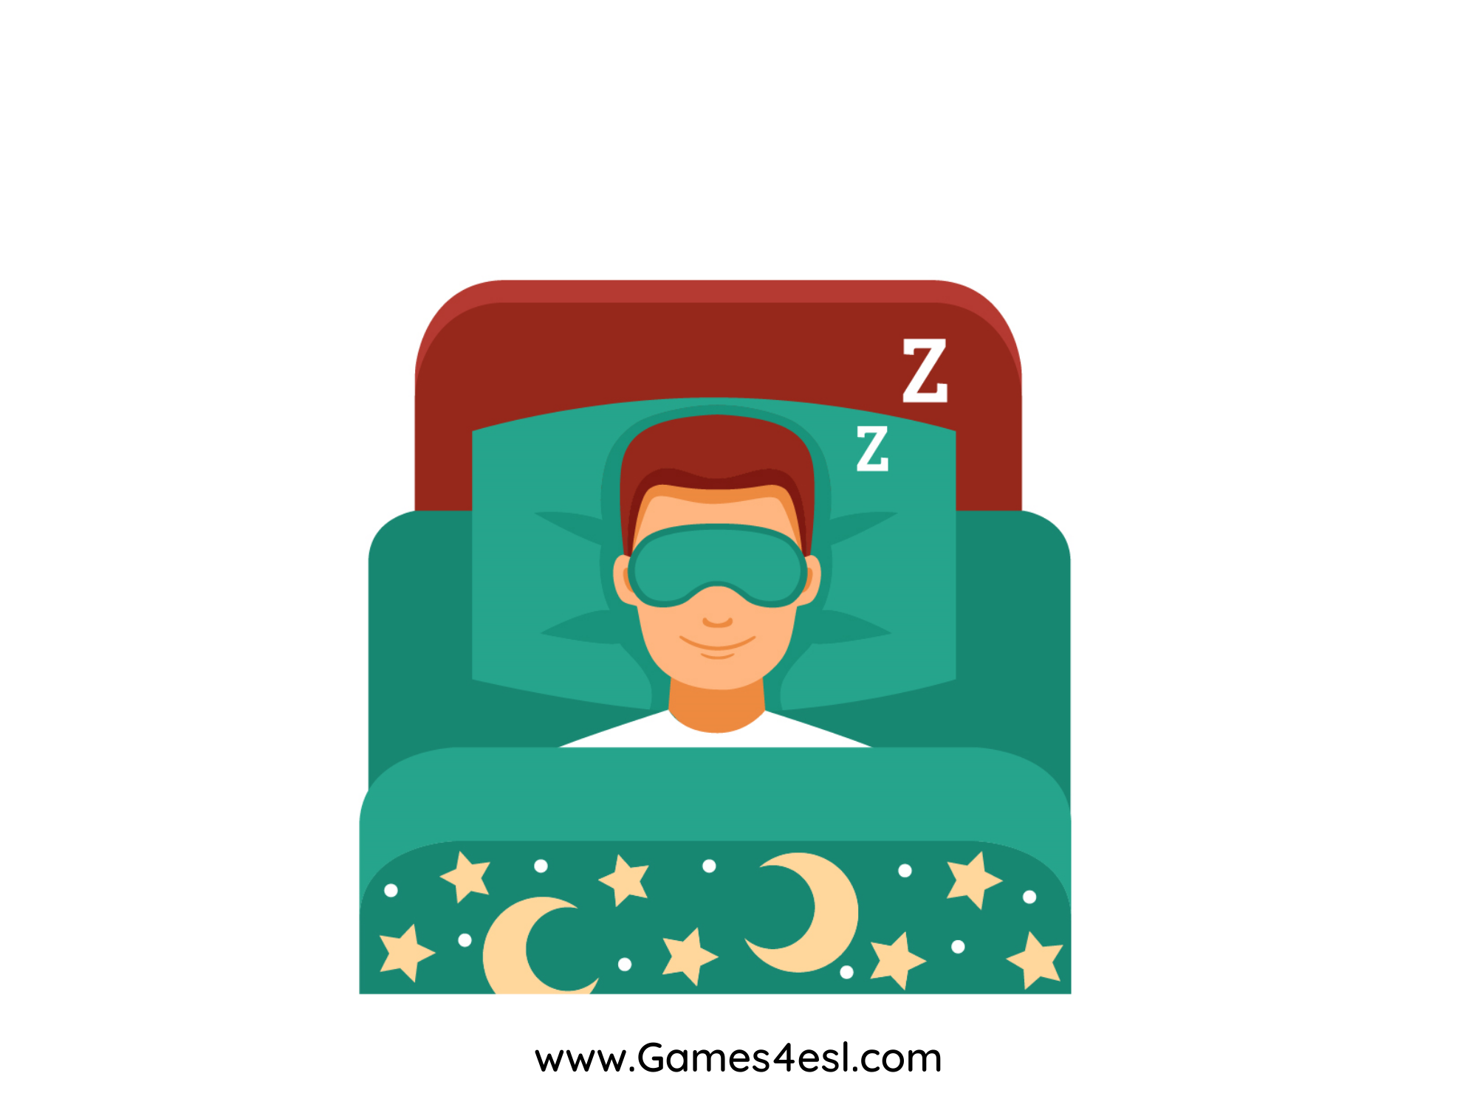
go to bed
SHOW

