Slide 3
sheep
SHOW

Slide 4
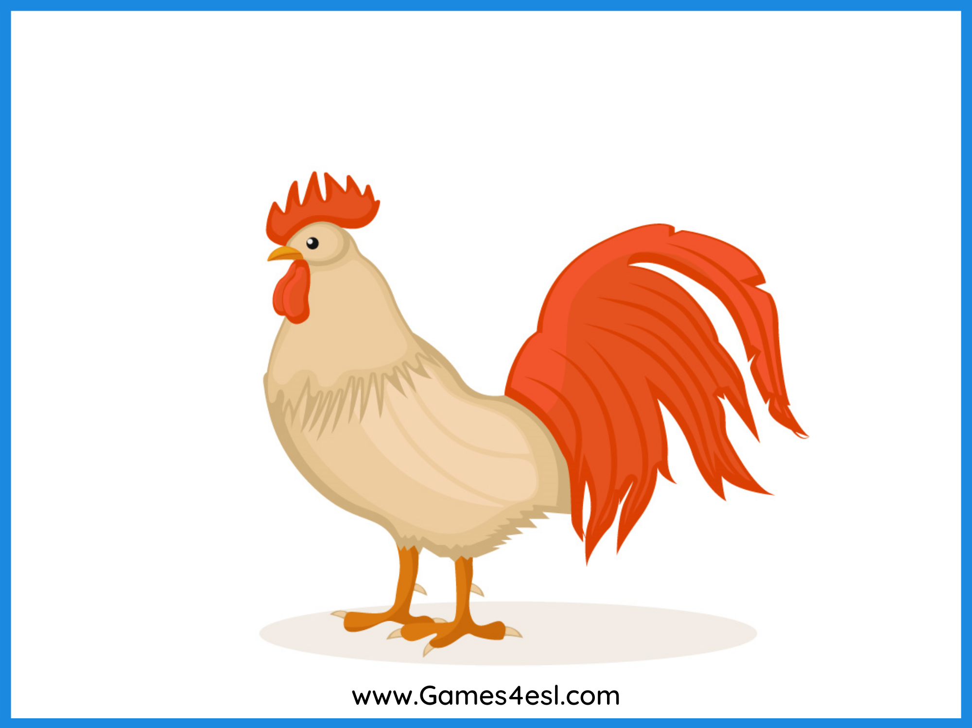
chicken
SHOW

Slide 5
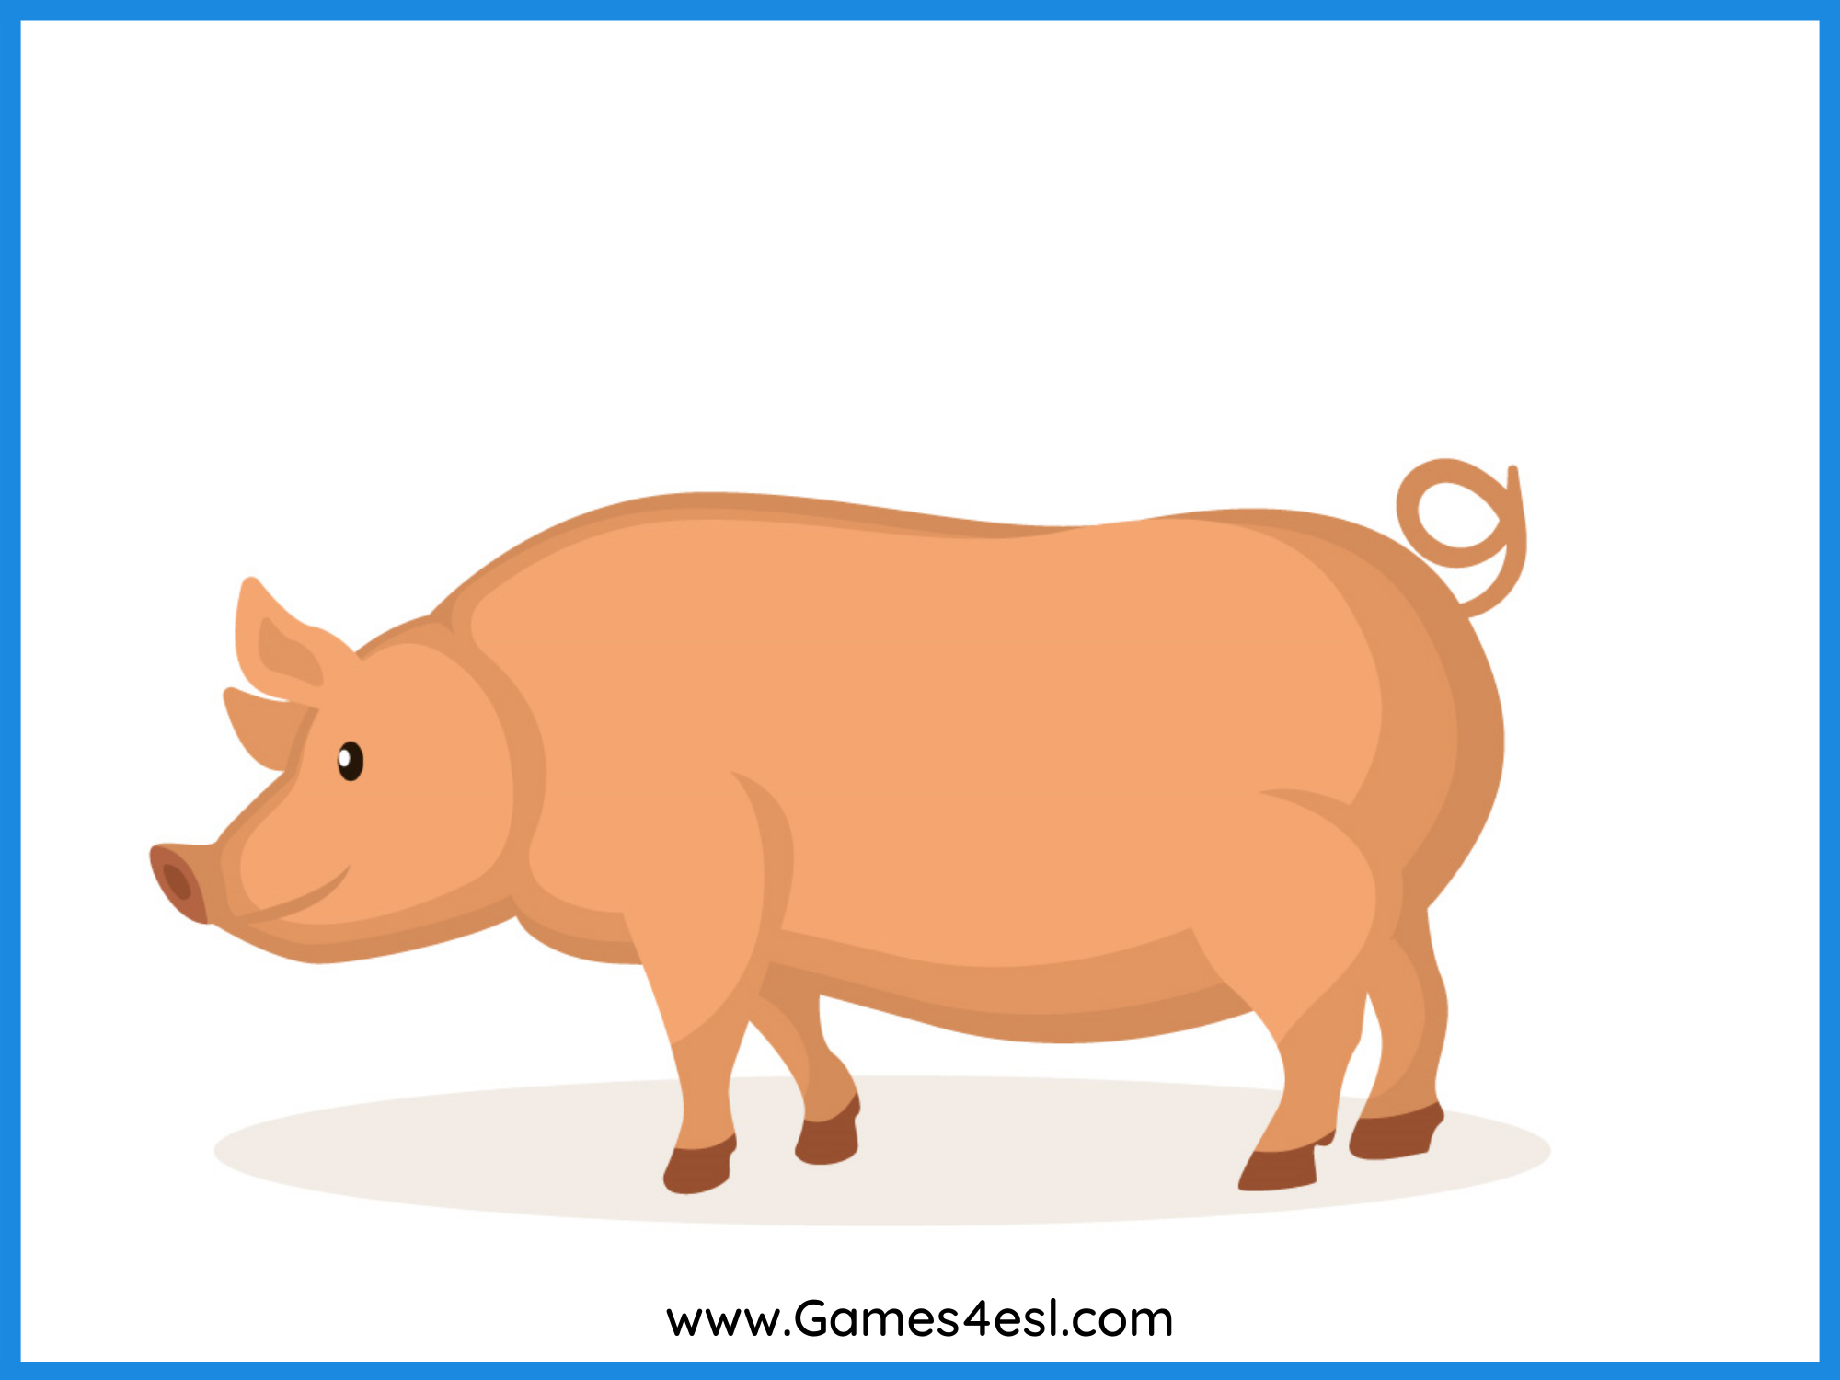
pig
SHOW

Slide 6
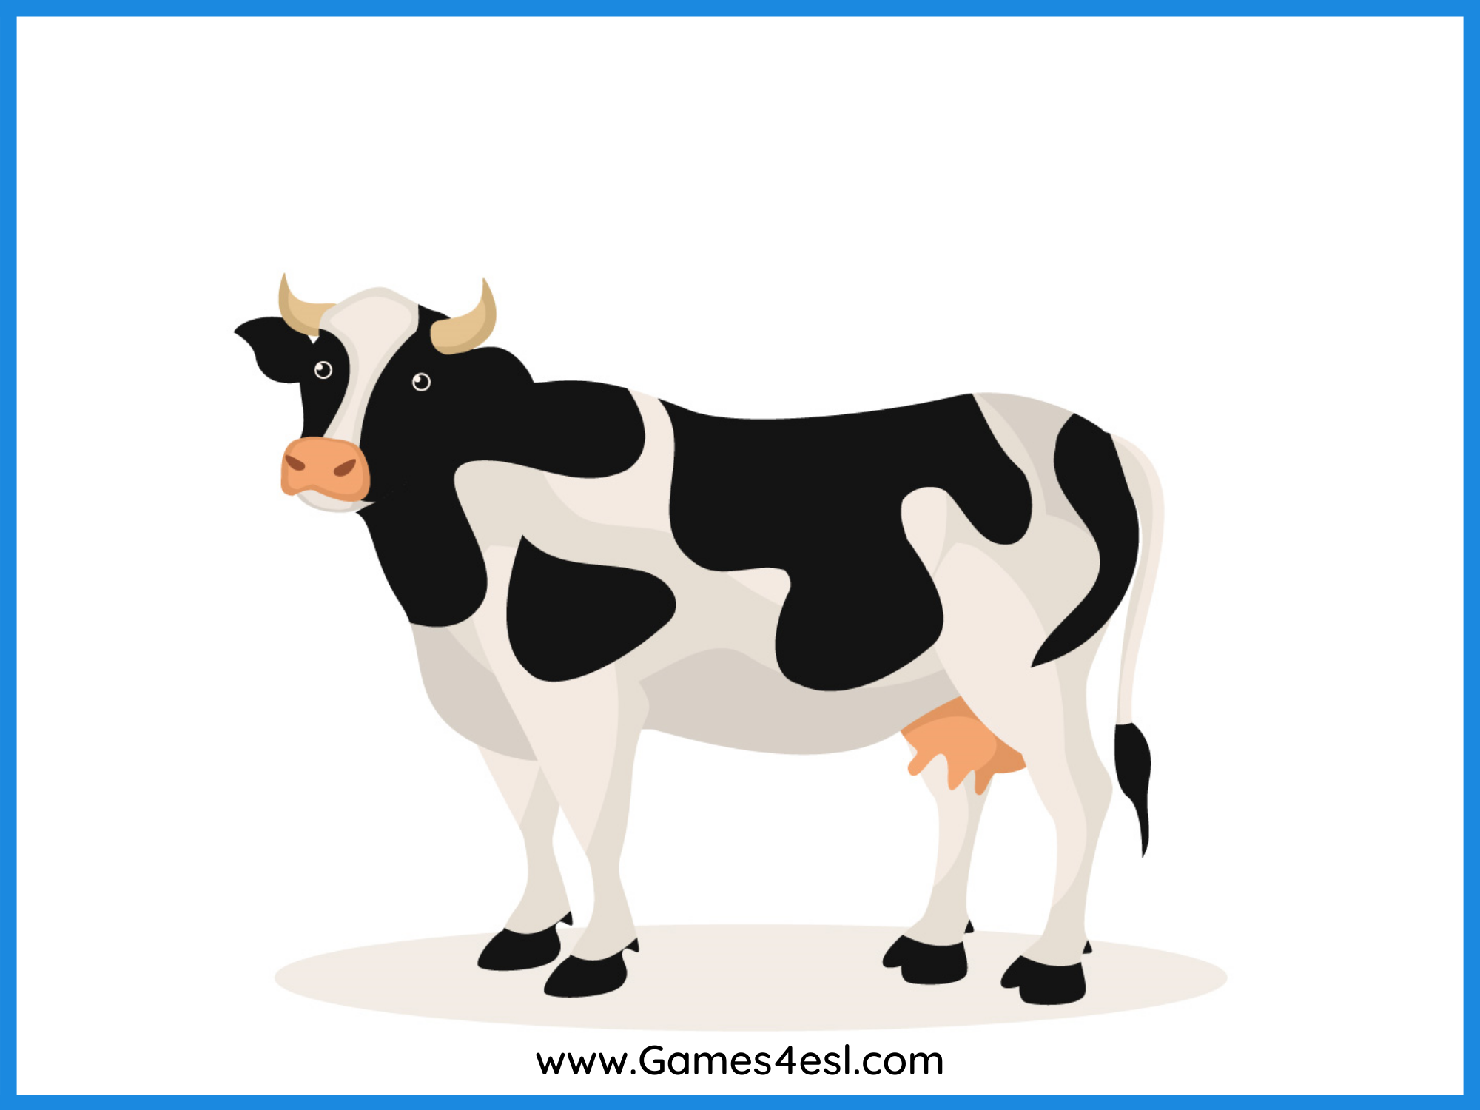
cow
SHOW

Slide 7
horse
SHOW

Slide 8
goat
SHOW

Slide 9
mouse
SHOW

Slide 10
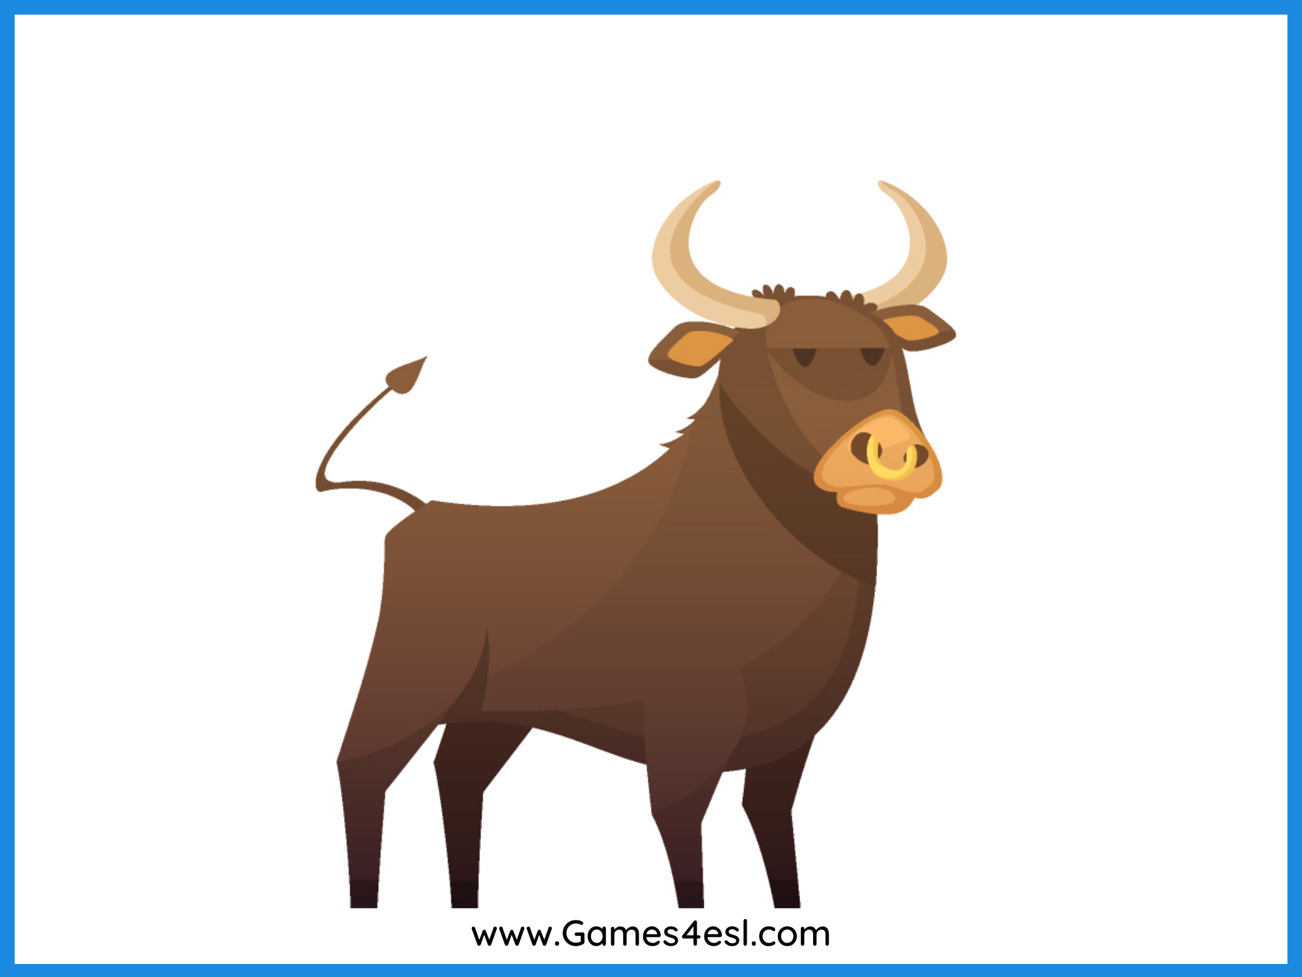
bull
SHOW

Slide 11
duck
SHOW

Slide 12
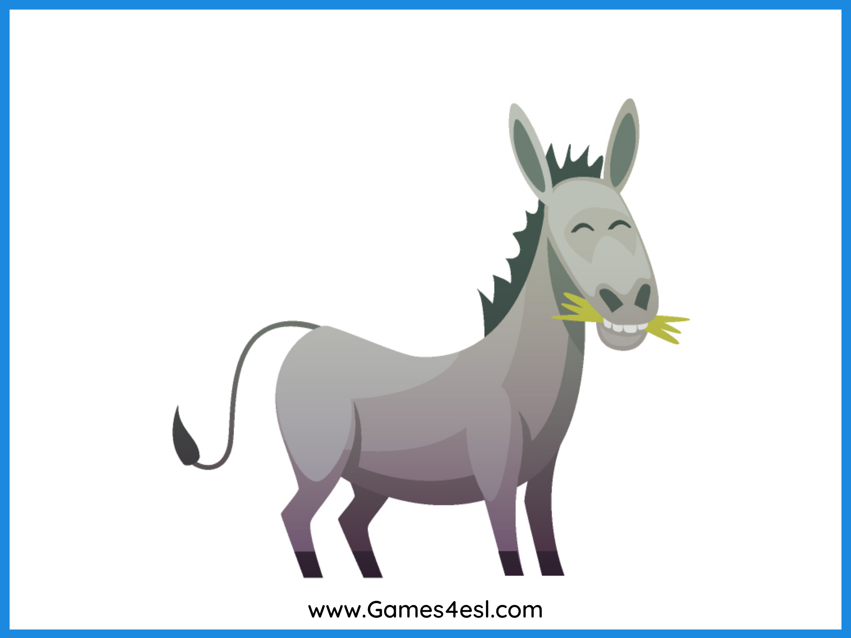
donkey
SHOW

Slide 13
chick
SHOW

