Slide 20
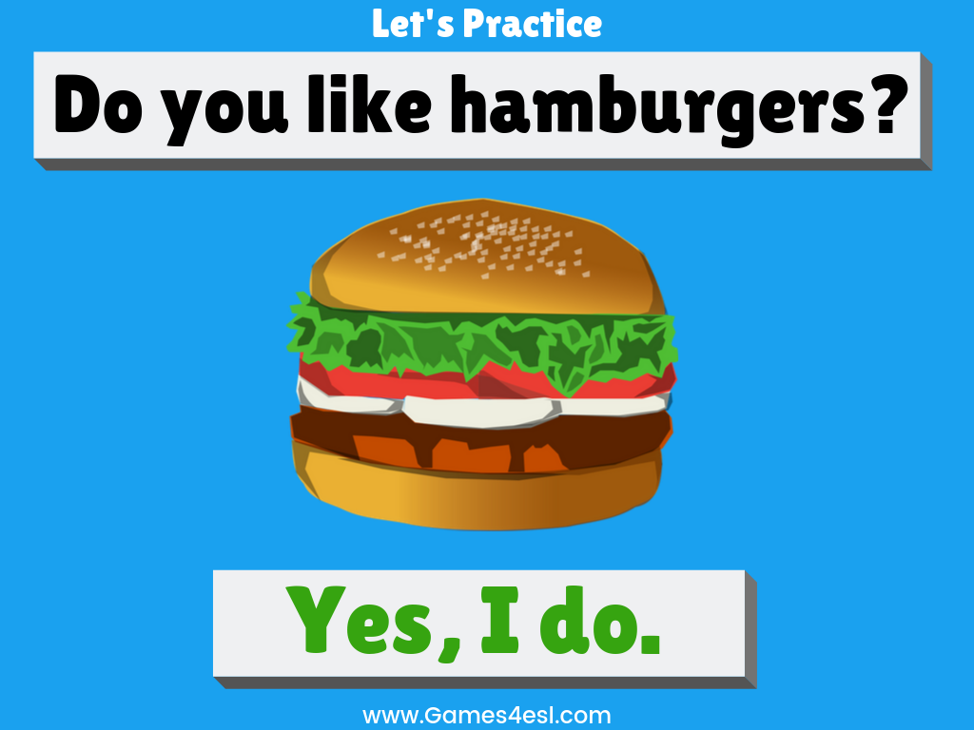

Slide 26
pizza
SHOW
www.Games4esl.com

Slide 27
chicken
SHOW
www.Games4esl.com

Slide 28
steak
SHOW
www.Games4esl.com

Slide 29
hamburger
SHOW
www.Games4esl.com

Slide 30
fish
SHOW
www.Games4esl.com

Slide 31
salad
SHOW
www.Games4esl.com

