Slide 1
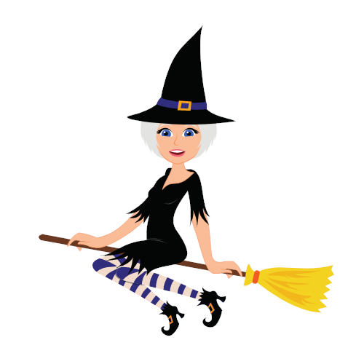
Halloween Race
VS

Slide 2
How To Play:
Make 2 teams.
One team is the ‘Witch’ and one team is the ‘Ghost’.
Take turns choosing a letter and answering the question.
Then, click on the ‘Home’ icon to return to the race.
Click on the Witch / Ghost and it will move.
The first team to get to the candy is the winner.

Slide 4
A
B
C
D
E
F
G
H
I
J
K
L
M
N
O
P
Q
R

Slide 5
jack-o’-lantern

Slide 6
bat

Slide 7
witch

Slide 8
ghost

Slide 9
candy

Slide 10
haunted house

Slide 11
cat

Slide 12
pumpkin

Slide 13
spider

Slide 14
mummy

Slide 15
spider web

Slide 16
broomstick

Slide 17
costume

Slide 18
vampire

Slide 19
skeleton

Slide 20
cauldron

Slide 21
monster

Slide 22
trick or treat

