Slide 1



cat
NEXT
SHOW

Slide 2
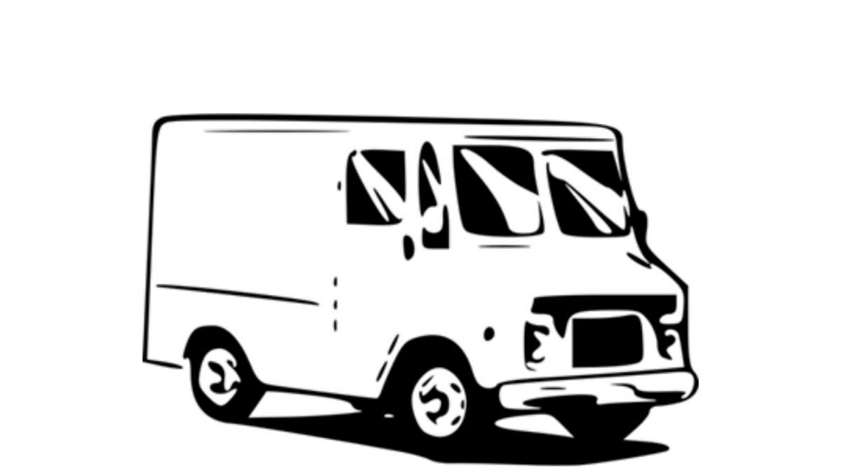
van
NEXT
SHOW

Slide 3

can
NEXT
SHOW

Slide 4

man
NEXT
SHOW

Slide 5

tag
NEXT
SHOW

Slide 6

rat
NEXT
SHOW

Slide 7

bag
NEXT
SHOW

Slide 8

map
NEXT
SHOW

Slide 9

tap
SHOW

