Slide 1
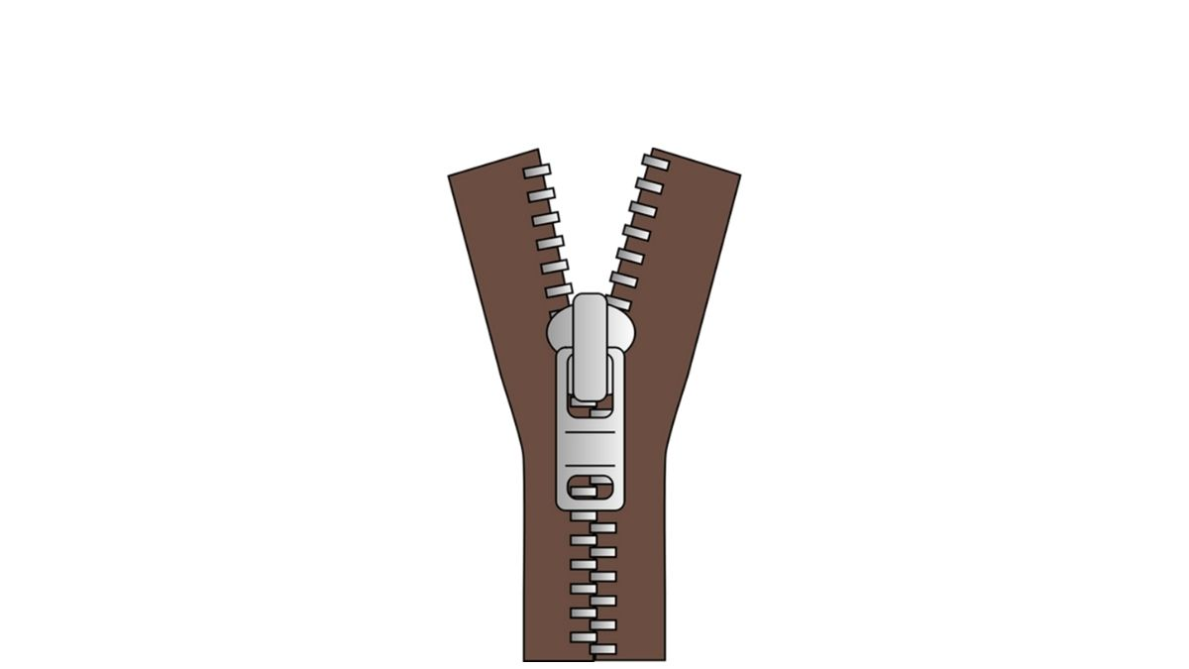
zip
NEXT
SHOW

Slide 2
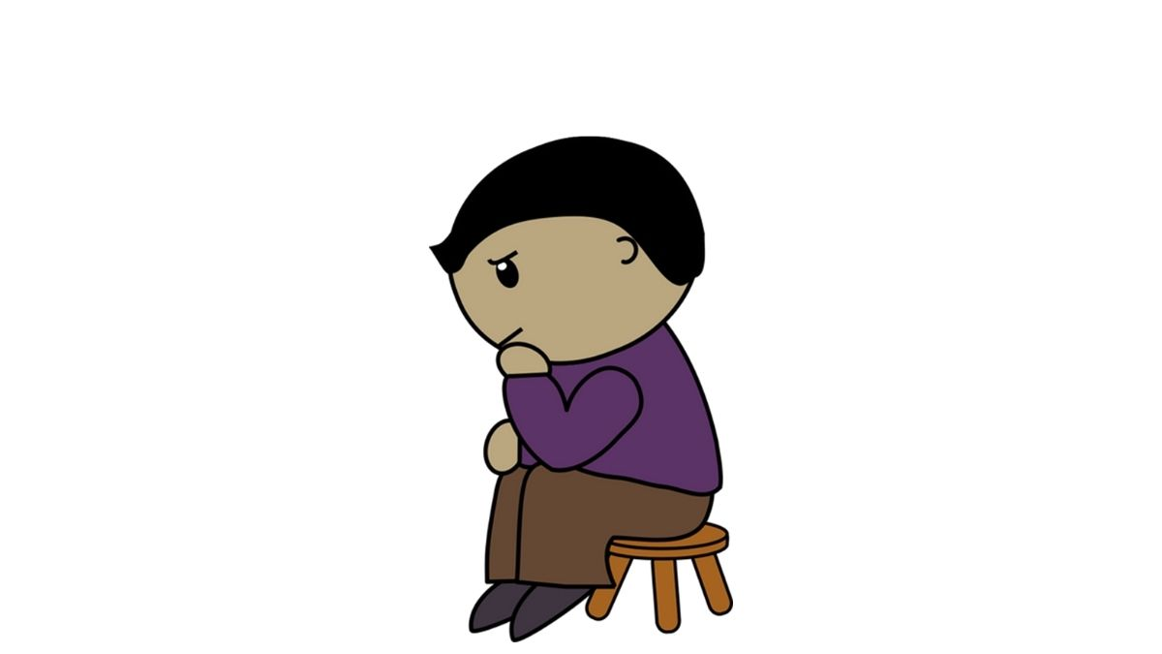
sit
NEXT
SHOW

Slide 3
wig
NEXT
SHOW

Slide 4
bin
NEXT
SHOW

Slide 5
pin
NEXT
SHOW

Slide 6
six
NEXT
SHOW

Slide 7
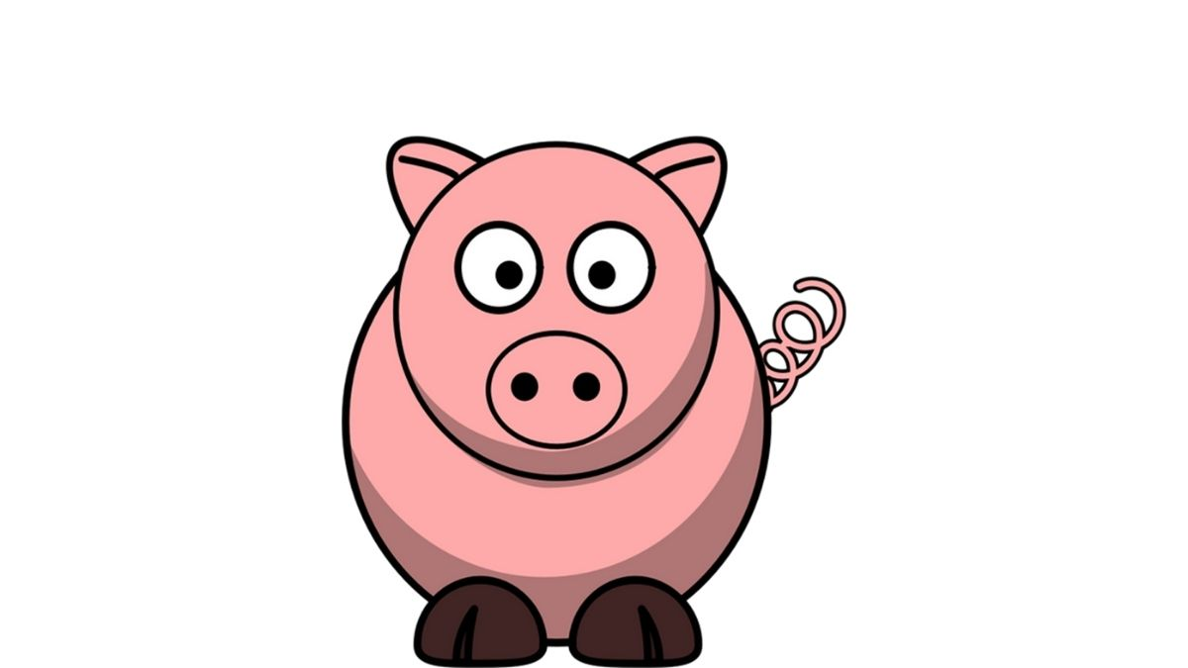
pig
SHOW

