Slide 1
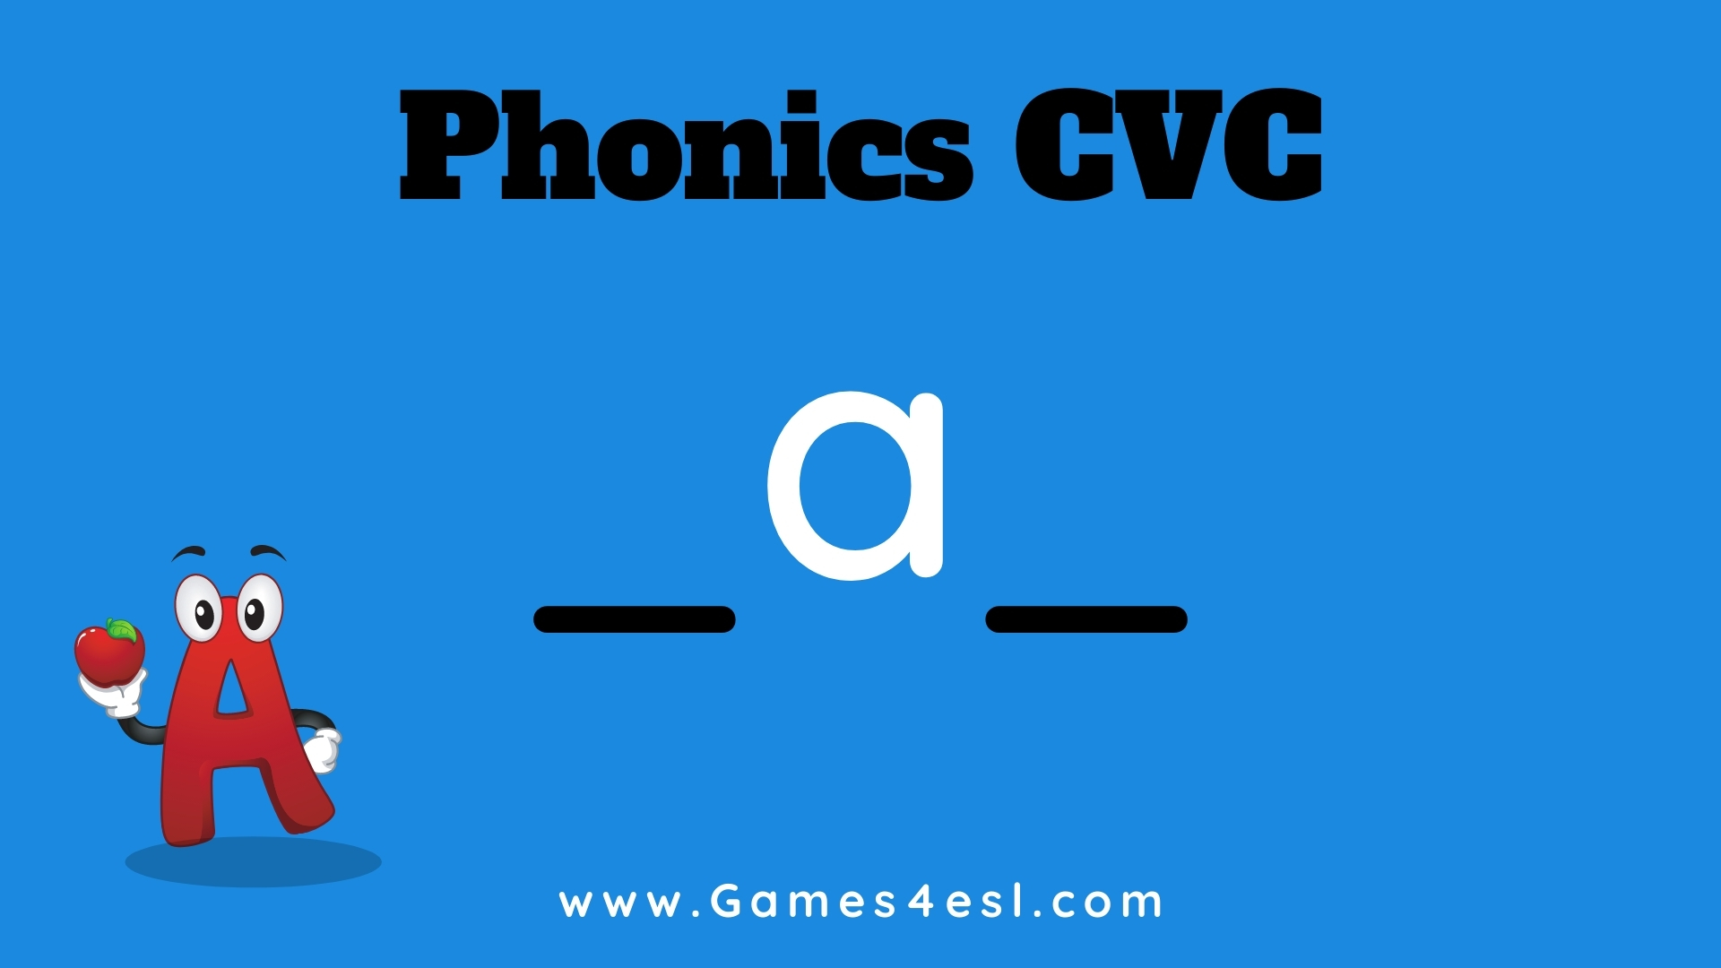

Slide 2

Word Family:
_an

Slide 3
c
a
n

Slide 4
v
a
n

Slide 5
m
a
n

Slide 6
f
a
n

Slide 7
p
a
n

Slide 8
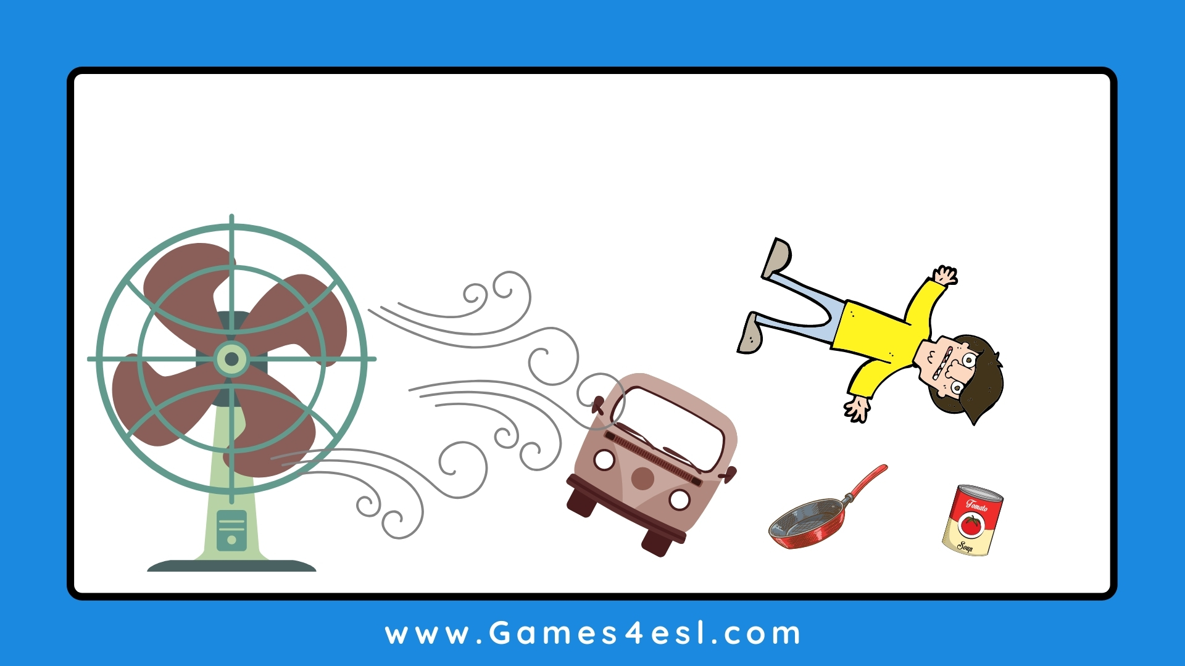
The big fan blew over the van, pan, can,
and the man.

