Slide 1
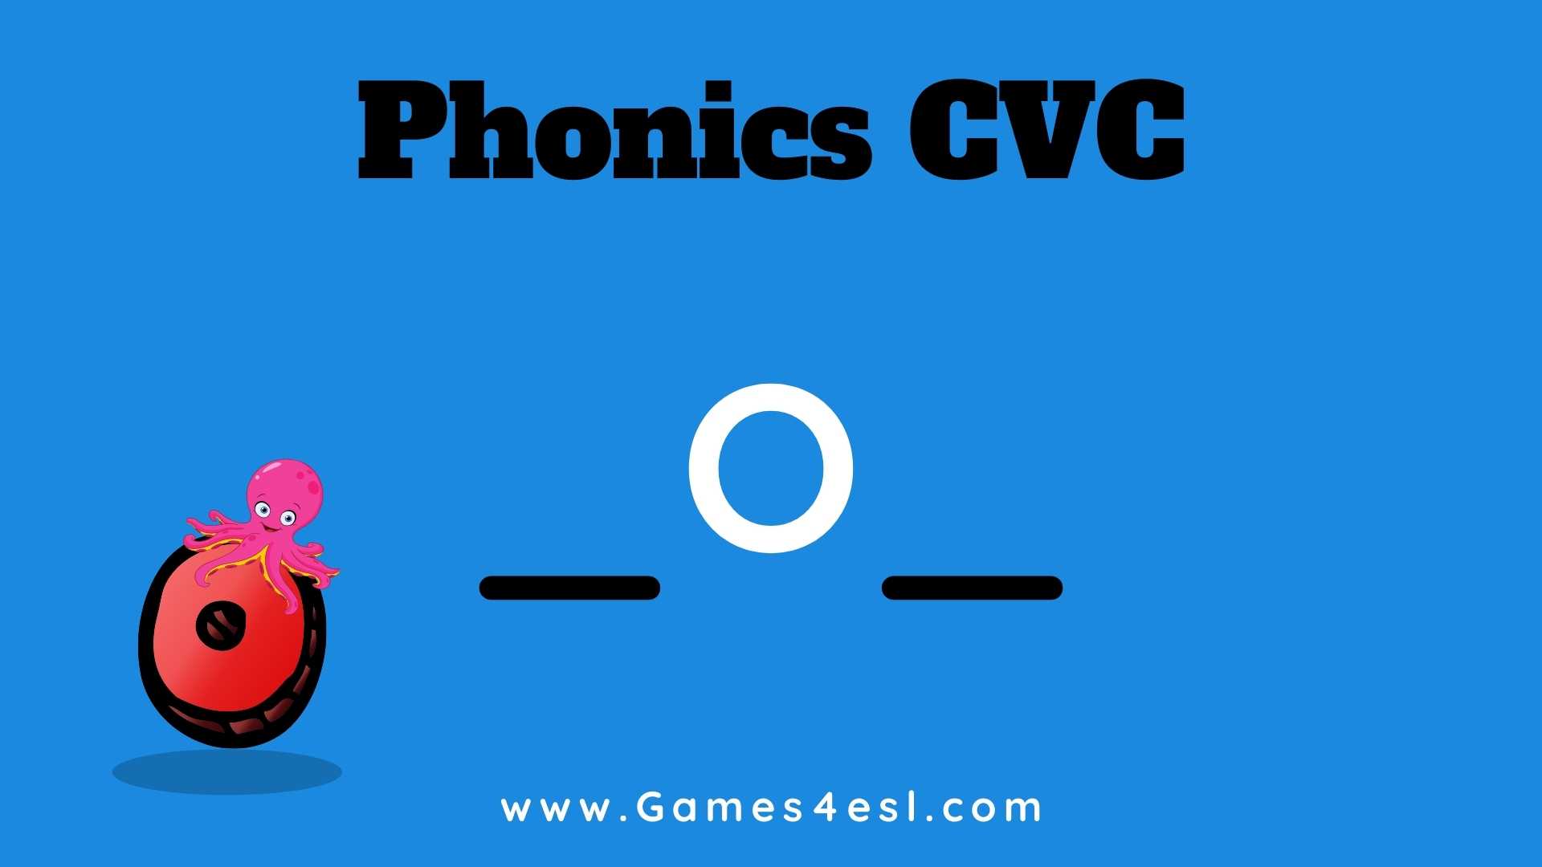

Slide 2

Word Family:
_op

Slide 3
h
o
p

Slide 4
c
o
p

Slide 5
p
o
p

Slide 6
t
o
p

Slide 7
b
o
p

Slide 8
m
o
p

Slide 9
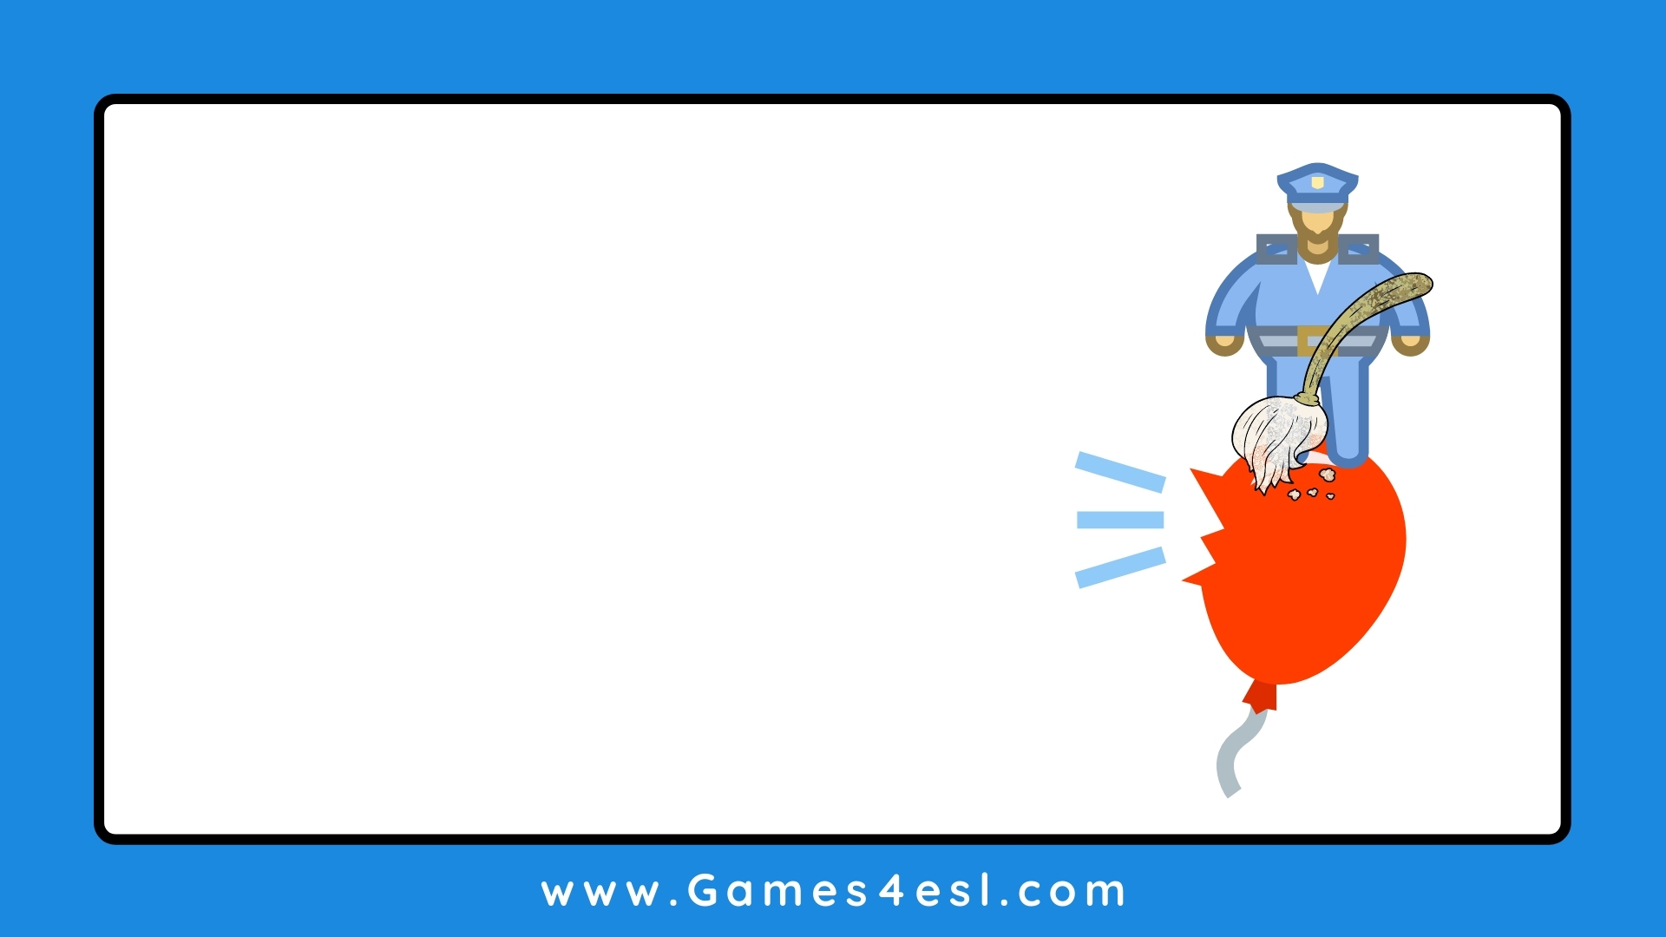
The cop with the mop were on top of the balloon when it went pop!

