Slide 1
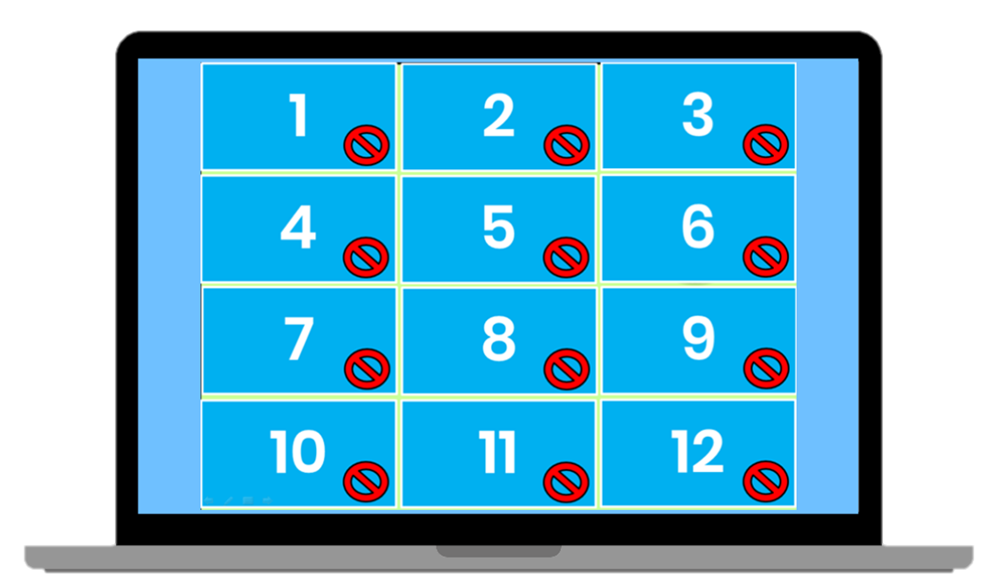
Matching Game
How to Play
Divide the class into two teams. Each team then takes turns in choosing TWO squares. If the two squares are the same word / picture, then the team gets a point. If the two squares are different, then click on the red circle to hide the picture again. Students must try to remember where the matching pairs of words are.
www.Games4esl.com

Slide 2
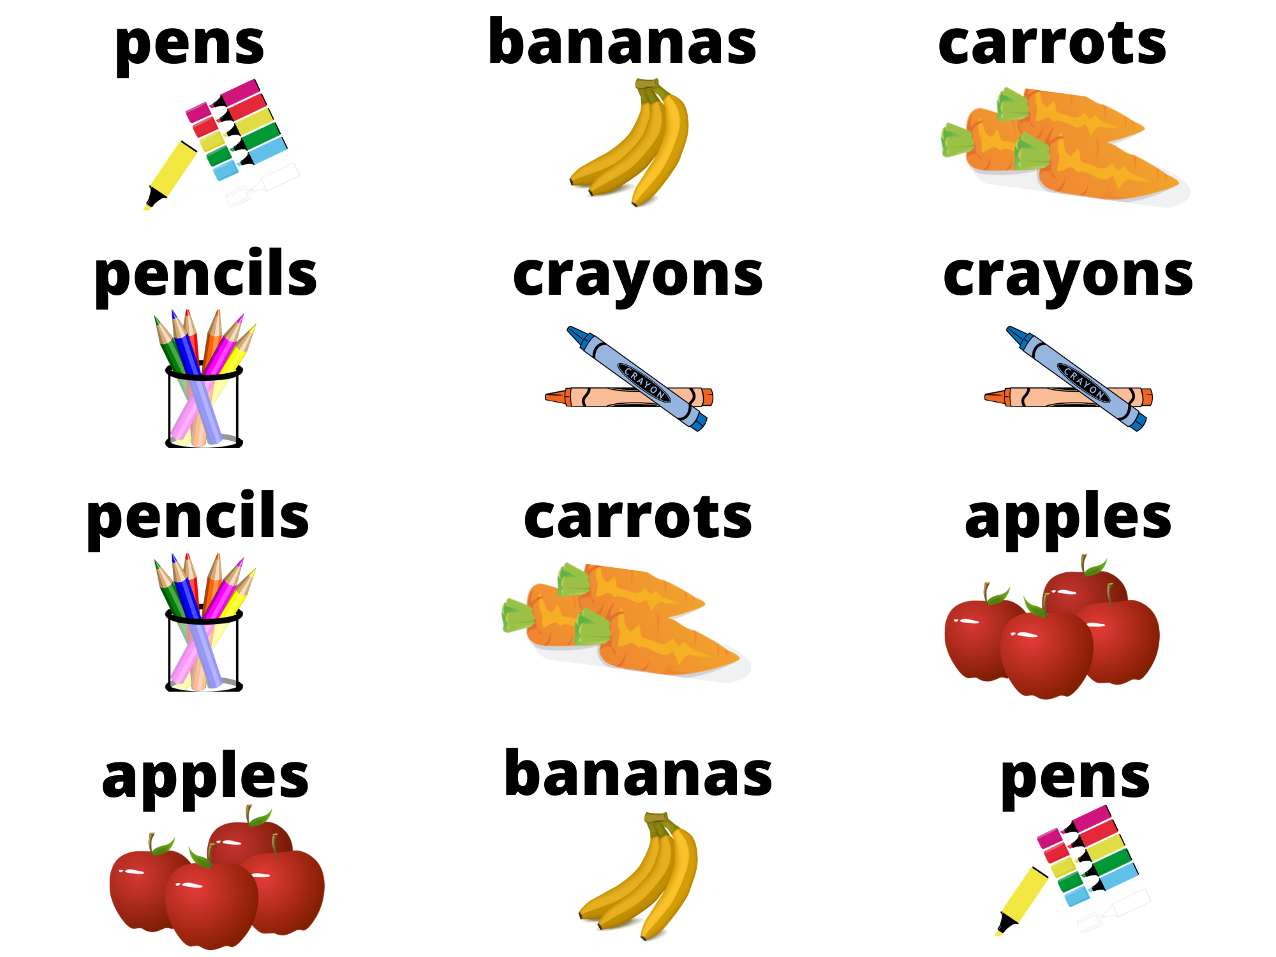
1
2
3
4
5
6
7
8
9
10
11
12

