Slide 1
in
SHOW

Slide 2
on
SHOW

Slide 3
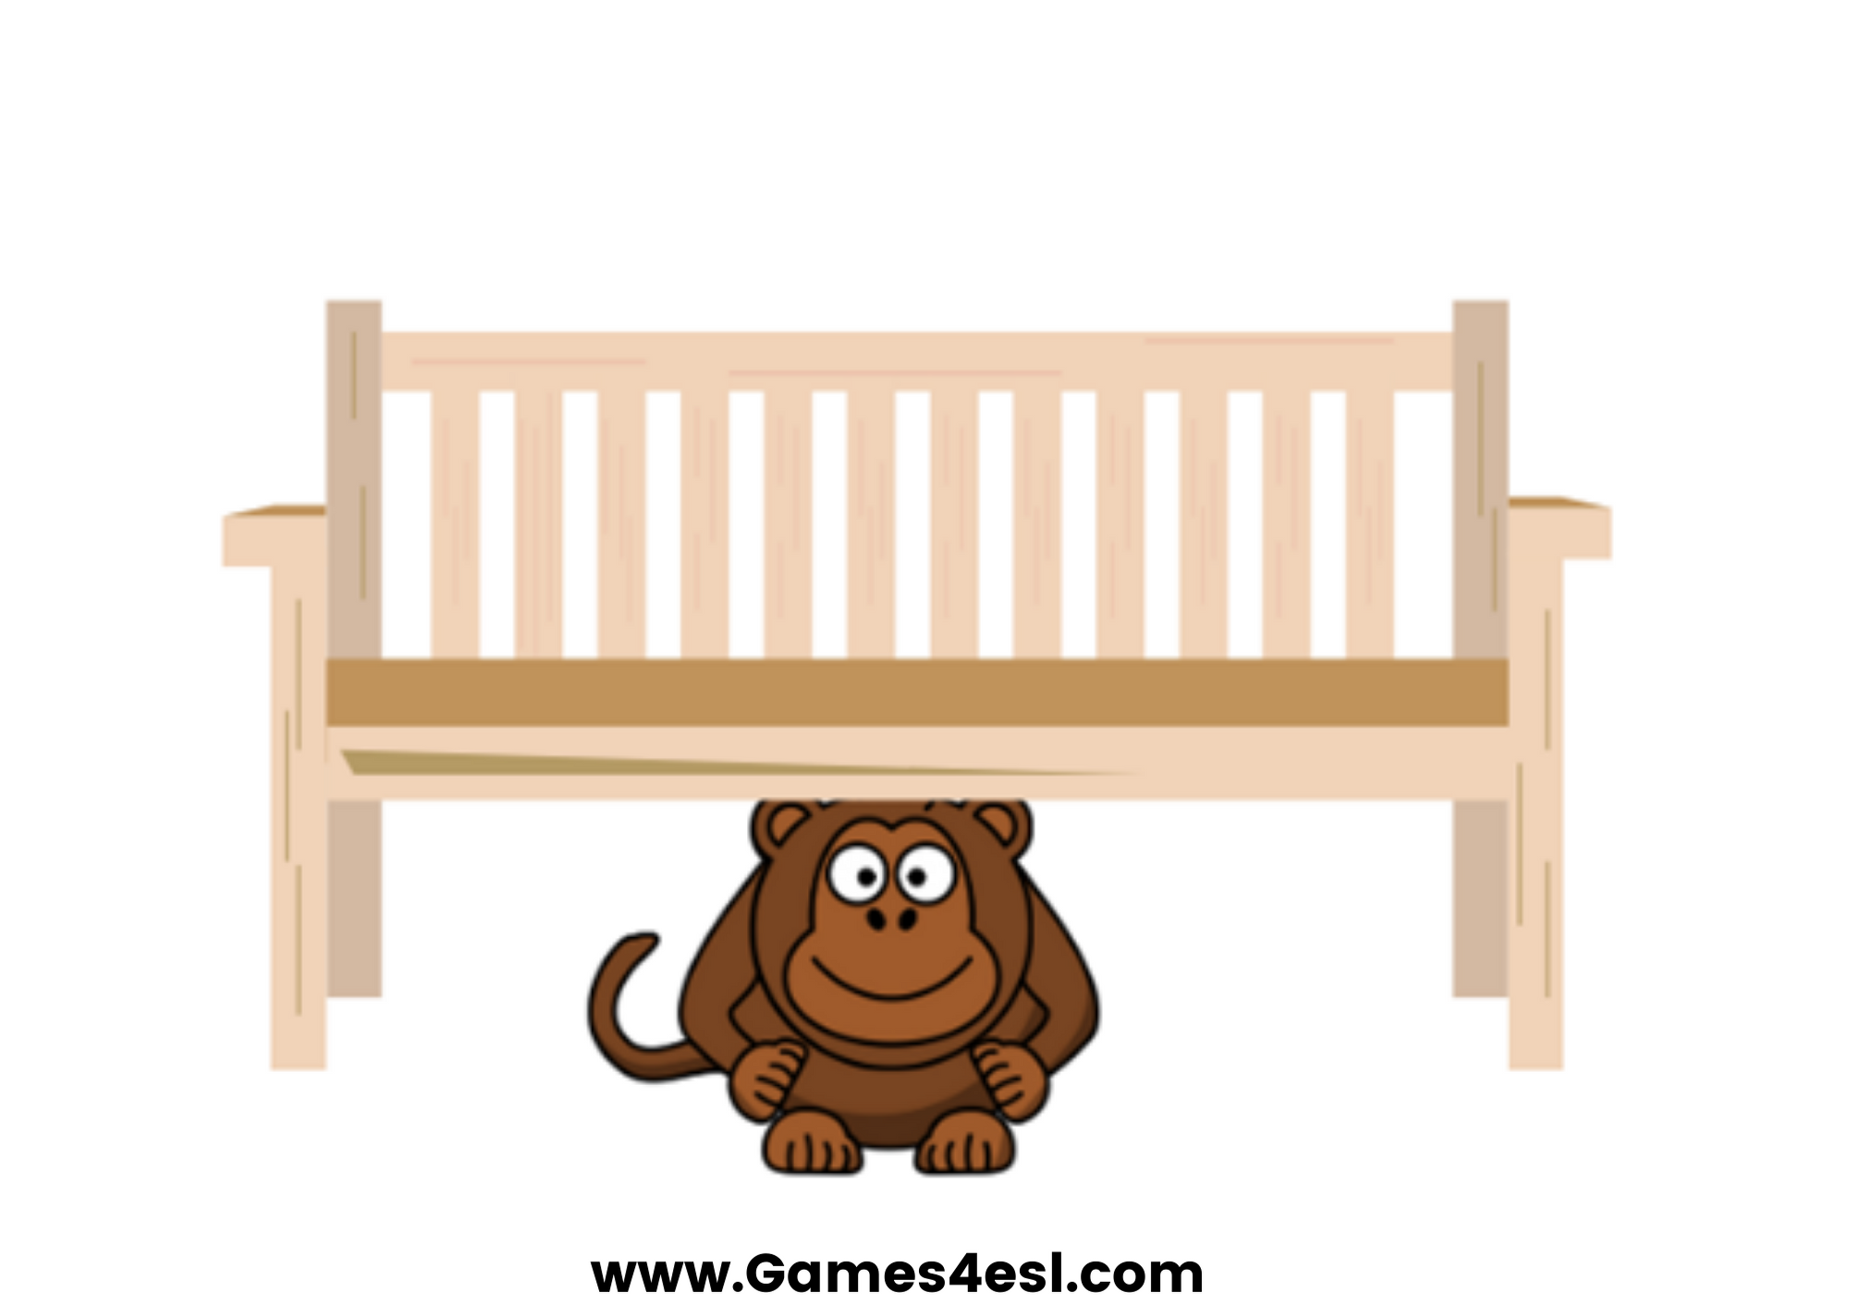
under
SHOW

Slide 4
behind
SHOW

Slide 5
between
SHOW

Slide 6
next to
SHOW

Slide 7
in front of
SHOW

