Slide 1


Present Perfect
Connecting the past to the present moment
Games4esl.com

Slide 2

The Present Perfect Tense
We use the Present Perfect to talk about experiences in our lives without saying exactly when they happened. It connects a past action or experience to the present.
Present Perfect Examples
I have been to London.
I have eaten sushi.
Games4esl.com

Slide 3
Present Perfect vs Past Simple
If you specify a time, like "yesterday" or "in 2010", you must use the Past Simple instead.
Present Perfect
Past Simple
I have been to London.
I went to London in 2010.
Games4esl.com

Slide 4
Present Perfect Structure
Subject + have/has + past participle
I have eaten sushi.
He has been to London.
Games4esl.com

Slide 5
Past Participle Examples
The past participle is the third form of a verb. To make Present Perfect sentences, you must use the past participle.
Verb
Past Simple
Past Participle
work
worked
worked
play
played
played
eat
ate
eaten
go
went
gone
see
saw
seen
write
wrote
written
do
did
done
Games4esl.com

Slide 6

Example Sentences
Present Perfect
Subject + have/has + past participle
I have eaten breakfast.
Games4esl.com

Slide 7
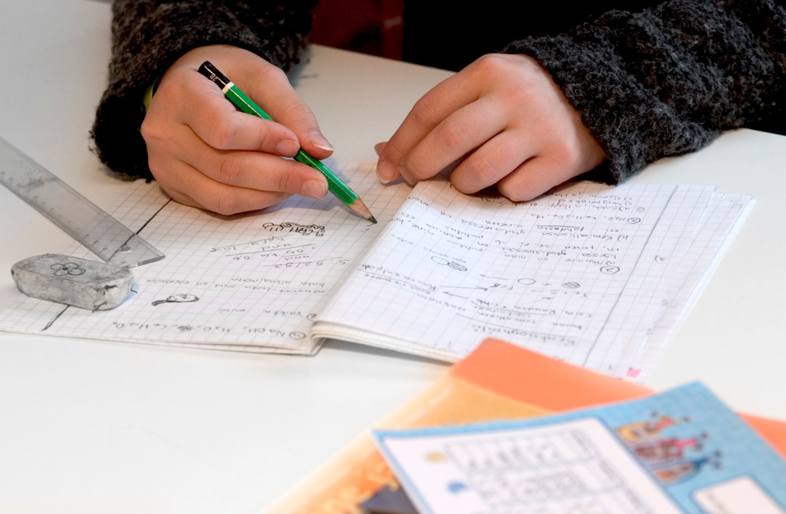
Example Sentences
Present Perfect
Subject + have/has + past participle
I have finished my homework.
Games4esl.com

Slide 8

Example Sentences
Present Perfect
Subject + have/has + past participle
She has visited Paris three times.
Games4esl.com

Slide 9
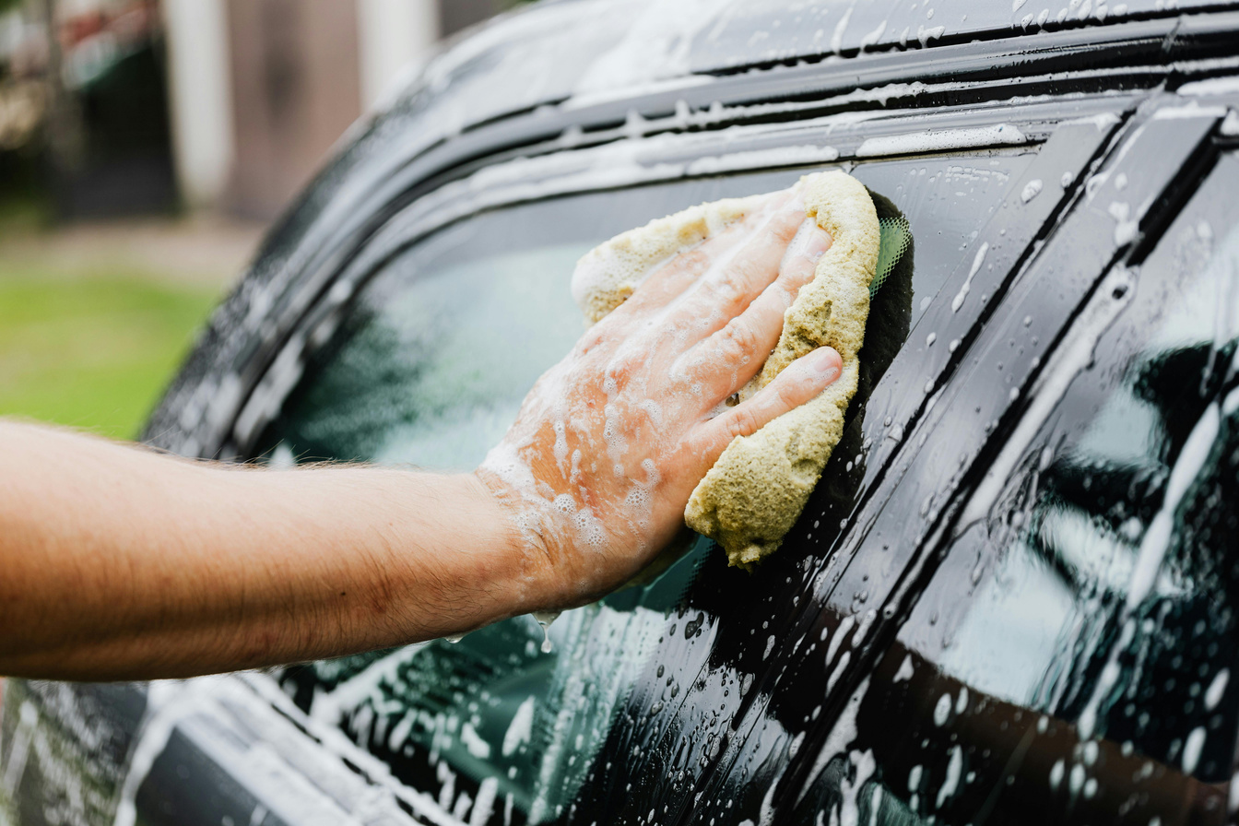
Example Sentences
Present Perfect
Subject + have/has + past participle
He has washed the car.
Games4esl.com

Slide 10

Example Sentences
Present Perfect
Subject + have/has + past participle
They have visited London.
Games4esl.com

Slide 11

Example Sentences
Present Perfect
Subject + have/has + past participle
I have tried Korean food.
Games4esl.com

Slide 12

Example Sentences
Present Perfect
Subject + have/has + past participle
We have watched that movie twice.
Games4esl.com

Slide 13
Quiz Time
Choose the correct present perfect sentence
Games4esl.com

Slide 14
Question #1
Which sentence is correct?
A:
She has finished her homework.
B:
She have finished her homework.
Games4esl.com

Slide 15

Question #1
Which sentence is correct?
A:
She has finished her homework.
B:
She have finished her homework.
Games4esl.com

Slide 16
Question #2
Which sentence is correct?
A:
He has went to school.
B:
He has gone to school.
Games4esl.com

Slide 17
Question #2
Which sentence is correct?
A:
He has went to school.
B:
He has gone to school.
Games4esl.com

Slide 18
Question #3
Which sentence is correct?
A:
I has tried sushi before.
B:
I have tried sushi before.
Games4esl.com

Slide 19
Question #3
Which sentence is correct?
A:
I has tried sushi before.
B:
I have tried sushi before.
Games4esl.com

Slide 20
Question #4
Which sentence is correct?
A:
She has visited London twice.
B:
She has visit London twice.
Games4esl.com

Slide 21
Question #4
Which sentence is correct?
A:
She has visited London twice.
B:
She has visit London twice.
Games4esl.com

Slide 22
Question #5
Which sentence is correct?
A:
They has washed the dishes.
B:
They have washed the dishes.
Games4esl.com

Slide 23
Question #5
Which sentence is correct?
A:
They has washed the dishes.
B:
They have washed the dishes.
Games4esl.com

Slide 24
Well Done!
Games4esl.com

