Slide 1
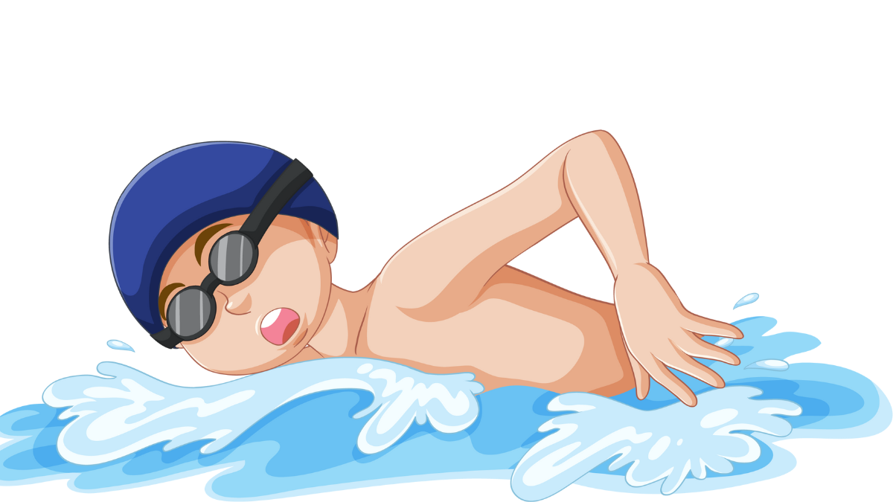


swimming
NEXT
SHOW

Slide 2
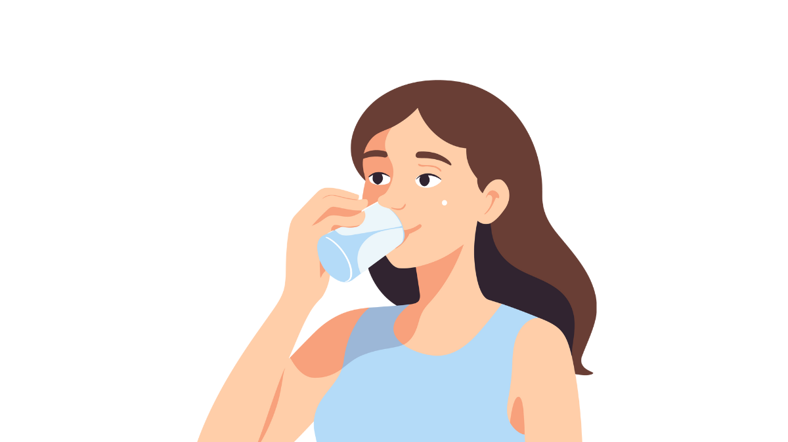
drinking
NEXT
SHOW

Slide 3
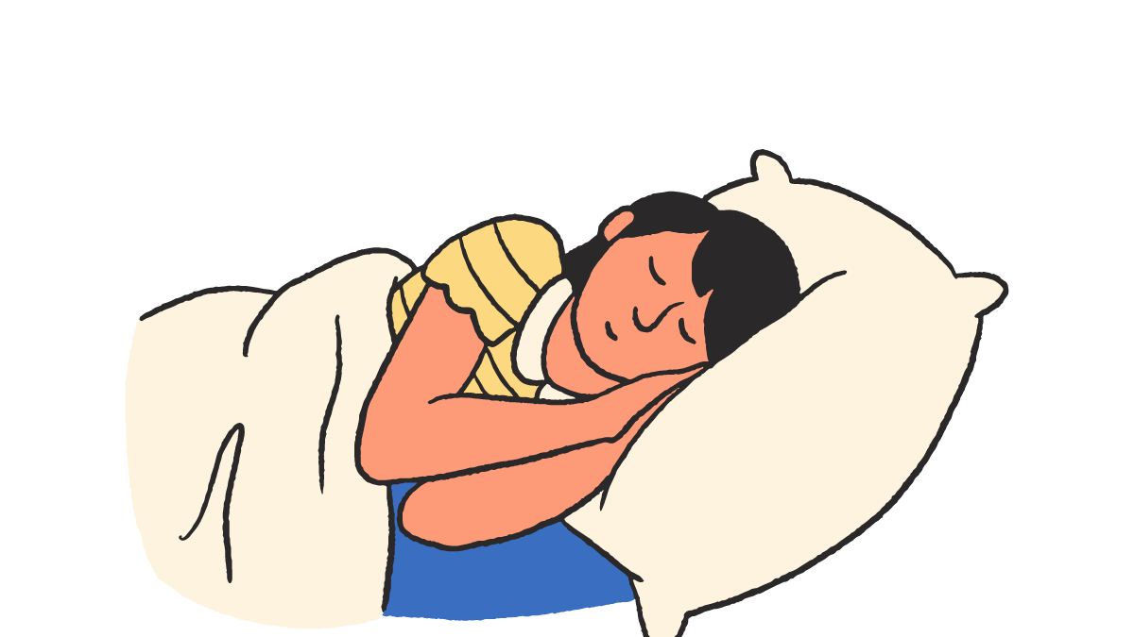
sleeping
NEXT
SHOW

Slide 4
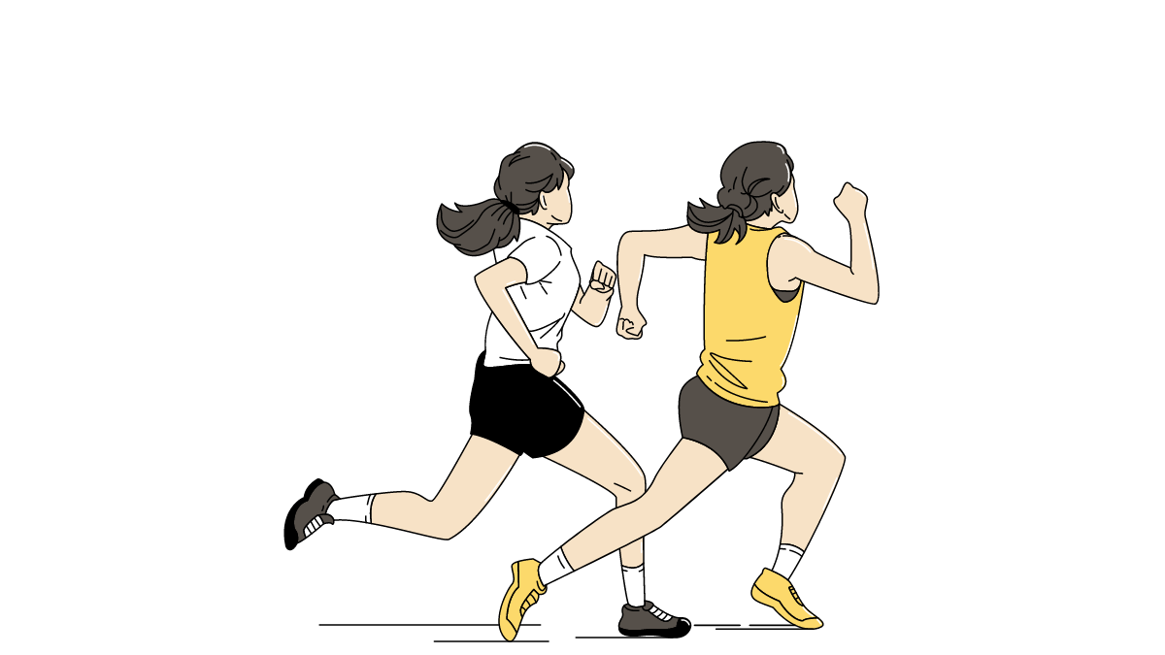
running
NEXT
SHOW

Slide 5
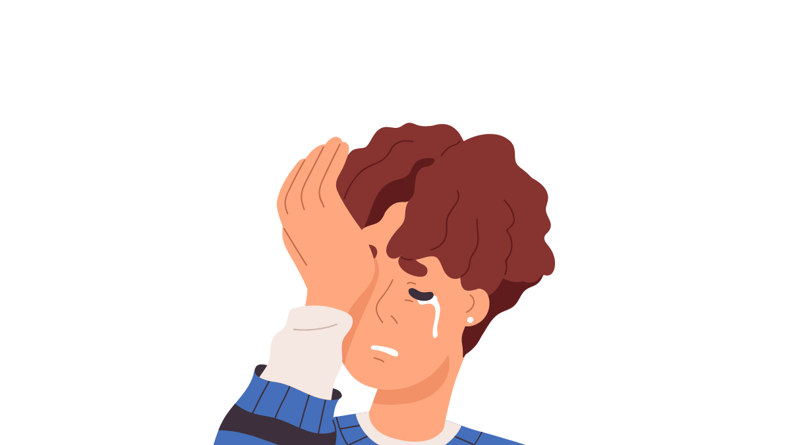
crying
NEXT
SHOW

Slide 6
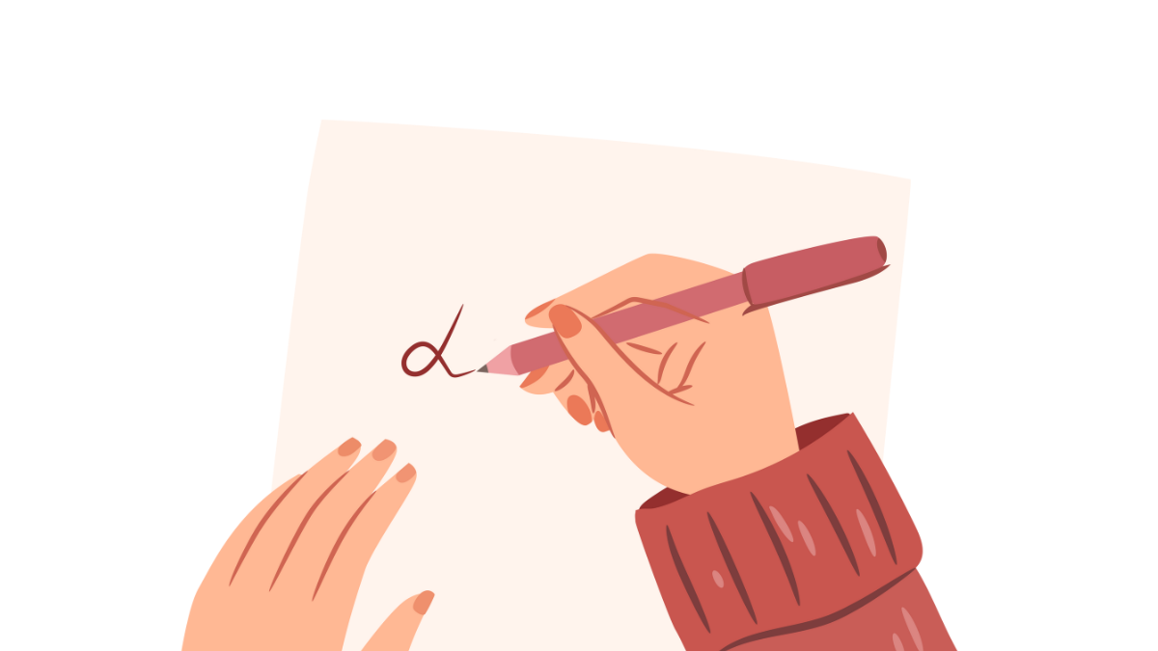
writing
NEXT
SHOW

Slide 7
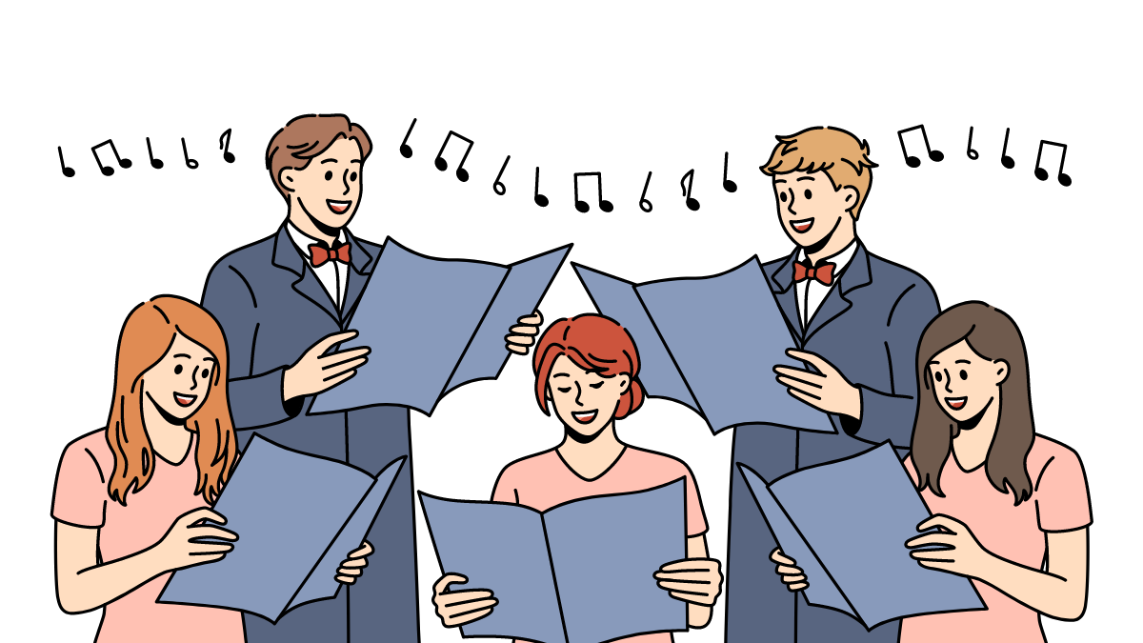
singing
NEXT
SHOW

Slide 8
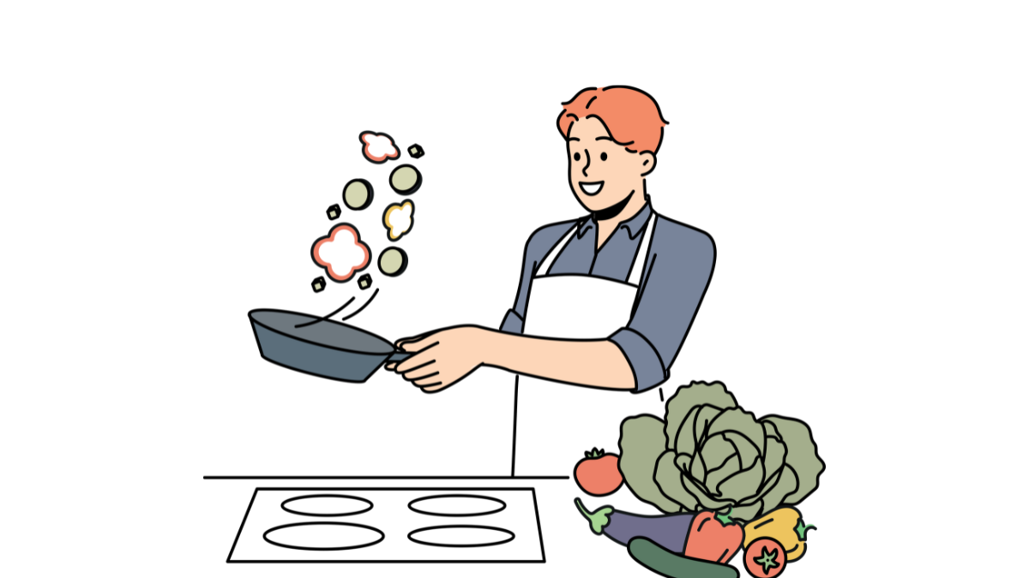
cooking
NEXT
SHOW

Slide 9
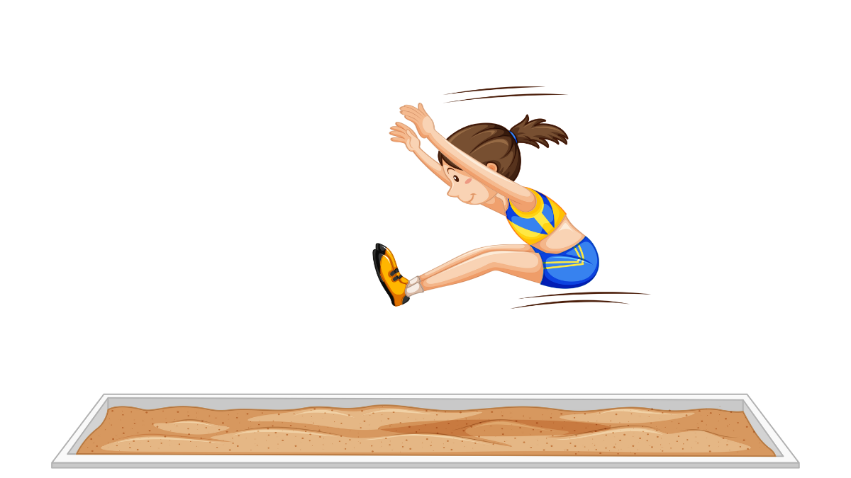
jumping
NEXT
SHOW

Slide 10

reading
NEXT
SHOW

Slide 11

sitting
NEXT
SHOW

Slide 12

listening
NEXT
SHOW

Slide 13
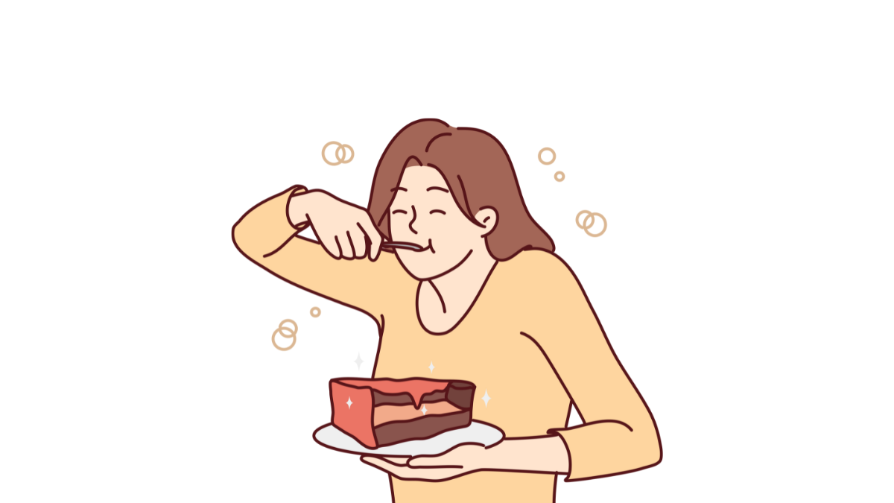
eating
NEXT
SHOW

Slide 14

talking
NEXT
SHOW

Slide 15
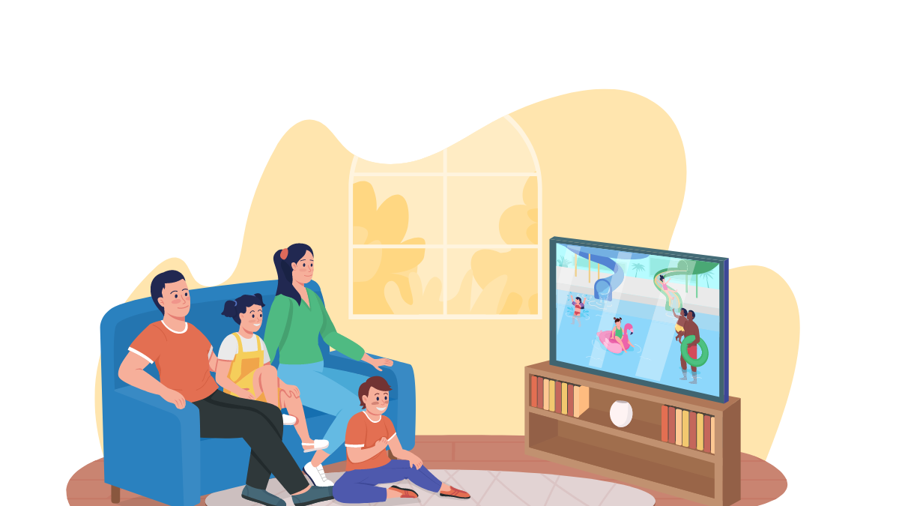
watching
SHOW

