Slide 1
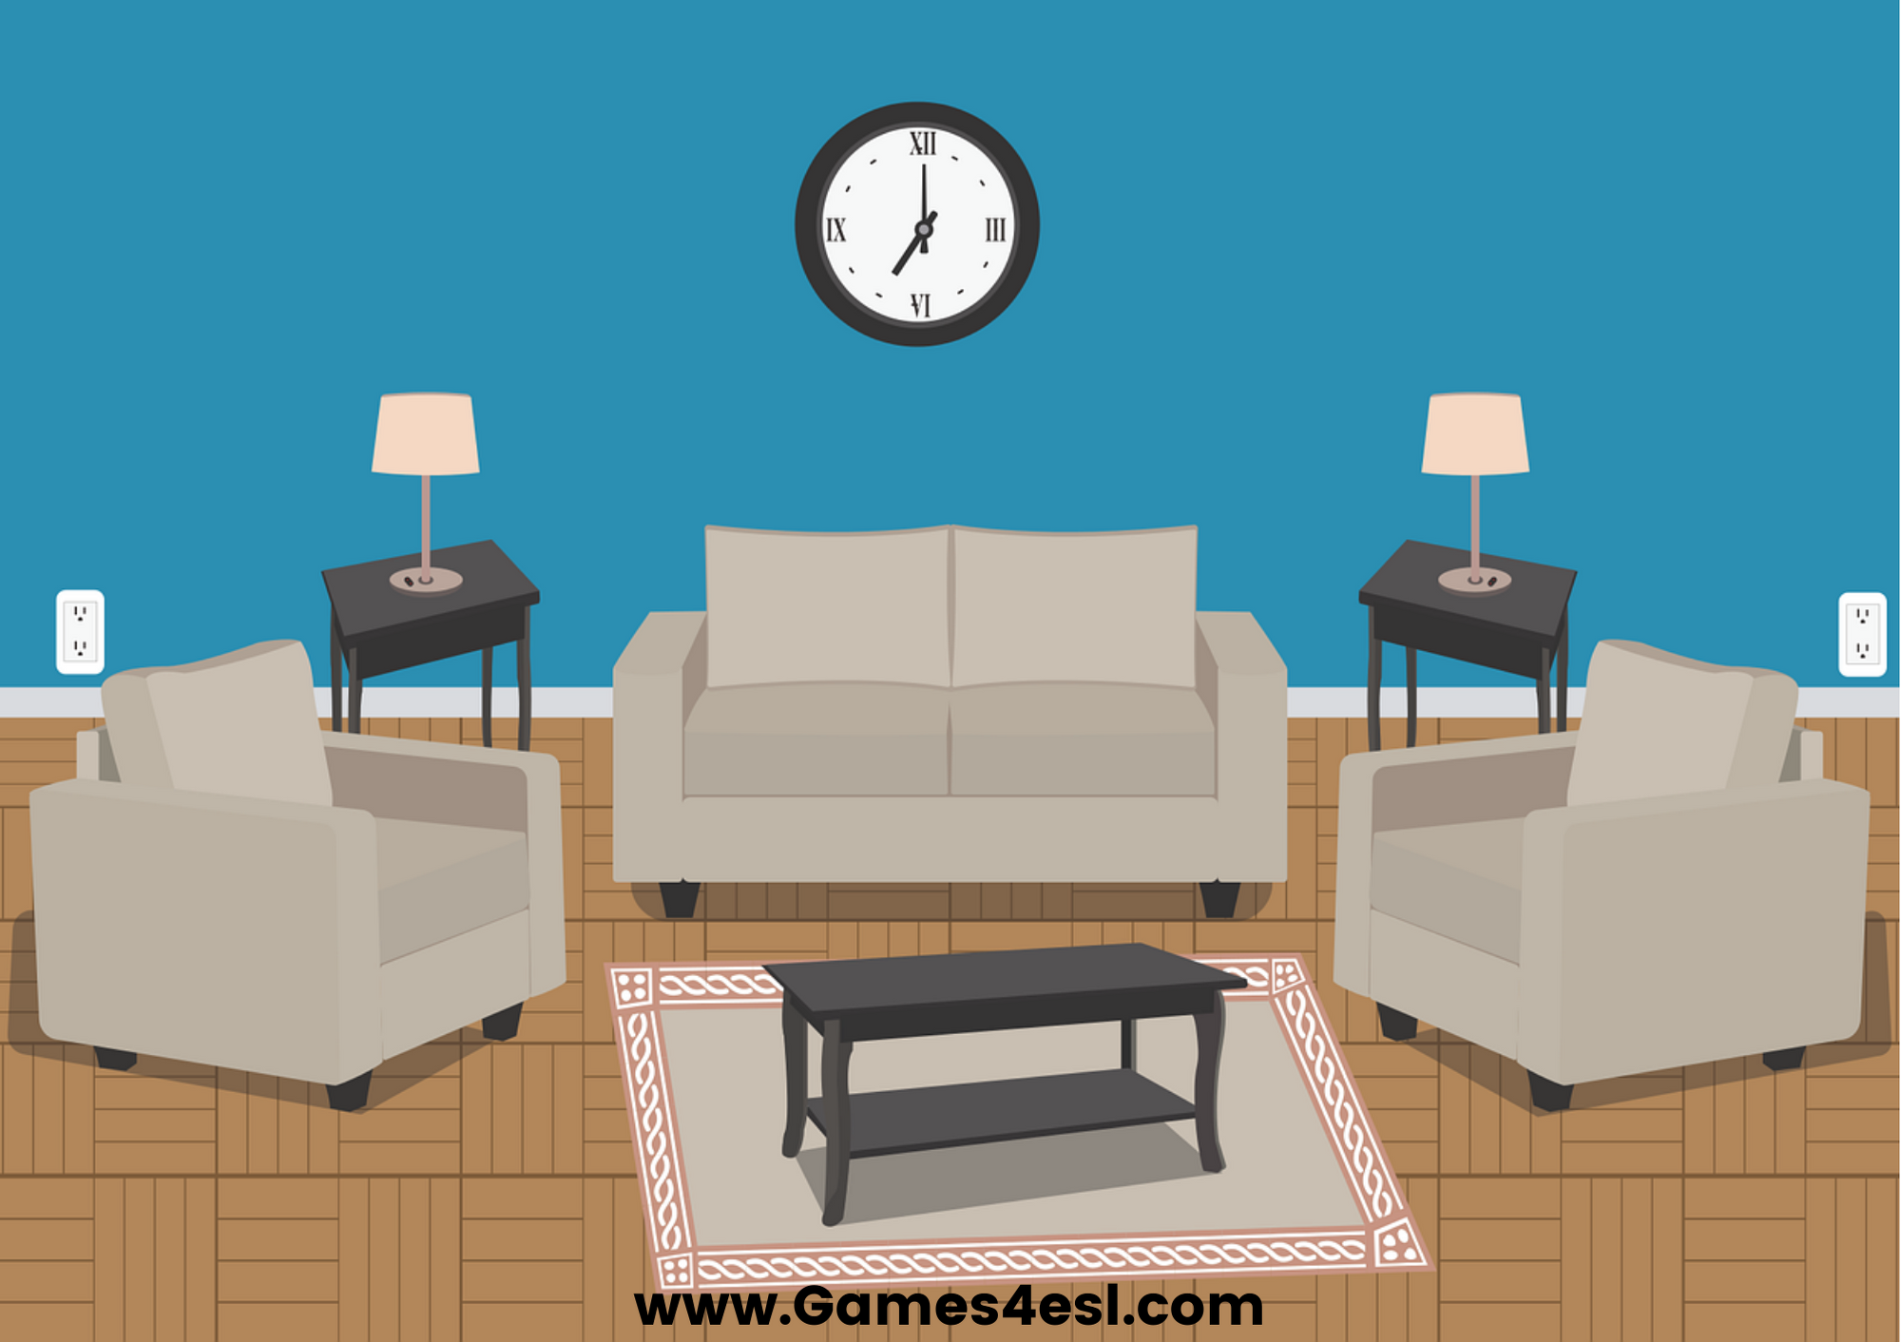
living room
SHOW

Slide 2
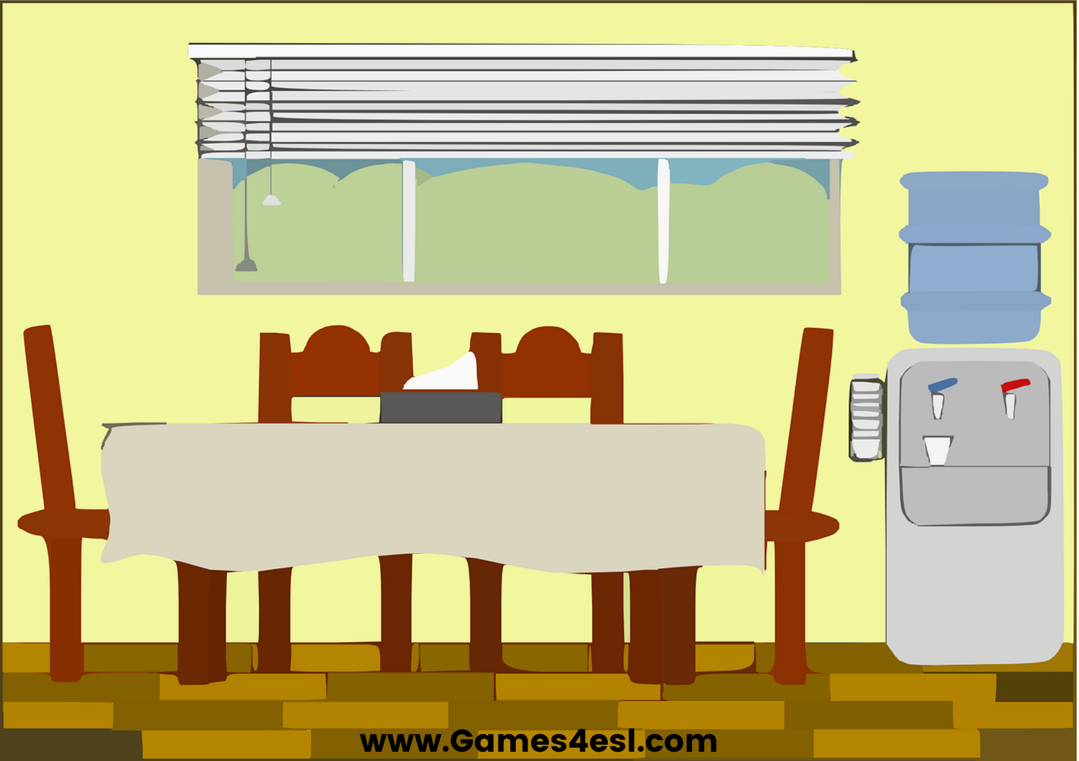
dining room
SHOW

Slide 3
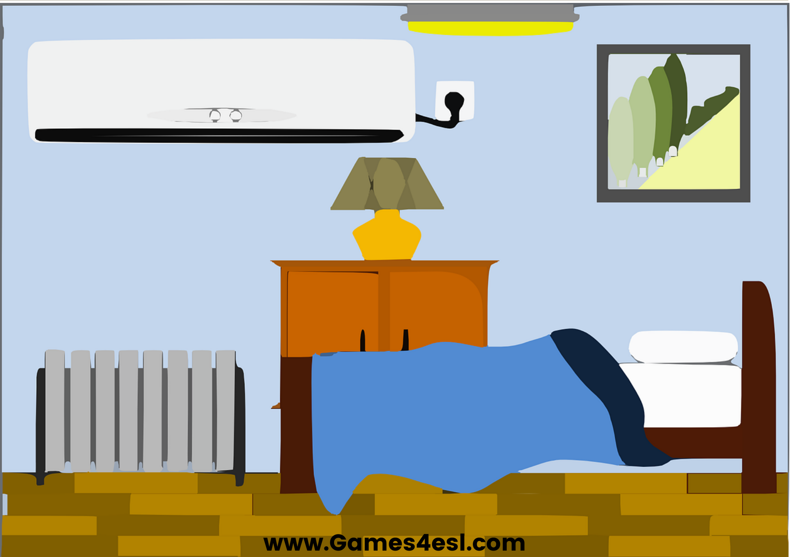
bedroom
SHOW

Slide 4
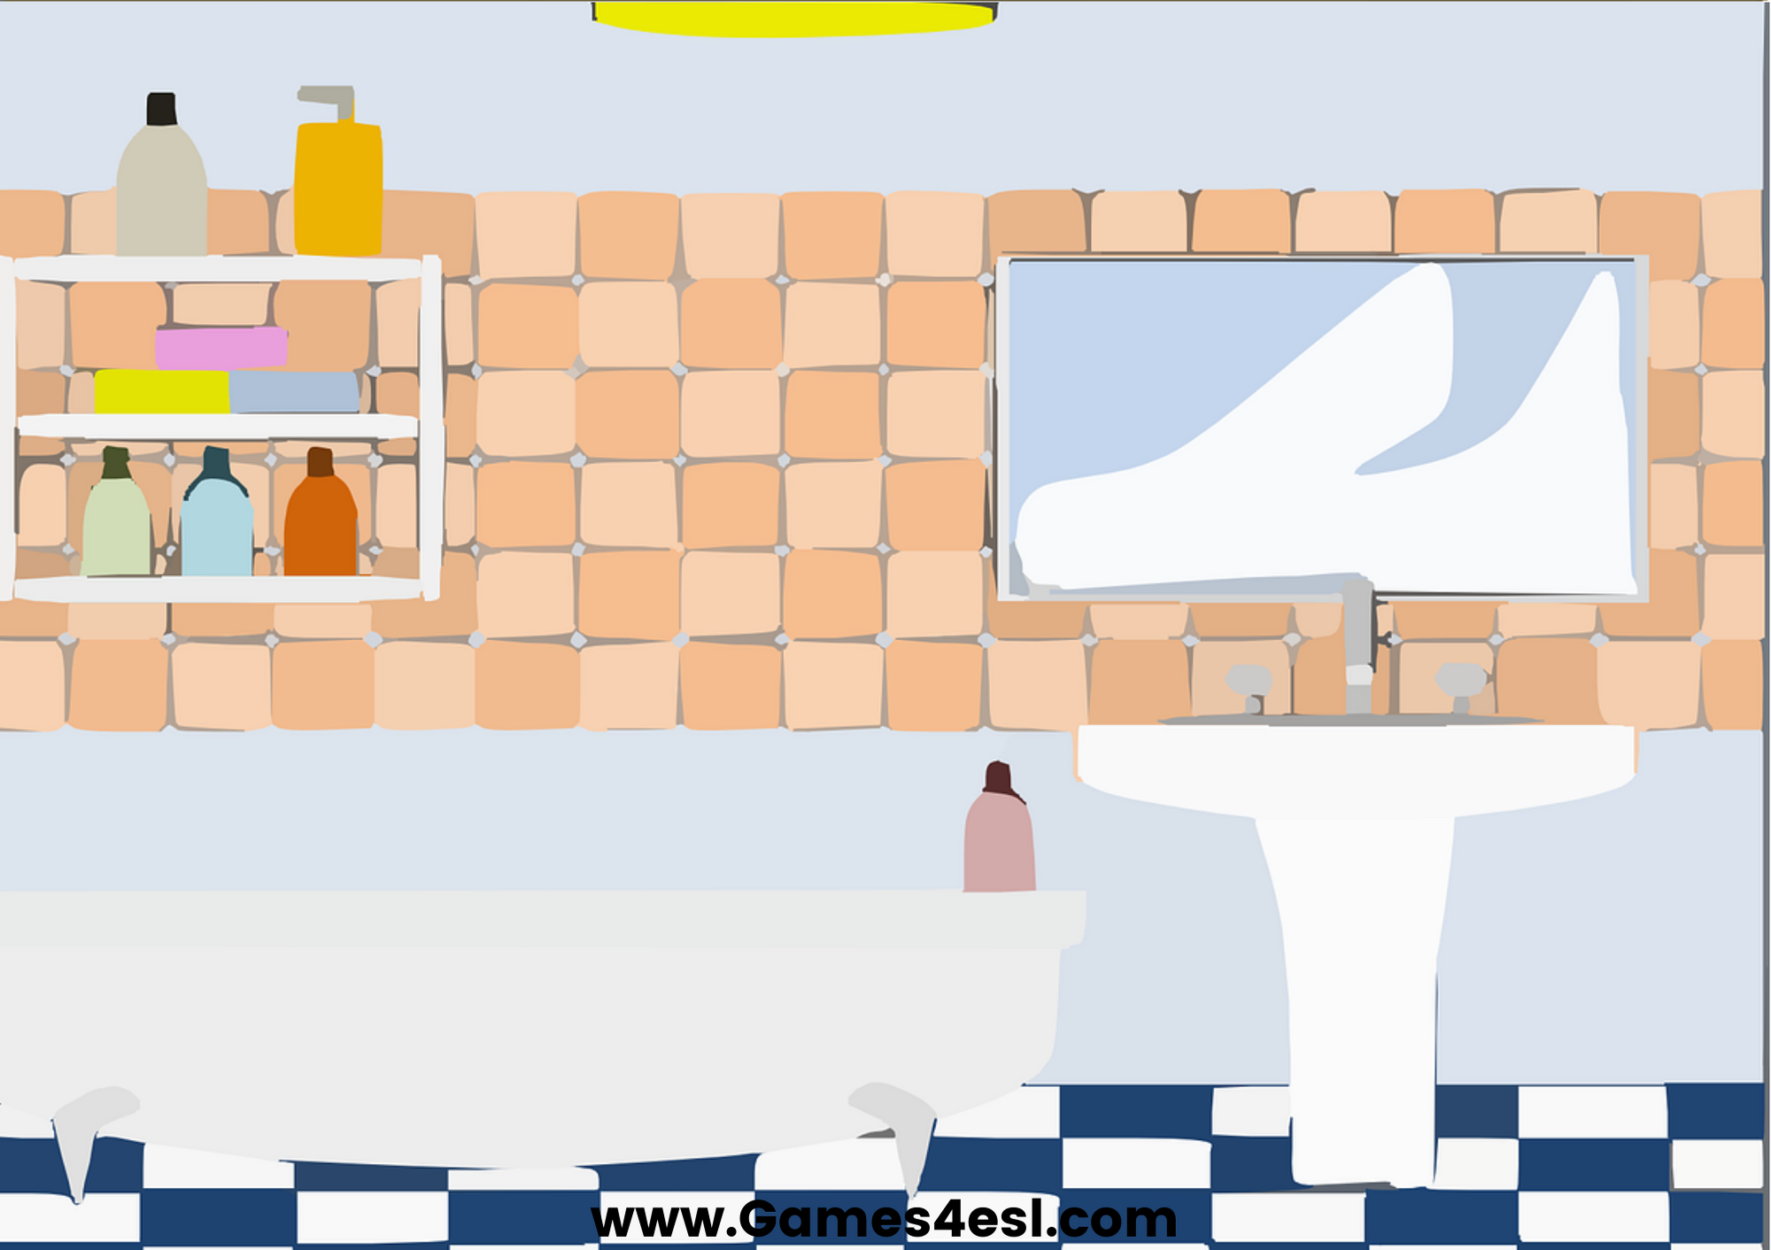
bathroom
SHOW

Slide 5
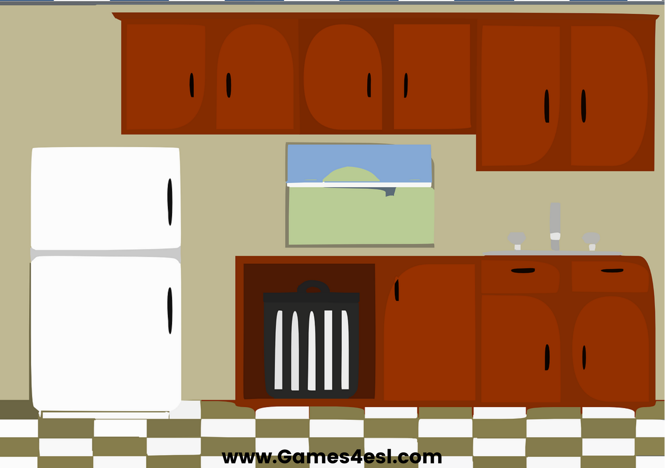
kitchen
SHOW

Slide 6
office
SHOW

Slide 7
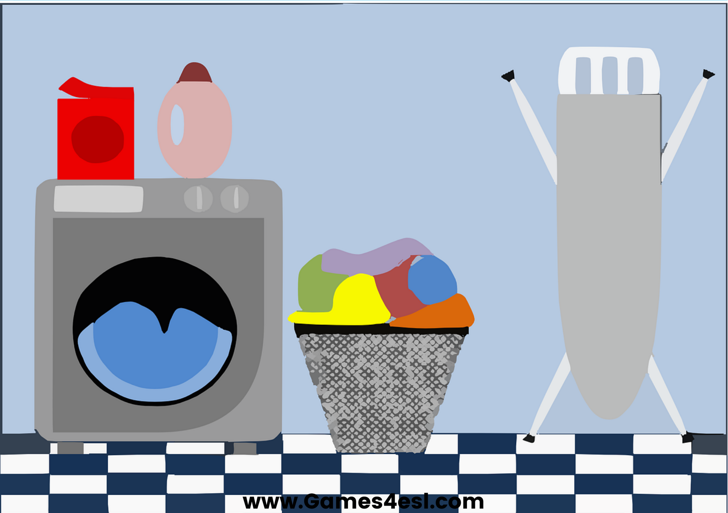
laundry room
SHOW

Slide 8
garden
SHOW

