Slide 1
math
NEXT
SHOW

Slide 2
English
NEXT
SHOW

Slide 3
art
NEXT
SHOW

Slide 4
science
NEXT
SHOW

Slide 5
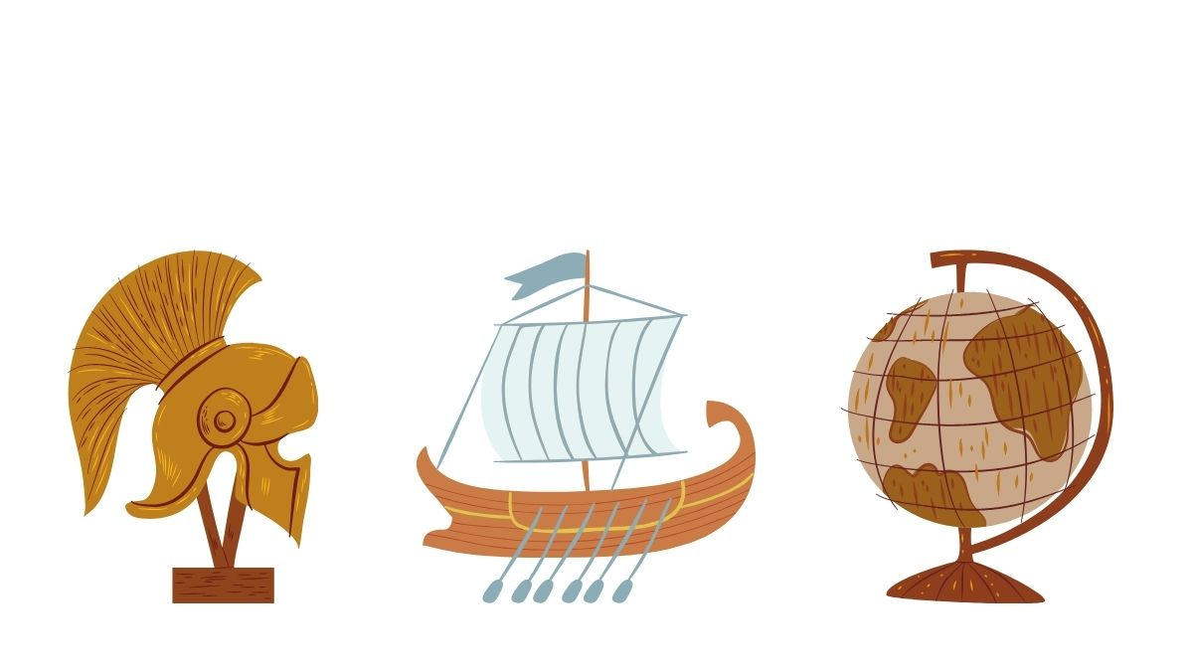
history
NEXT
SHOW

Slide 6
music
NEXT
SHOW

Slide 7
geography
NEXT
SHOW

Slide 8
P.E
NEXT
SHOW

Slide 9
Drama
NEXT
SHOW

Slide 10
biology
SHOW

