Slide 1
square
SHOW

Slide 2
triangle
SHOW

Slide 3
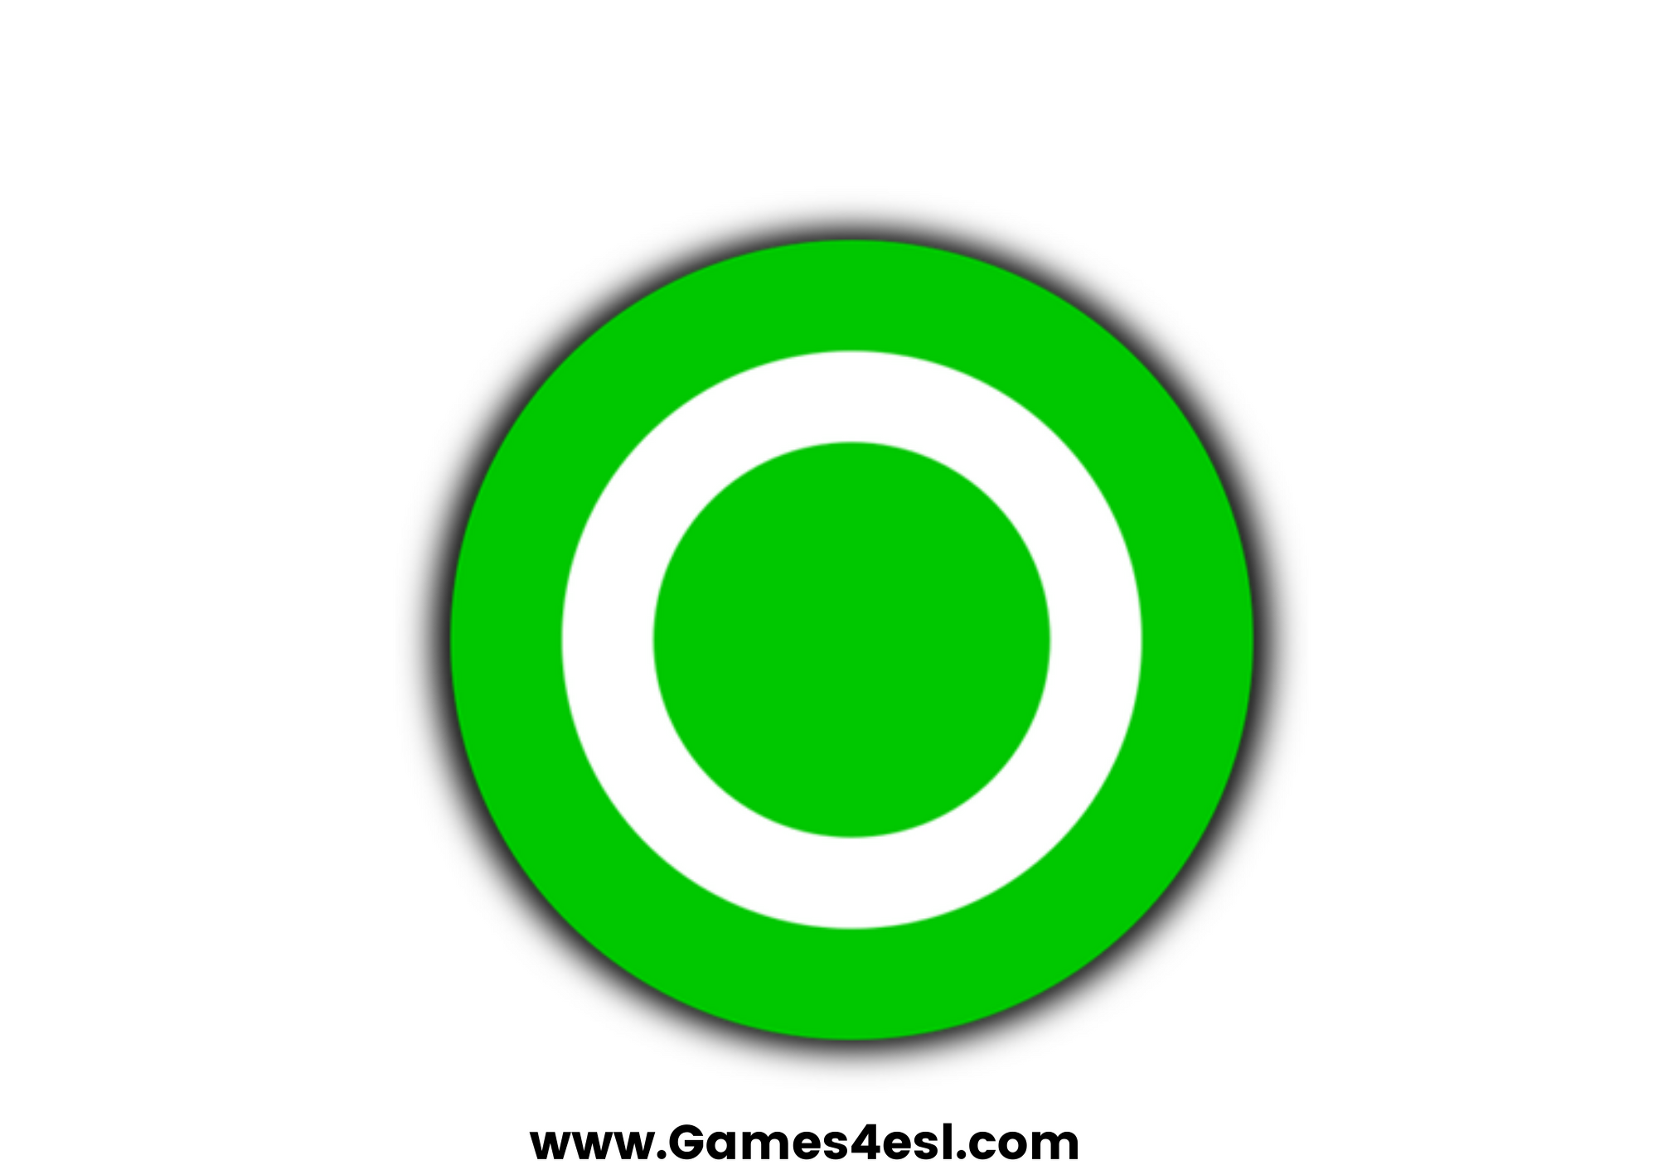
circle
SHOW

Slide 4
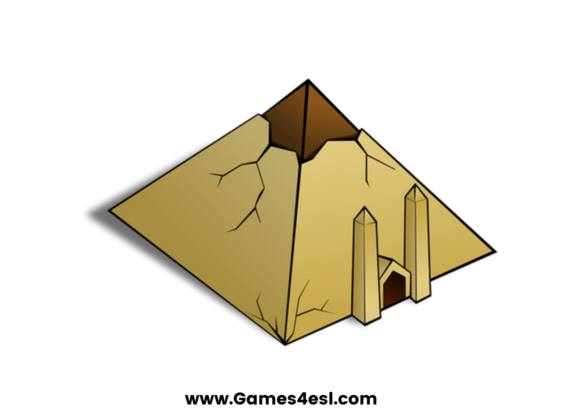
pyramid
SHOW

Slide 5
star
SHOW

Slide 6
diamond
SHOW

Slide 7
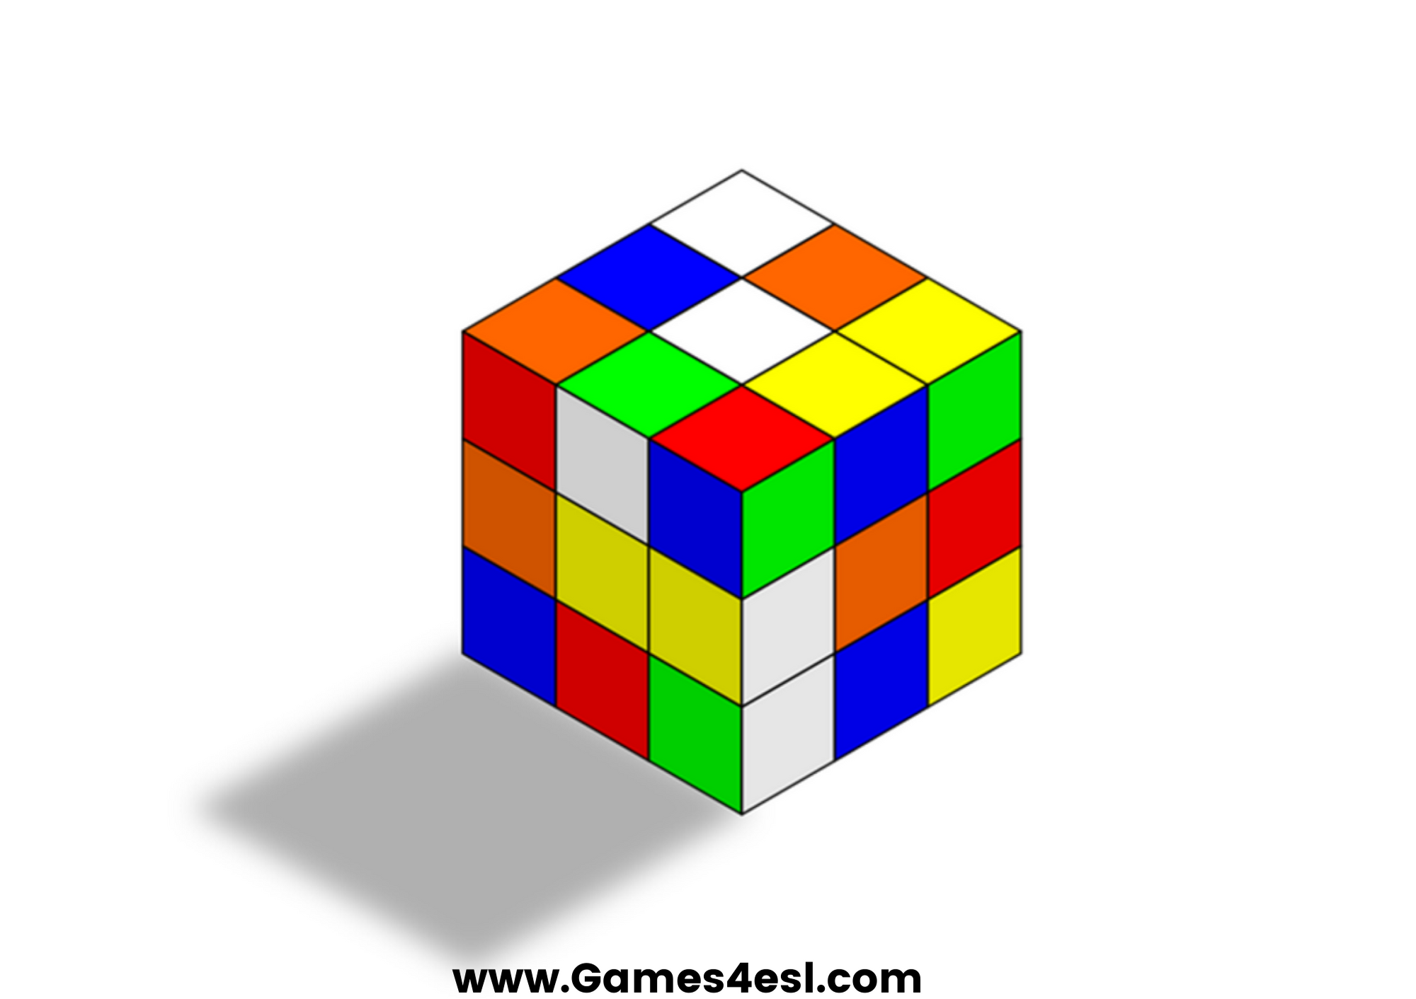
cube
SHOW

Slide 8
heart
SHOW

