Slide 1
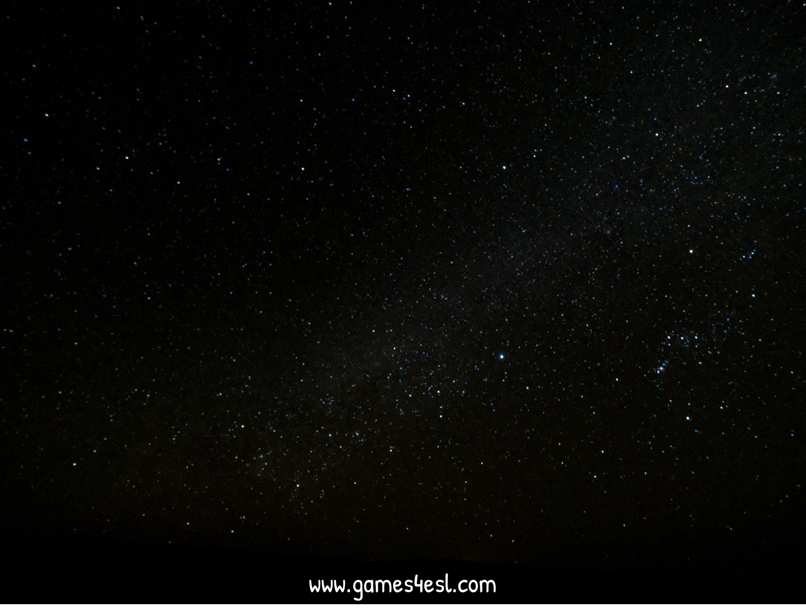
www.Games4esl.com
Ready to use ESL activities for busy English Teachers
www.YouTube.com/Games4esl
Visit us on YouTube to see our FREE, FUN, and ENGAGING, ESL Games and Activities.
Click Here:

Slide 2
SPACE RACE
How to Play:
-Make 2 teams
-One team is the ‘Rocket’ and one team is the ‘Alien Ship’
- The teams take turns in choosing a letter and then answering the question.
After answering the question, click on the Rocket / Alien Ship and it will move.
The first team to arrive at Mars is the winner.

Slide 3
SPACE RACE
Choose One:
Rocket Ship or Alien Ship?

Slide 4
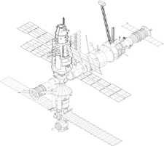
SPACE RACE
GO!
3
2
1
ROCKET SHIP WINS!
ALIEN SHIP
WINS!

Slide 5
SPACE RACE
1
2
3
4
5
6
7
8
9
10
11
12
13
14
15
16

Slide 6
I go there by…
car

Slide 7
I go there by…
car

Slide 8
I go there by…
car

Slide 9
I go there by…
bus

Slide 10
I go there by…
bus

Slide 11
I go there by…
bus

Slide 12
I go there by…
train

Slide 13
I go there by…
train

Slide 14
I go there by…
train

Slide 15
I go there by…
airplane

Slide 16
I go there by…
airplane

Slide 17
I go there by…
airplane

Slide 18
I go there by…
bike

Slide 19
I go there by…
bike

Slide 20
I go there by…
bike

Slide 21
I go there by…
ship

Slide 22
I go there by…
ship

