Slide 21
sunny
SHOW

Slide 22
rainy
SHOW

Slide 23
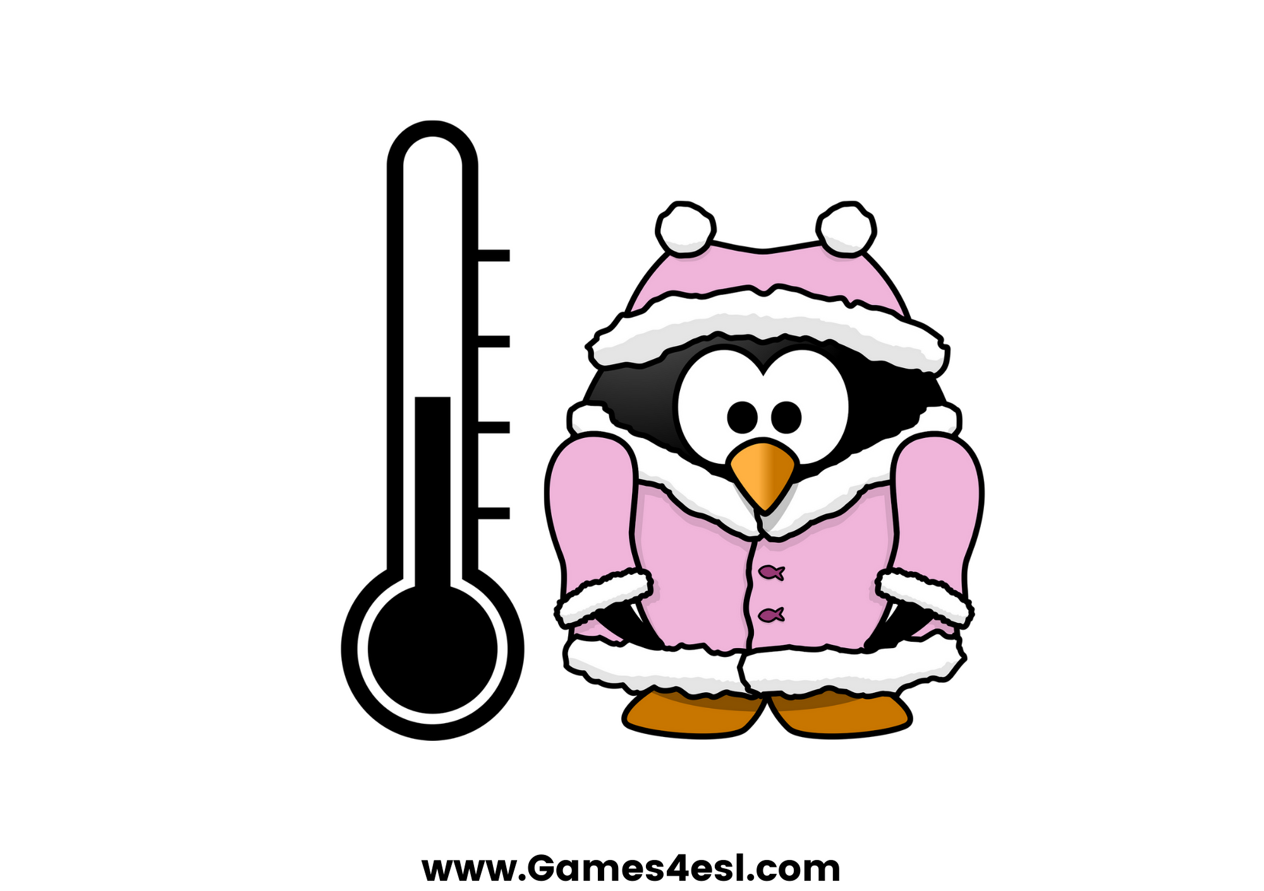
cold
SHOW

Slide 24
hot
SHOW

Slide 25
windy
SHOW

Slide 26
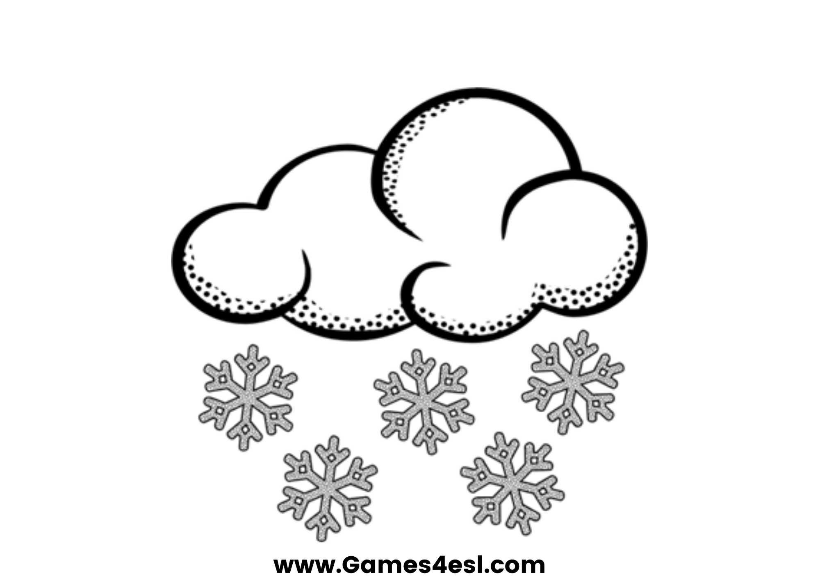
snowy
SHOW

Slide 27
cloudy
SHOW

Slide 28
stormy
SHOW

