Slide 1
Zero Conditional
Sentences
www.Games4esl.com

Slide 2
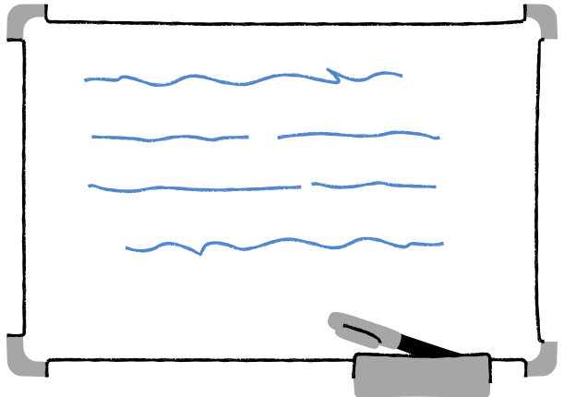
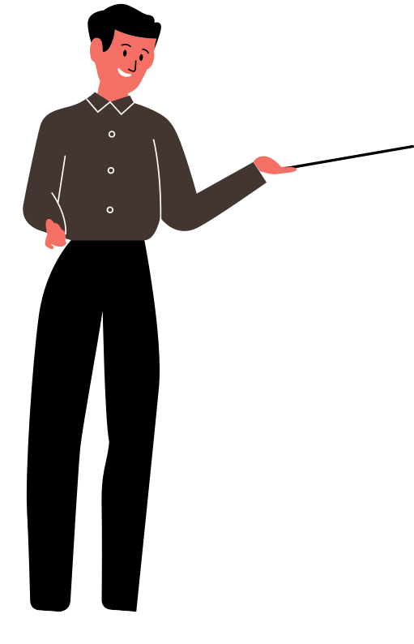
In This Lesson:
What is the zero conditional?
How to form zero conditional sentences.
Zero conditional example sentences
Review Quiz
www.Games4esl.com

Slide 3
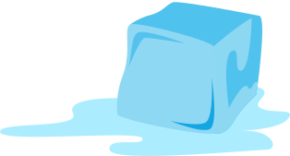
What Is The Zero Conditional?
Zero conditional sentences are used to talk about facts or general truths that are always true, like scientific facts.
Example:
"If you heat ice, it melts"
www.Games4esl.com

Slide 4
2. How To Form Zero Conditional Sentences
Zero conditional sentences are made up of an 'if clause' and a 'main clause'. Both of which include verbs in the present simple tense.
Example:
"If you heat ice, it melts"
www.Games4esl.com

Slide 5
2. How To Form Zero Conditional Sentences
Zero conditional sentences can also be made with 'when' instead of 'if'.
www.Games4esl.com

Slide 6
2. How To Form Zero Conditional Sentences
Zero conditional sentences can also be made with 'when' instead of 'if'.
Example:
"When you heat ice, it melts"
www.Games4esl.com

Slide 7
3. Example Sentences
If you heat water to 100 degrees, it boils.
www.Games4esl.com

Slide 8
3. Example Sentences
If I am late for class, my teacher gets angry.
www.Games4esl.com

Slide 9
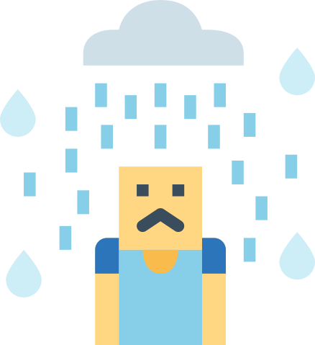
3. Example Sentences
If it rains and I don't have an umbrella, I get wet.
www.Games4esl.com

Slide 10
3. Example Sentences
If people eat too much, they get fat.
www.Games4esl.com

Slide 11
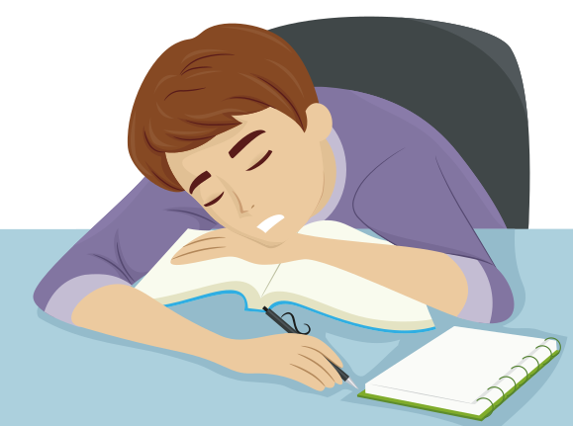
3. Example Sentences
If I study too much, I get really tired.
www.Games4esl.com

Slide 12
Review Quiz
Choose the correct answer to make a zero conditional sentence
www.Games4esl.com

Slide 13
1
If people eat lots of candy,
A
they gain weight.
B
they gained weight.
C
they are gaining weight.
www.Games4esl.com

Slide 14
1
If people eat lots of candy,
A
they gain weight.
B
they gained weight.
C
they are gaining weight.
www.Games4esl.com

Slide 15
2
If I wake up late,
A
I was late for work.
B
I lates for work.
C
I am late for work.
www.Games4esl.com

Slide 16
2
If I wake up late,
A
I was late for work.
B
I lates for work.
C
I am late for work.
www.Games4esl.com

Slide 17
3
When it's cold,
A
I wore a jacket.
B
I always wear a jacket.
C
If I wear a jacket.
www.Games4esl.com

Slide 18
3
When it's cold,
A
I wore a jacket.
B
I always wear a jacket.
C
If I wear a jacket.
www.Games4esl.com

Slide 19
4
If I don't have much money,
A
I don't eat out.
B
I didn't eat out.
C
I am eating out.
www.Games4esl.com

Slide 20
4
If I don't have much money,
A
I don't eat out.
B
I didn't eat out.
C
I am eating out.
www.Games4esl.com

Slide 21
5
When you put water in the freezer,
A
it will be frozen.
B
it freezes.
C
it has frozen.
www.Games4esl.com

Slide 22
5
When you put water in the freezer,
A
it will be frozen.
B
it freezes.
C
it has frozen.
www.Games4esl.com

Slide 23
GOOD JOB!
www.Games4esl.com

